Slide 1
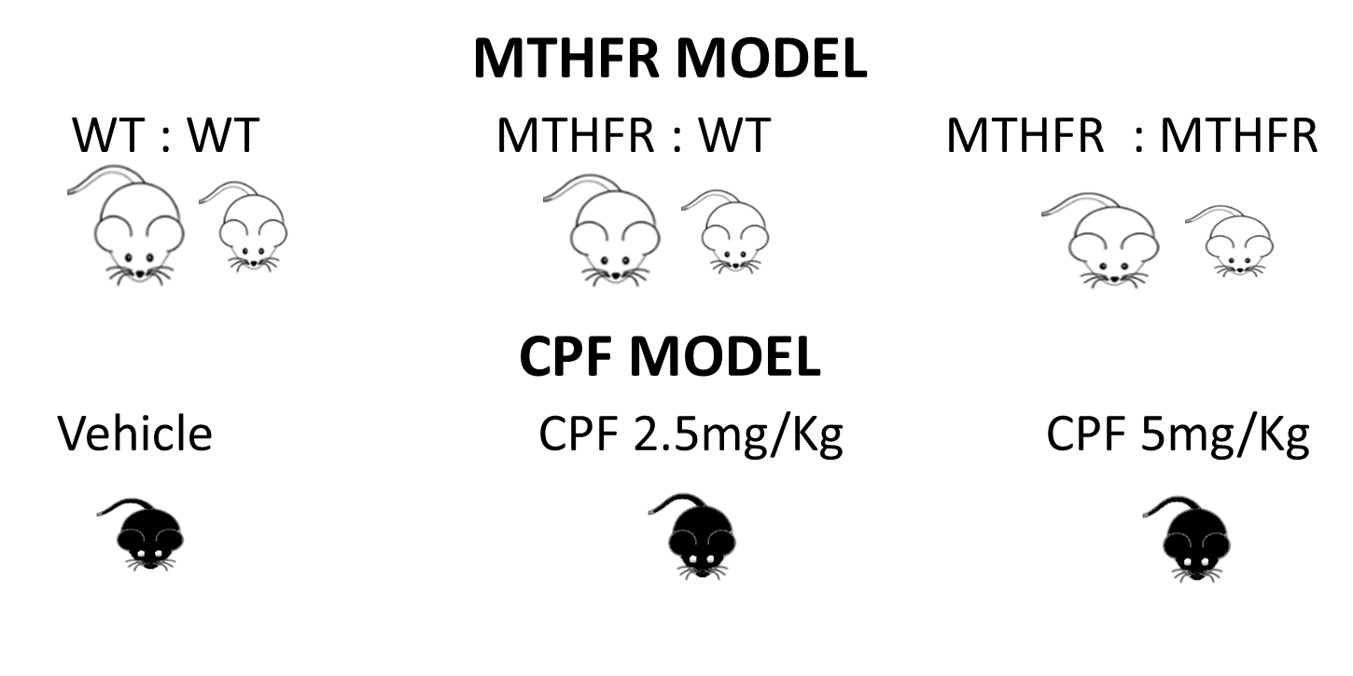
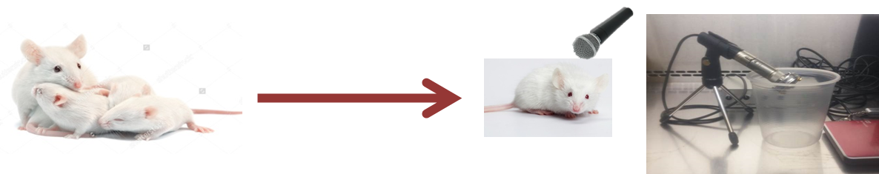
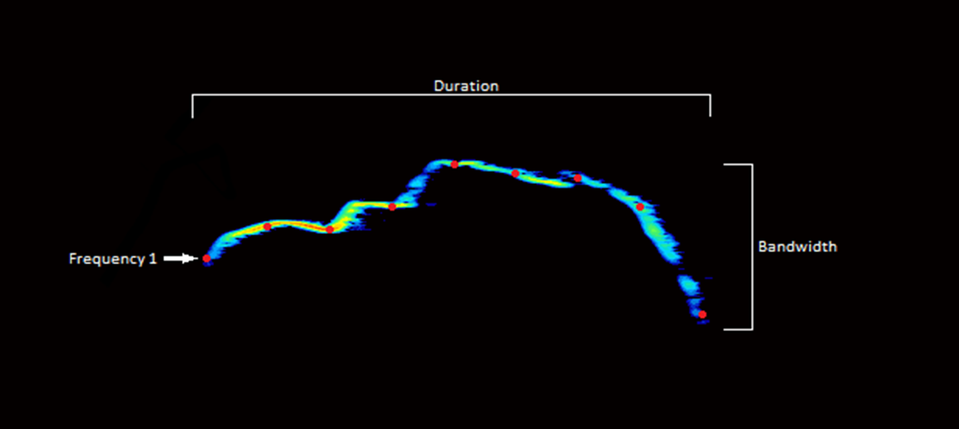
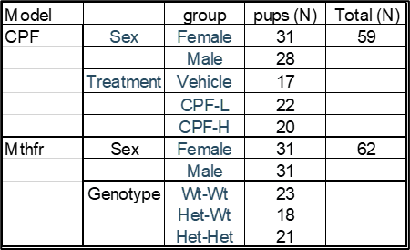
Supplementary materials
Supplementary Figure 1
A. Study design
CPF model mice: CPF to dams at gestation day 12 to 15.
B. USV recording
Postnatal day 8
10 min
Examples of recorded sonograms of USV syllables. Red dots are the data points detected by Avisoft SASLab Pro ver5.2.11. The time and mean frequency at these points was used for syllable analysis.
C. Experimental groups
Supplementary Figure 1:
A. Study design, B. Recording scheme and an example of USV sonogram , C. Experimental groups, number of pups recorded.

Slide 2
Supplementary Figure 2: Strain and sex affect the distribution of basic variables of isolation induced syllables. C57/B6 (blue) treated with vehicle and Balb/C Wt:Wt (orange), female (left) and male (right) pups are compared for the distribution of the following variables: A. Start frequency, B. End frequency, C. Mean frequency, D. Bandwidth E. Duration.

Slide 3
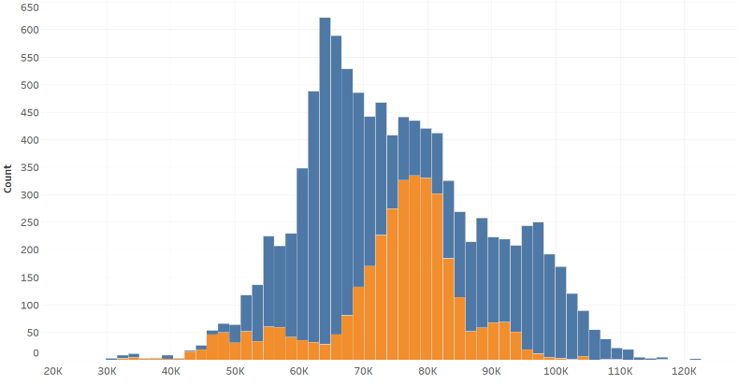
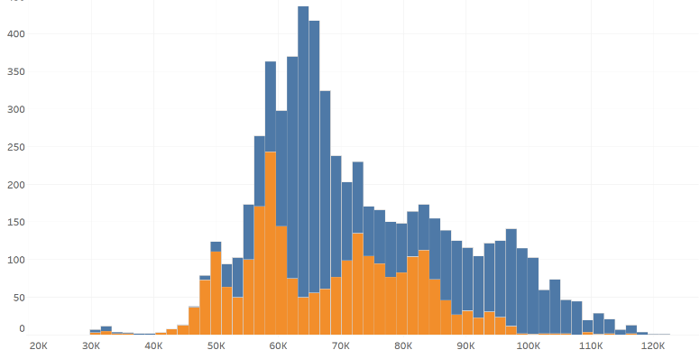
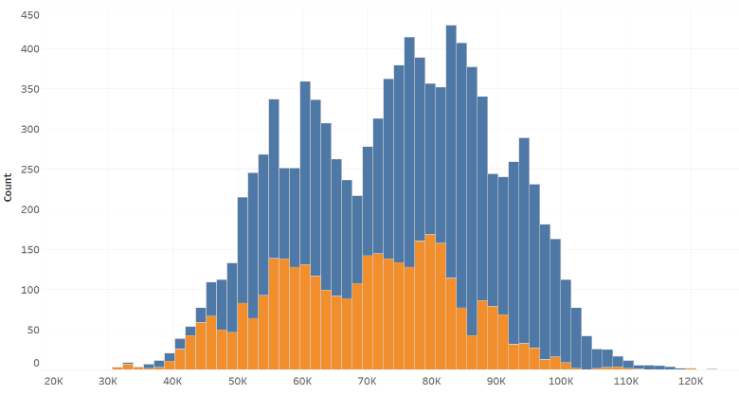
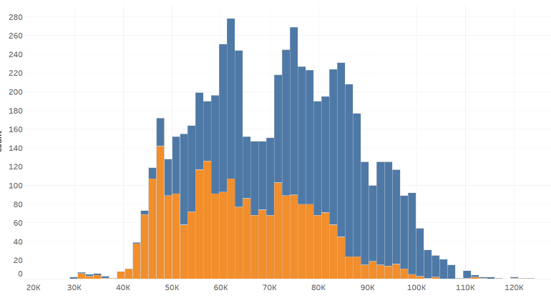
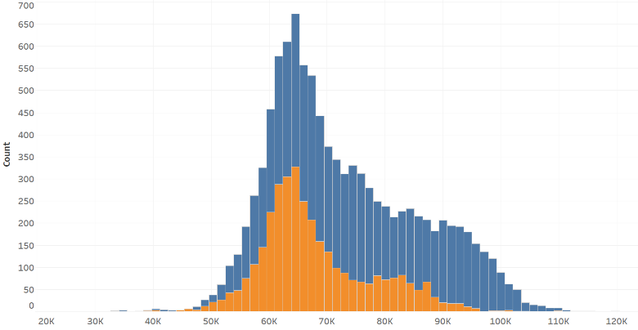
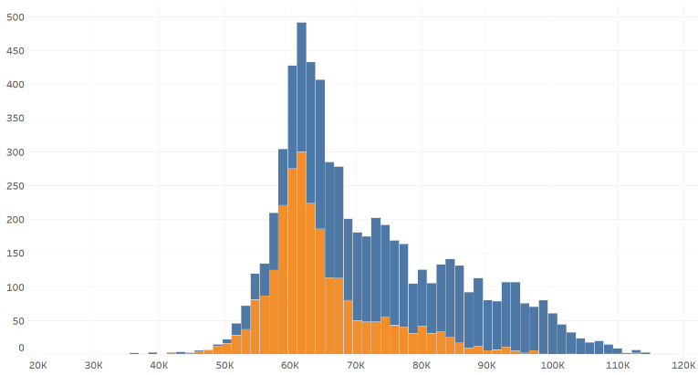
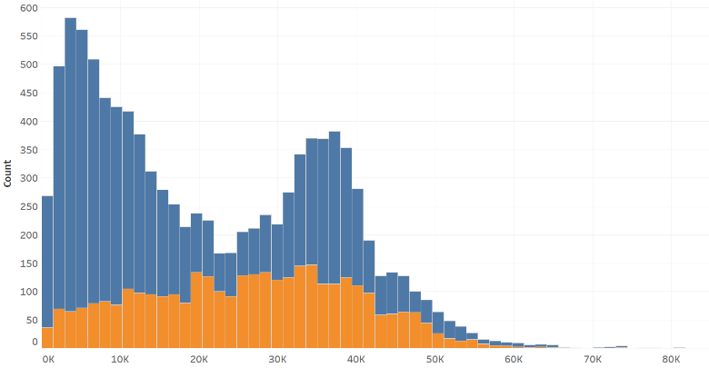
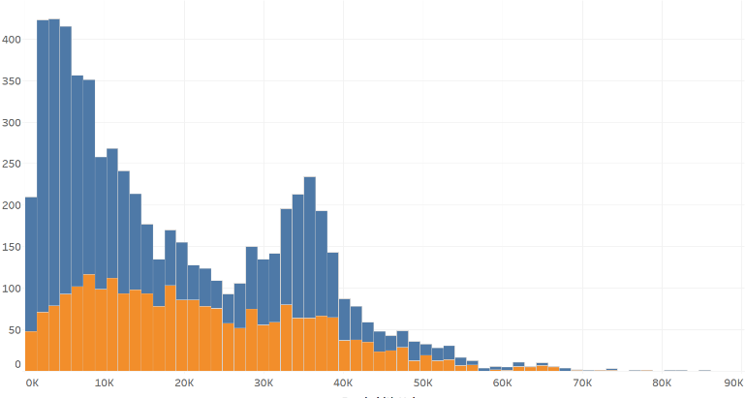
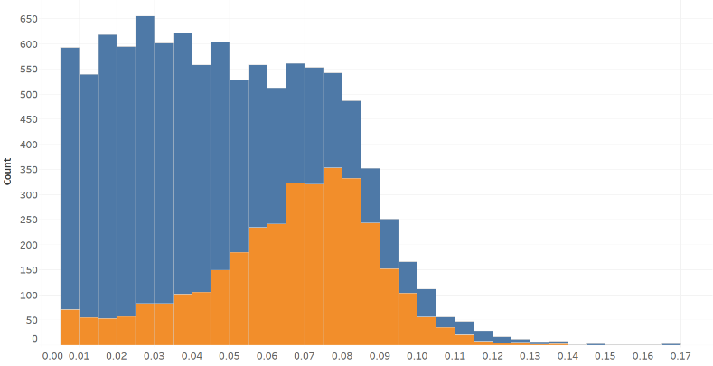
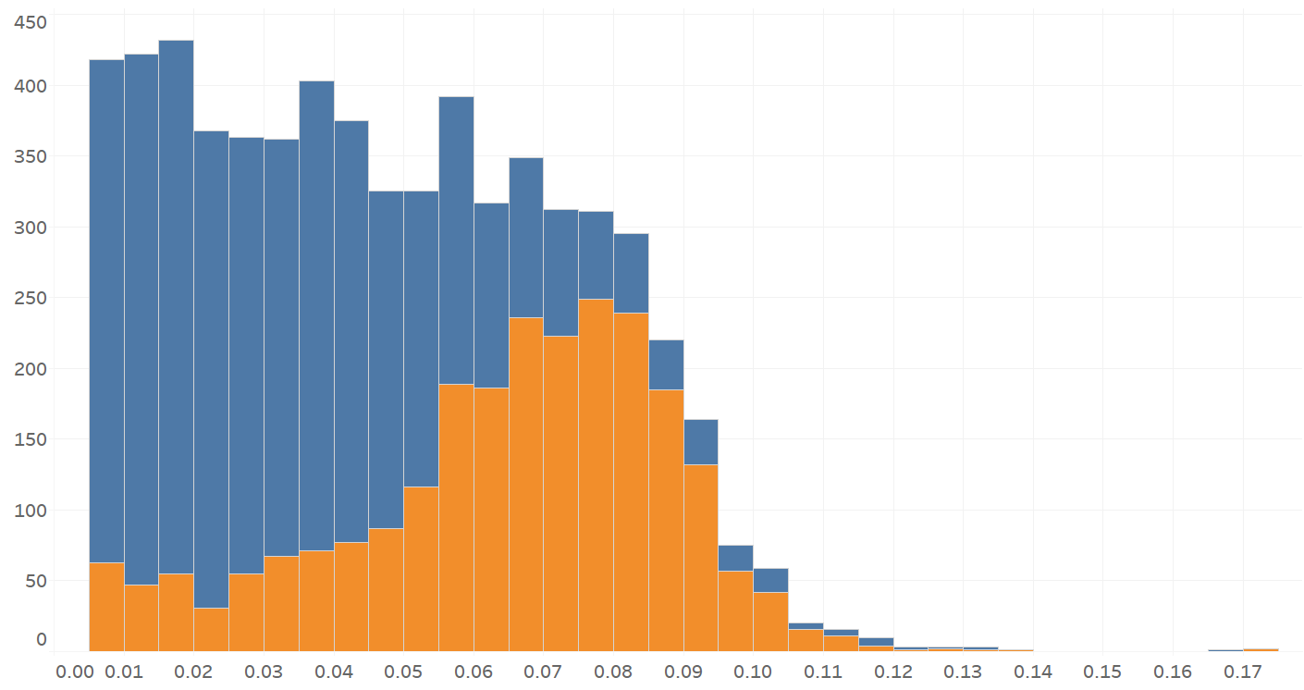
A
Female
Supplementary Figure 2
Male
Start Frequency
B6
Balb/c
Number of Syllables
B
End Frequency
Hz
Syllables
C
Mean Frequency
Hz
Syllables
D
Bandwidth
Hz
Syllables
E
Duration
Hz
Syllables
Sec
Notes:
X axis write that the numbers are in k (1000) and each bin equal 2000kHz
Add start end and some in the middle numbers in normal size.
Remove background horizontal lines – ask itay to do it and also Y axis also font use larger numbers

Slide 4
Supplementary Table 1. Basic properties of isolation induced syllables in the two tested strains
Supplementary Table1. Basic properties of isolation induced syllables in the two tested strains. Mean and median values of syllable spectral and temporal properties are presented for C57/B6 treated with vehicle and Balb/c Wt:Wt , female and male. Bold digits indicate a significant difference between male and female of the same strain at P<0.01, * indicates significant difference between same sex mice of the different strains at P<0.01. Mean frequency – MF, bandwidth - BW.
Notes:
StrainUnclusteredAnalysis.xlsx
N- write all below the table. Sig. replace a by **, k or K replace for k in all.
F1 and F9 – replace all with start and end.

Slide 5
Supplementary Table 2A – CPF model
Supplementary Table 2B – Mthfr model.
Supplementary Table 2. Median values of spectral and temporal properties of isolation induced syllables clusters for the CPF model (A) and Mthfr model, color-coded to ease visualization: red- high, green – low. (B). Results of Komogorov-Smirnov test for the effect of sex are shown in the lower part of the tables. Bold values indicate significant effects at p<0.05. Mean frequency – MF, bandwidth- BW.
Notes:
File B6PerSexDiscriptive
And
BalbcPerSexDiscriptive

