Slide 1
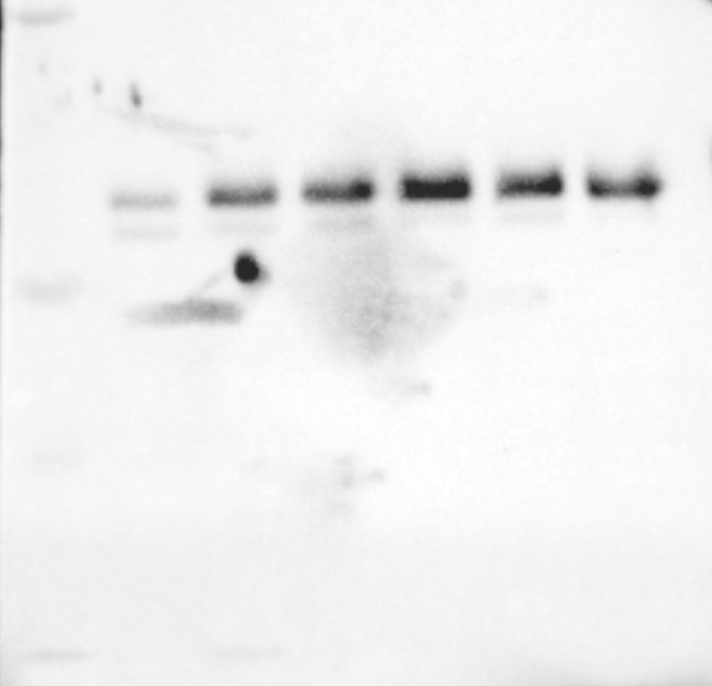
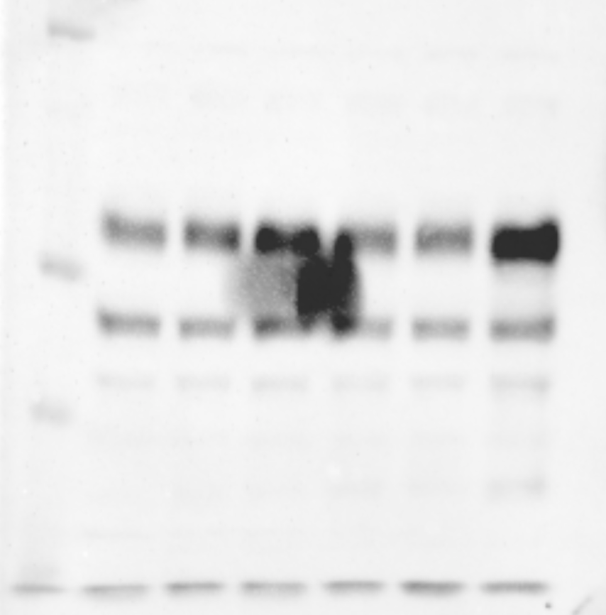
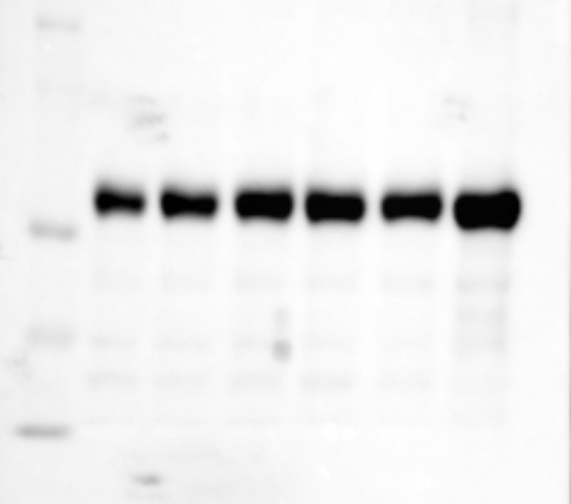
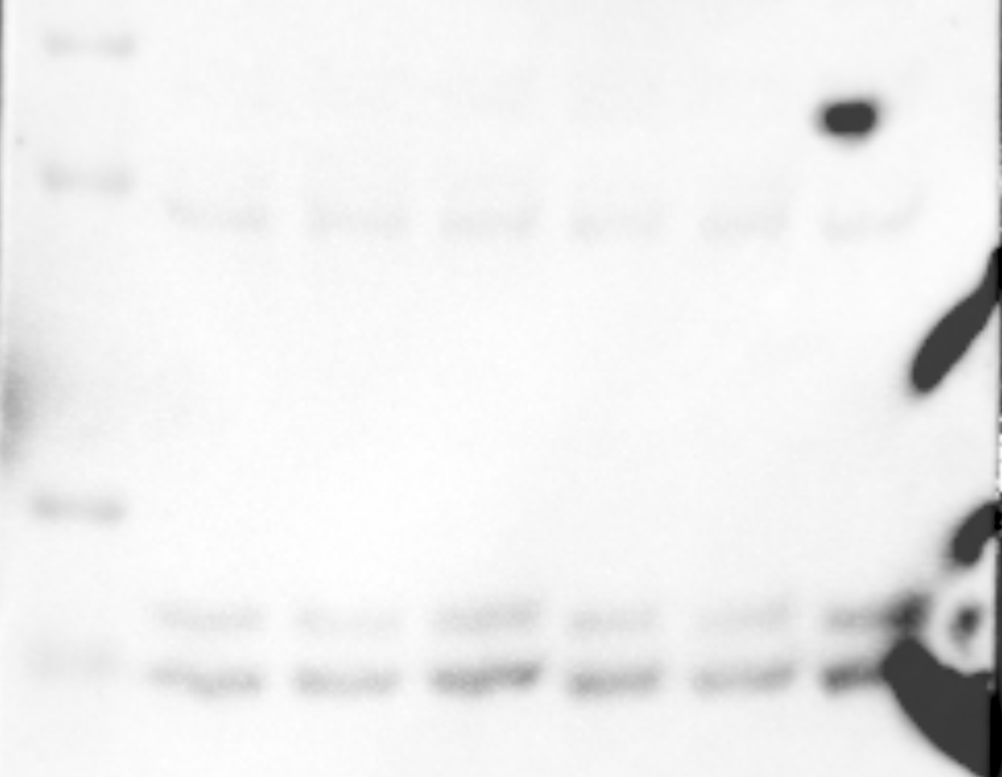
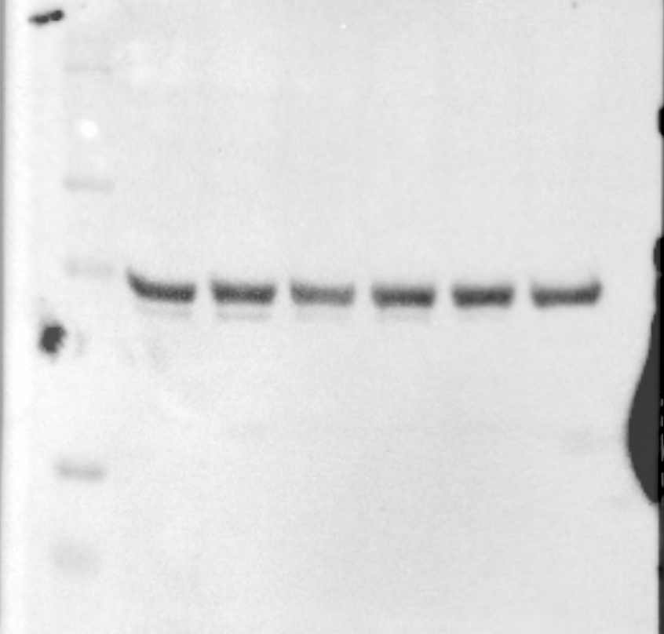
Supplementary Figure 1 - Western Blots (uncropped raw files)
A.
Figure 3A. (24h)
PM(μg/cm²)
AICAR (100 μM)
PM(μg/cm²)
AICAR (100 μM)
PM(μg/cm²)
AICAR (100 μM)
PM(μg/cm²)
AICAR (100 μM)
PM(μg/cm²)
AICAR (100 μM)
MW (kDa)
CON
25
50
100
50
100
MW (kDa)
CON
MW (kDa)
MW (kDa)
CON
25
50
100
50
100
MW (kDa)
25
50
100
50
100
25
50
100
50
100
CON
CON
25
50
100
100
50
100
100
100
100
75
75
100
75
75
75
50
50
50
50
37
15
37
37
37
10
20
15
20
20
10
P-AMPK Thr 172
(62kDa)
Sestrin2
(54kDa)
P62
(62kDa)
LC3
(16kDa)
GAPDH
(37kDa)
35
20

Slide 2
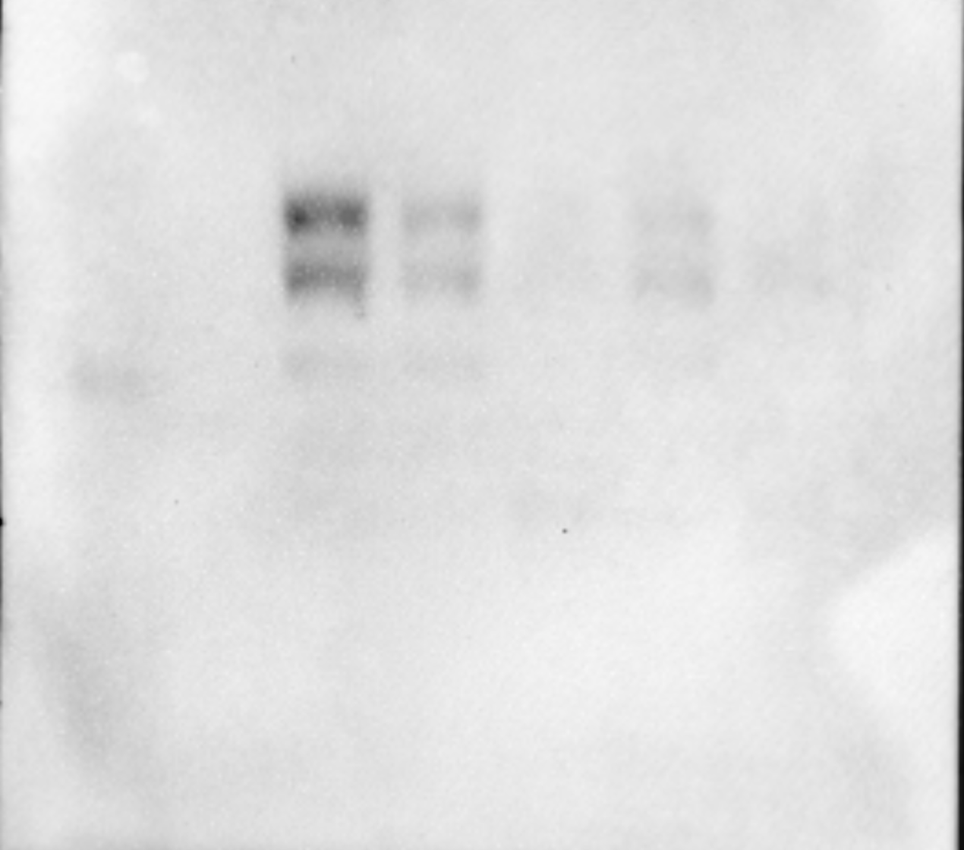
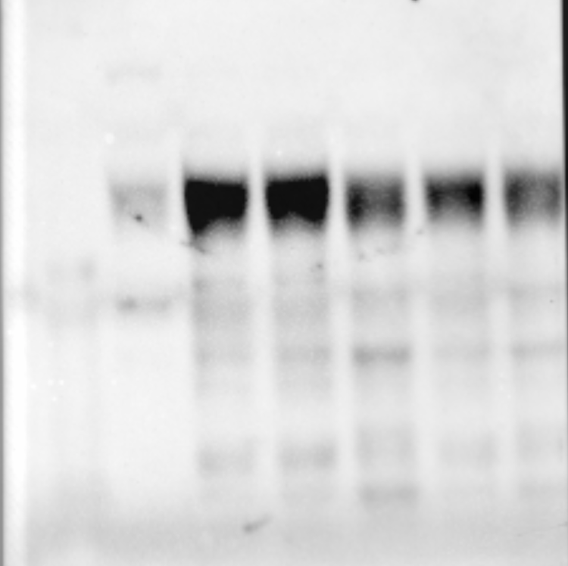
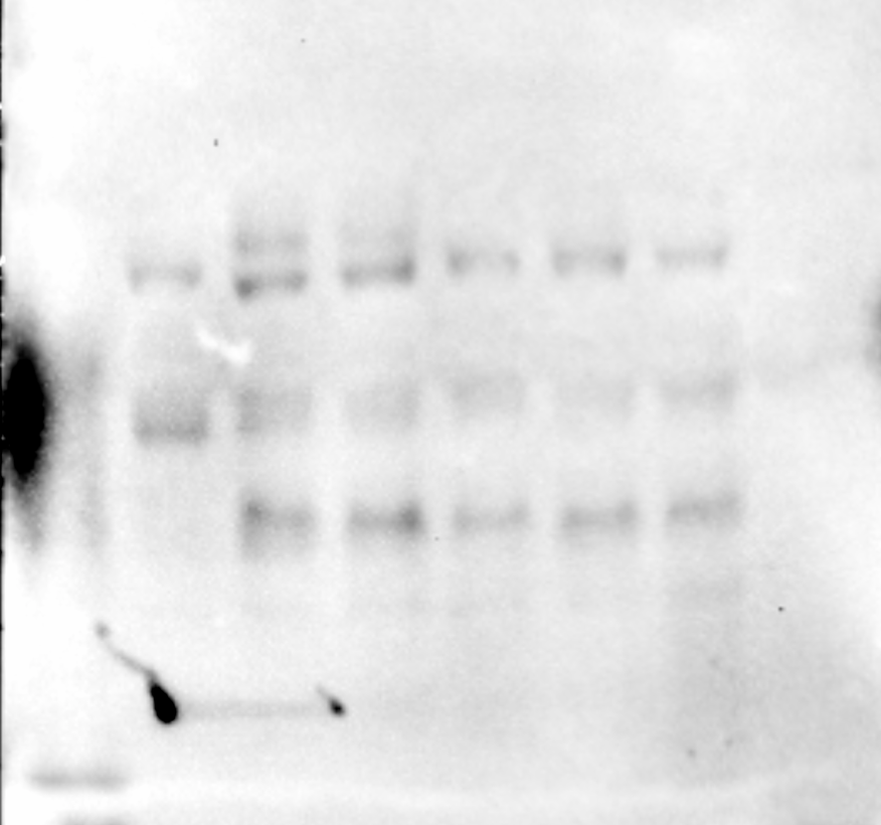
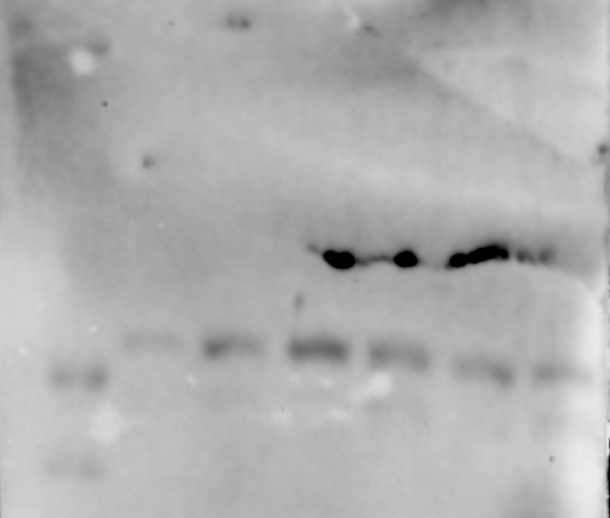
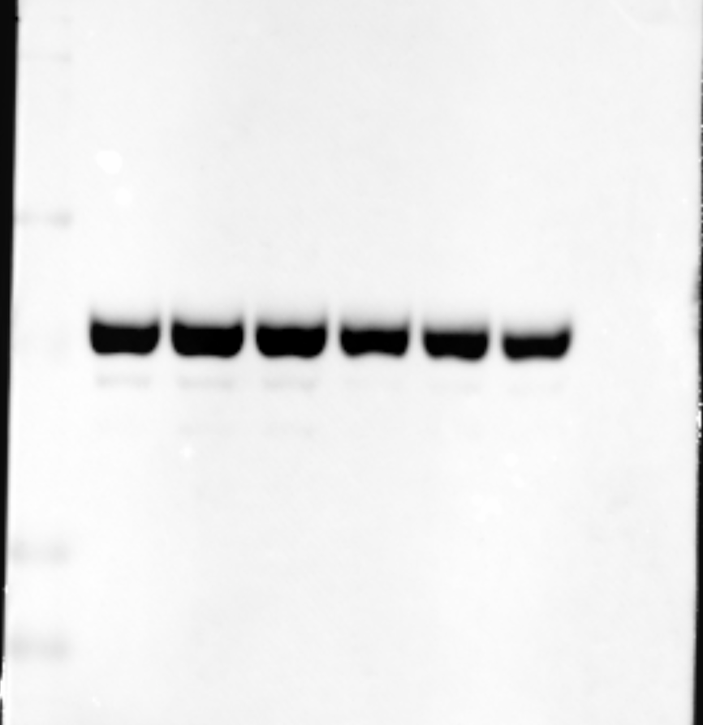
Supplementary Figure 1 - Western Blots (uncropped raw files)
A.
Figure 3B. (48h)
PM(μg/cm²)
AICAR (100 μM)
PM(μg/cm²)
AICAR (100 μM)
PM(μg/cm²)
AICAR (100 μM)
PM(μg/cm²)
AICAR (100 μM)
PM(μg/cm²)
AICAR (100 μM)
MW (kDa)
CON
25
50
100
50
100
MW (kDa)
CON
25
50
100
50
100
MW (kDa)
CON
25
50
100
50
100
MW (kDa)
CON
25
50
100
50
100
MW (kDa)
CON
25
50
100
50
100
100
100
100
100
100
75
75
75
75
75
50
50
50
50
15
37
37
37
37
10
15
P-AMPK Thr 172
(62kDa)
Sestrin2
(54kDa)
P62
(62kDa)
LC3
(16kDa)
GAPDH
(37kDa)

Slide 3
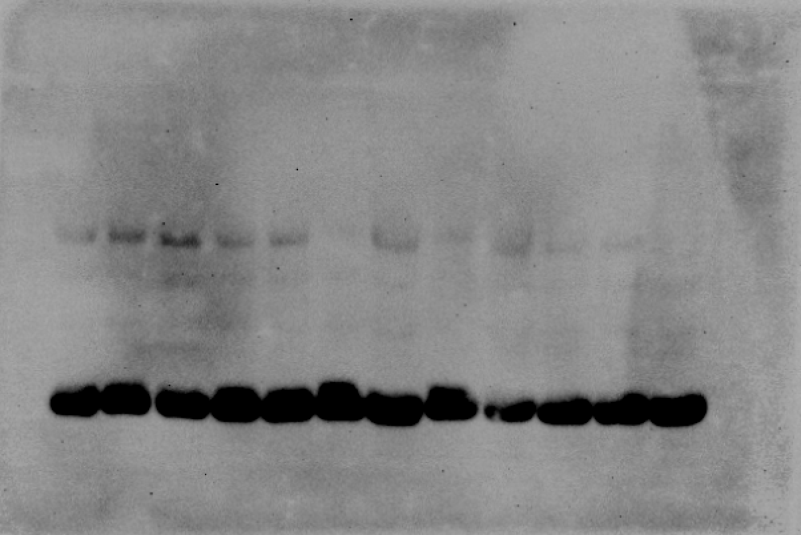
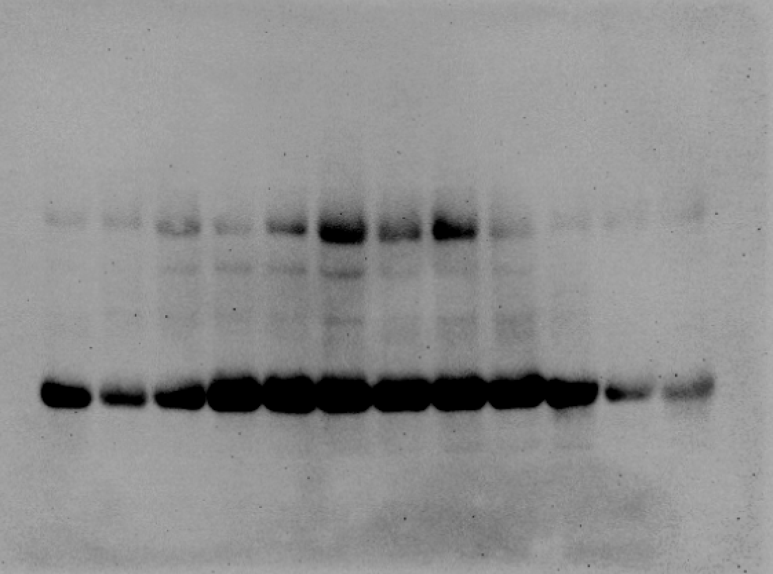
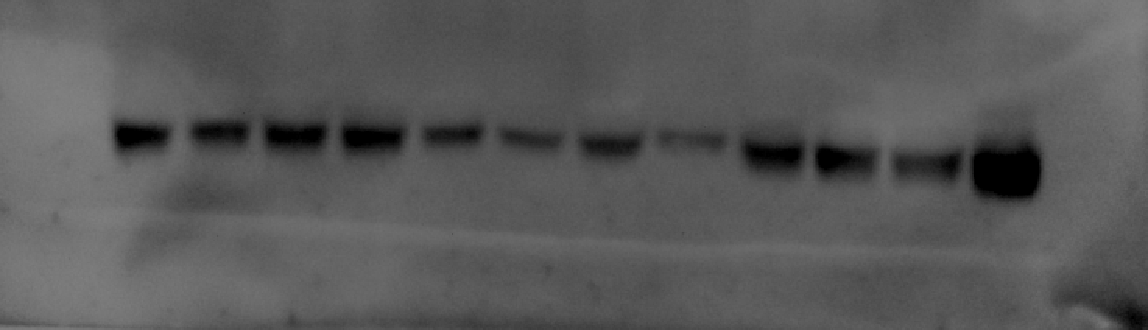
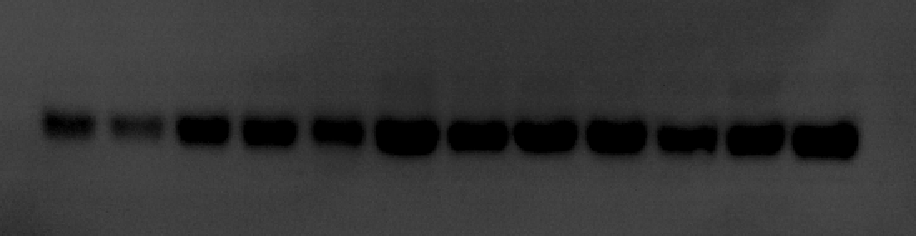
Supplementary Figure 1 - Western Blots (uncropped raw files)
B.
Figure 6B.
CON
(1-3)
PI
(1-3)
PIE
(1-3)
EX
(1-3)
CON
(4-6)
PI
(4-6)
PIE
(4-6)
EX
(4-6)
MW (kDa)
MW (kDa)
100
100
AMPKα
(62kDa)
75
AMPKα
(62kDa)
75
63
63
48
48
35
35
20
20
MW (kDa)
MW (kDa)
63
63
48
β-actin
48
β-actin
35
35
20
20

Slide 4
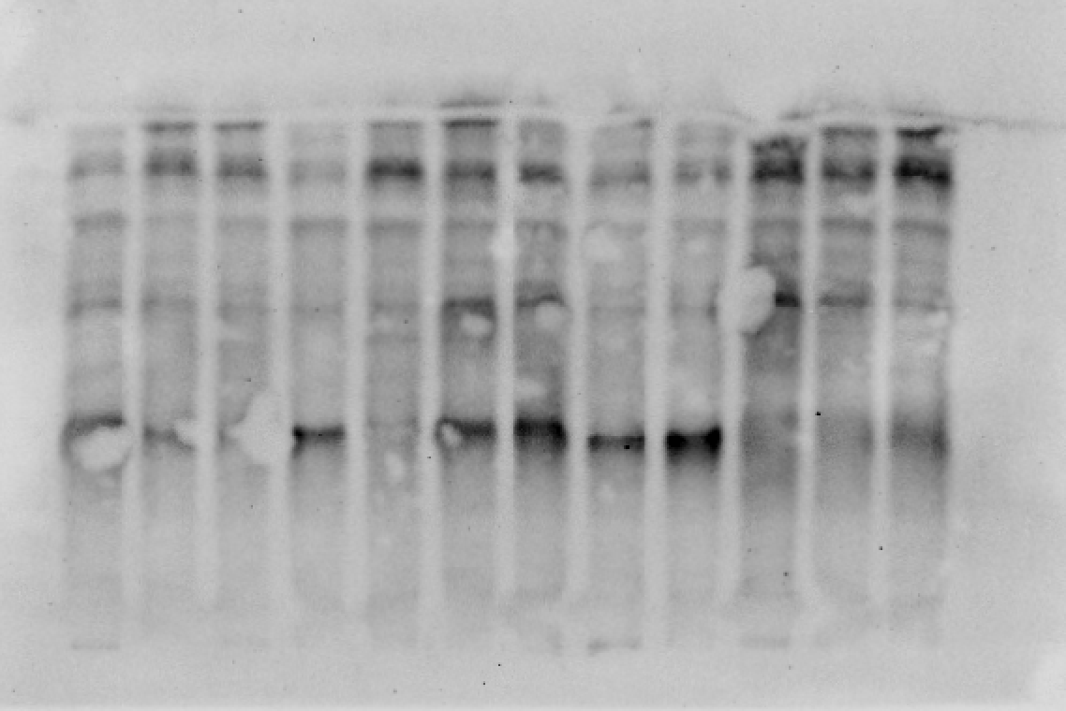
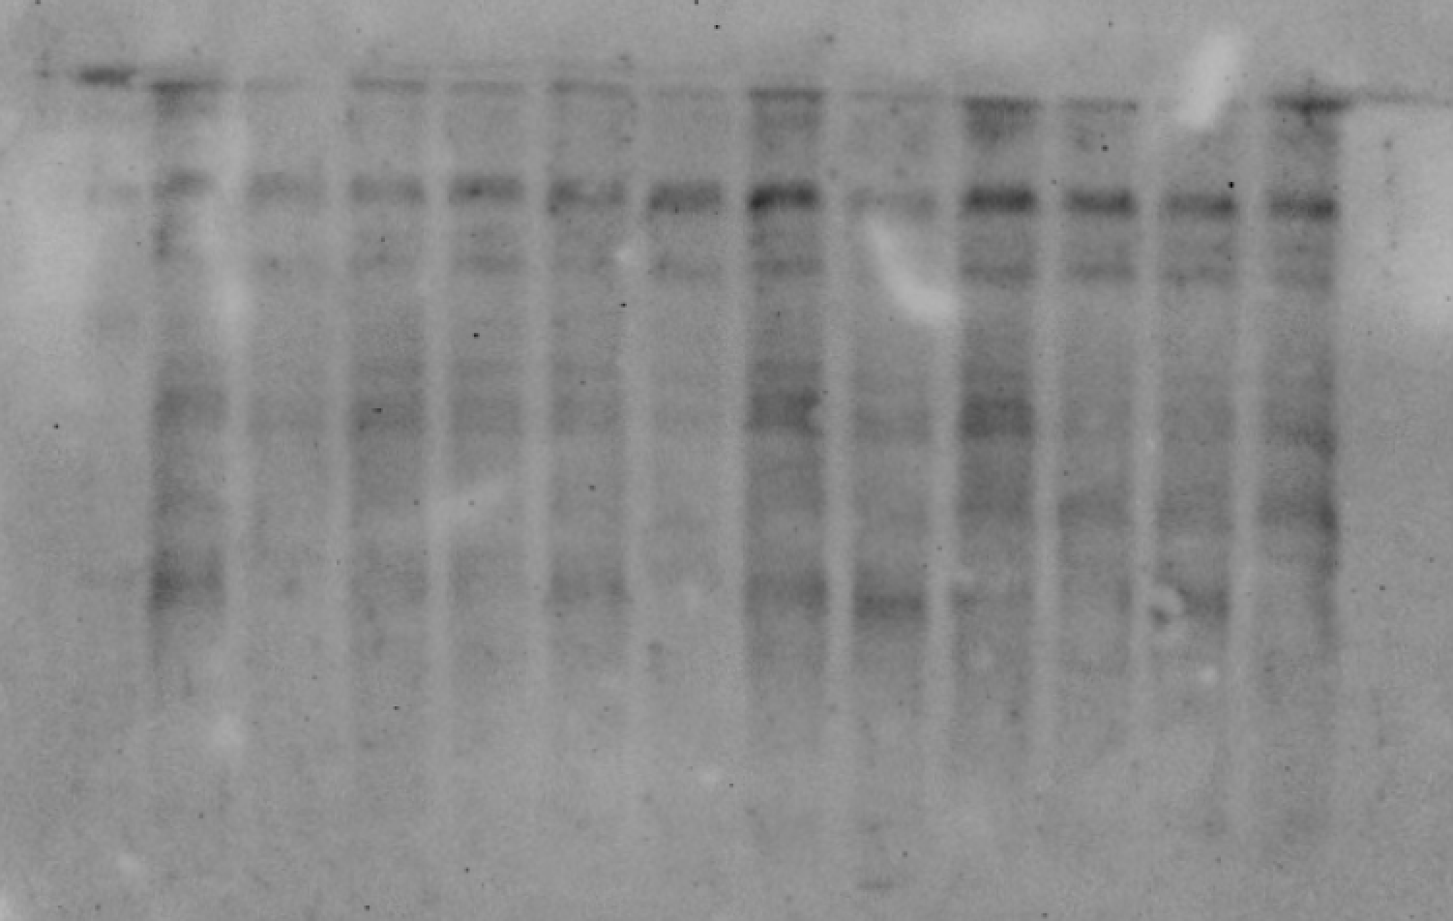
Supplementary Figure 1 - Western Blots (uncropped raw files)
B.
Figure 6C.
CON
(1-3)
PI
(1-3)
PIE
(1-3)
EX
(1-3)
MW (kDa)
CON
(4-6)
PI
(4-6)
PIE
(4-6)
EX
(4-6)
MW (kDa)
100
100
75
p-AMPKα (Thr 172)
(62kDa)
75
p-AMPKα (Thr 172)
(62kDa)
63
63
48
48
35
35
20
20

Slide 5
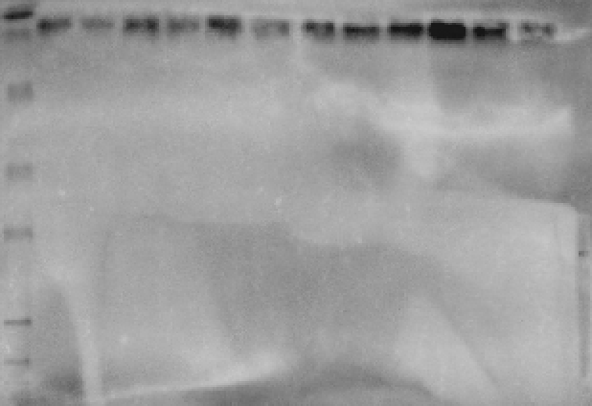
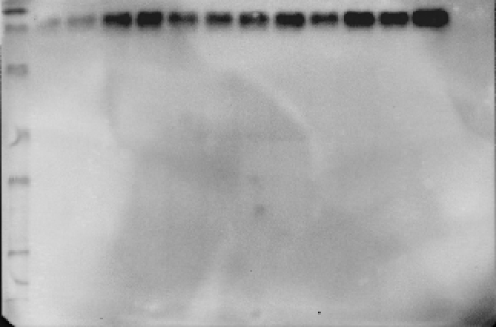
Supplementary Figure 1 - Western Blots (uncropped raw files)
B.
Figure 6E.
CON
(1-3)
PI
(1-3)
PIE
(1-3)
EX
(1-3)
CON
(4-6)
PI
(4-6)
PIE
(4-6)
EX
(4-6)
MW (kDa)
MW (kDa)
100
100
75
75
63
63
PGC-1α
(115kDa)
48
PGC-1α
(115kDa)
48
35
35
20
20

Slide 6
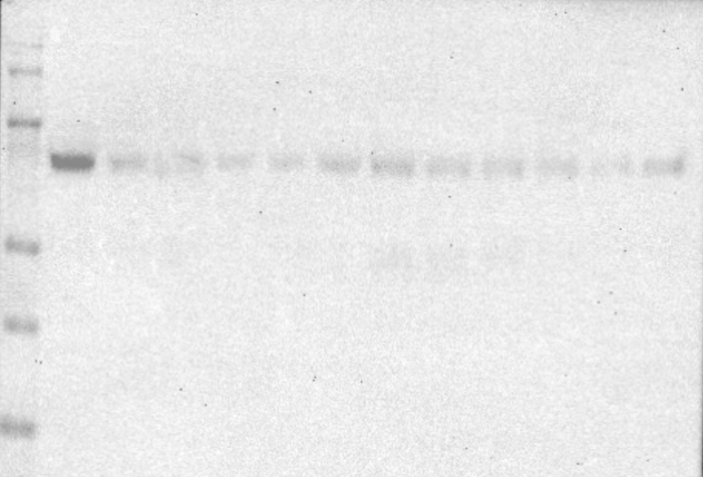
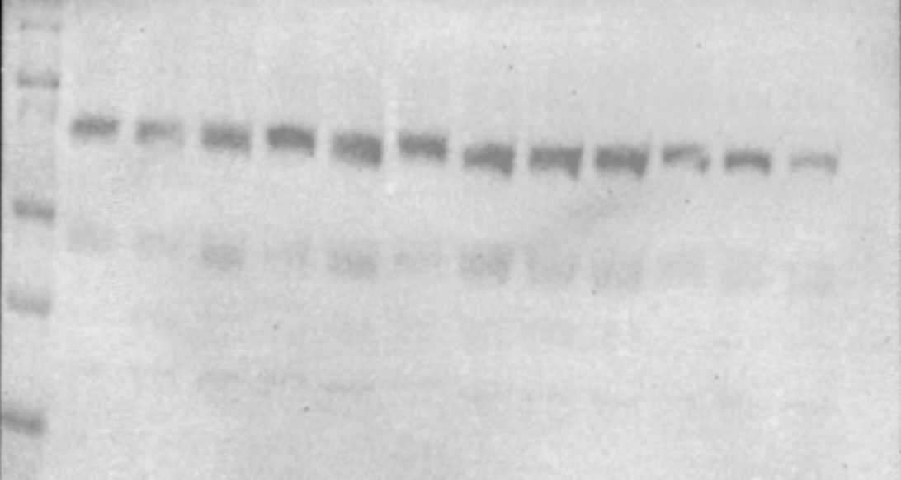
Supplementary Figure 1 - Western Blots (uncropped raw files)
B.
Figure 6F.
CON
(1-3)
PI
(1-3)
PIE
(1-3)
EX
(1-3)
CON
(4-6)
PI
(4-6)
PIE
(4-6)
EX
(4-6)
MW (kDa)
MW (kDa)
100
100
75
75
63
63
Sestrin2
(54kDa)
Sestrin2
(54kDa)
48
48
35
35
20
20

Slide 7
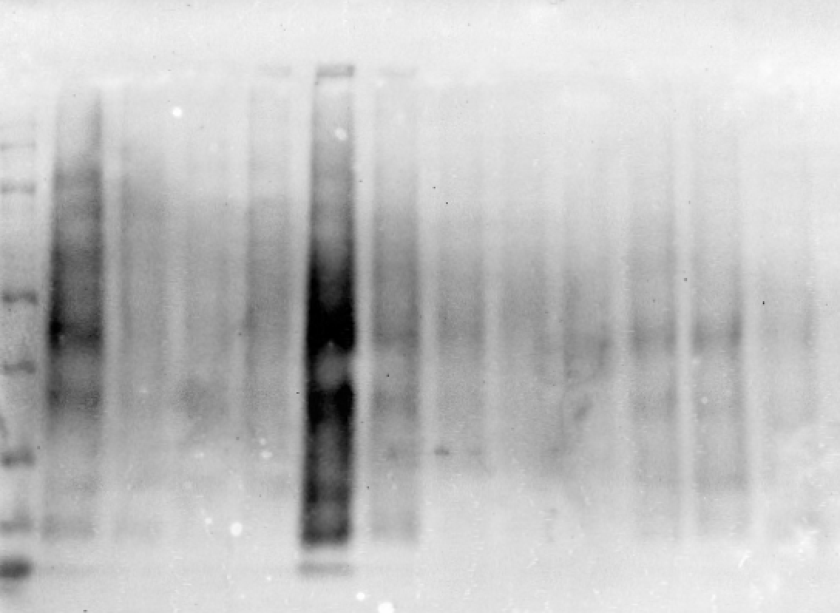
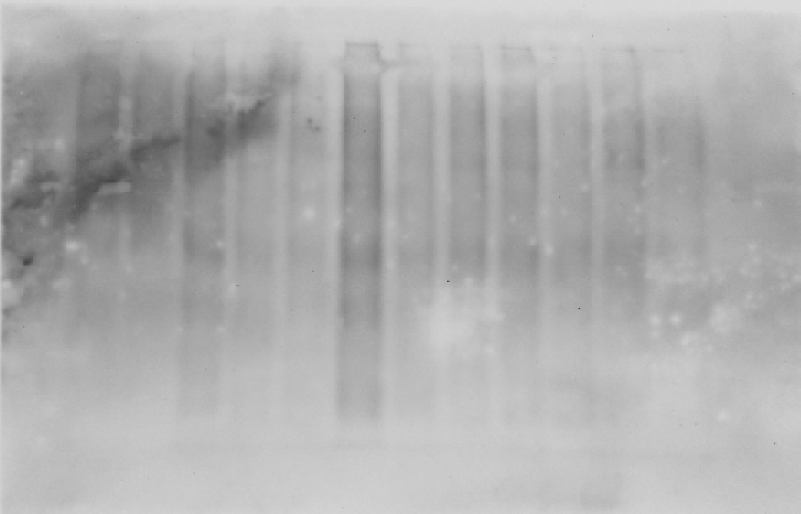
Supplementary Figure 2 - Western Blots (uncropped raw files)
B.
Figure 6G.
CON
(1-3)
PI
(1-3)
PIE
(1-3)
EX
(1-3)
MW (kDa)
CON
(4-6)
PI
(4-6)
PIE
(4-6)
EX
(4-6)
MW (kDa)
100
75
100
63
75
63
Carbonyl
Assay
48
Carbonyl
Assay
48
35
35
20
20
17
MW (kDa)
MW (kDa)
63
63
48
48
β-actin
β-actin
35
35
20
20

Slide 8
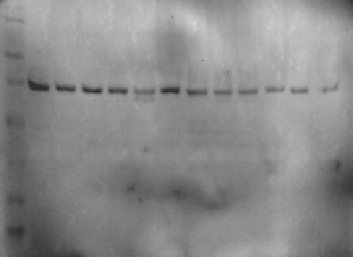
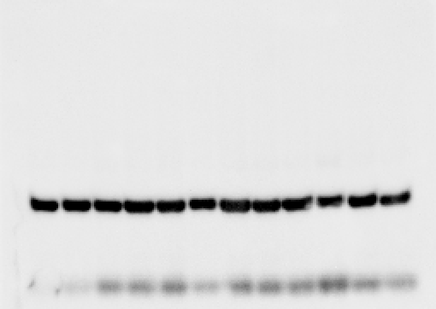
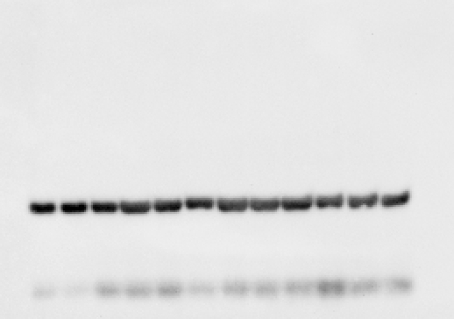
Supplementary Figure 1 - Western Blots (uncropped raw files)
C.
Figure 7A.
CON
(1-3)
PI
(1-3)
PIE
(1-3)
EX
(1-3)
CON
(4-6)
PI
(4-6)
PIE
(4-6)
EX
(4-6)
MW (kDa)
MW (kDa)
100
100
Cox2
(75kDa)
75
Cox2
(75kDa)
75
63
63
48
48
35
35
20
20
MW (kDa)
MW (kDa)
100
100
75
75
β-actin
63
β-actin
63
48
48
35
35
20
20

Slide 9
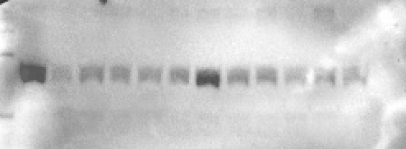
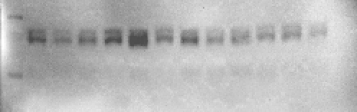
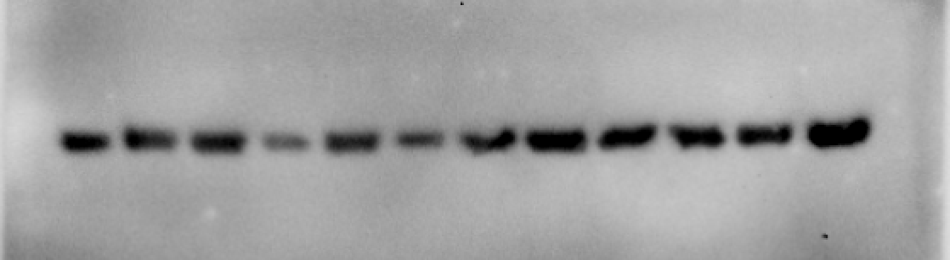
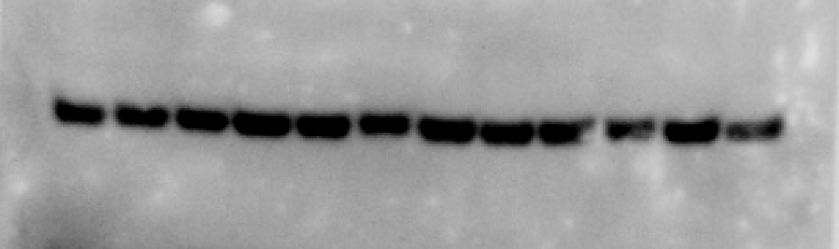
Supplementary Figure 1 - Western Blots (uncropped raw files)
C.
Figure 9B.
CON
(1-3)
PI
(1-3)
PIE
(1-3)
EX
(1-3)
CON
(4-6)
PI
(4-6)
PIE
(4-6)
EX
(4-6)
MW (kDa)
MW (kDa)
100
100
Drp1
(78kDa)
75
Drp1
(78kDa)
75
63
63
63
63
β-actin
48
β-actin
48
35
35

Slide 10
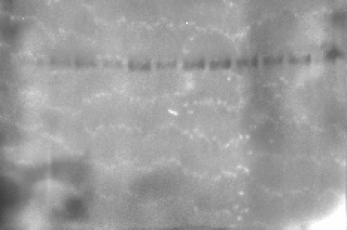
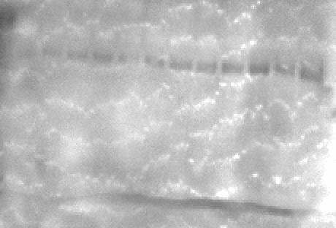
Supplementary Figure 1 - Western Blots (uncropped raw files)
C.
Figure 9C.
CON
(1-3)
PI
(1-3)
PIE
(1-3)
EX
(1-3)
CON
(4-6)
PI
(4-6)
PIE
(4-6)
EX
(4-6)
MW (kDa)
MW (kDa)
100
100
75
75
p-Drp1 (S616)
(78kDa)
63
p-Drp1 (S616)
(78kDa)
63
48
48
35
20
35
20

Slide 11
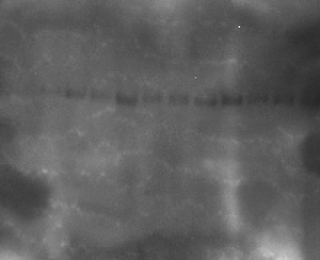
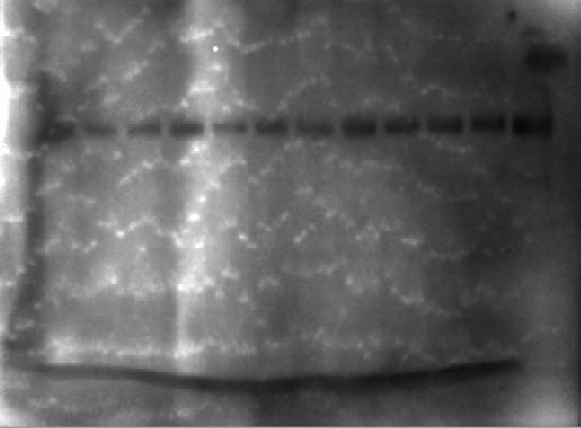
Supplementary Figure 1 - Western Blots (uncropped raw files)
C.
Figure 9D.
CON
(1-3)
PI
(1-3)
PIE
(1-3)
EX
(1-3)
CON
(4-6)
PI
(4-6)
PIE
(4-6)
EX
(4-6)
MW (kDa)
MW (kDa)
100
100
75
75
p-Drp1 (S637)
(78kDa)
63
p-Drp1 (S637)
(78kDa)
63
48
48
35
35
20
20

Slide 12


Supplementary Figure 1 - Western Blots (uncropped raw files)
C.
Figure 9F.
CON
(1-3)
PI
(1-3)
PIE
(1-3)
EX
(1-3)
CON
(4-6)
PI
(4-6)
PIE
(4-6)
EX
(4-6)
MW (kDa)
MW (kDa)
Opa1
(80kDa)
100
Opa1
(80kDa)
100
75
75
63
63

Slide 13
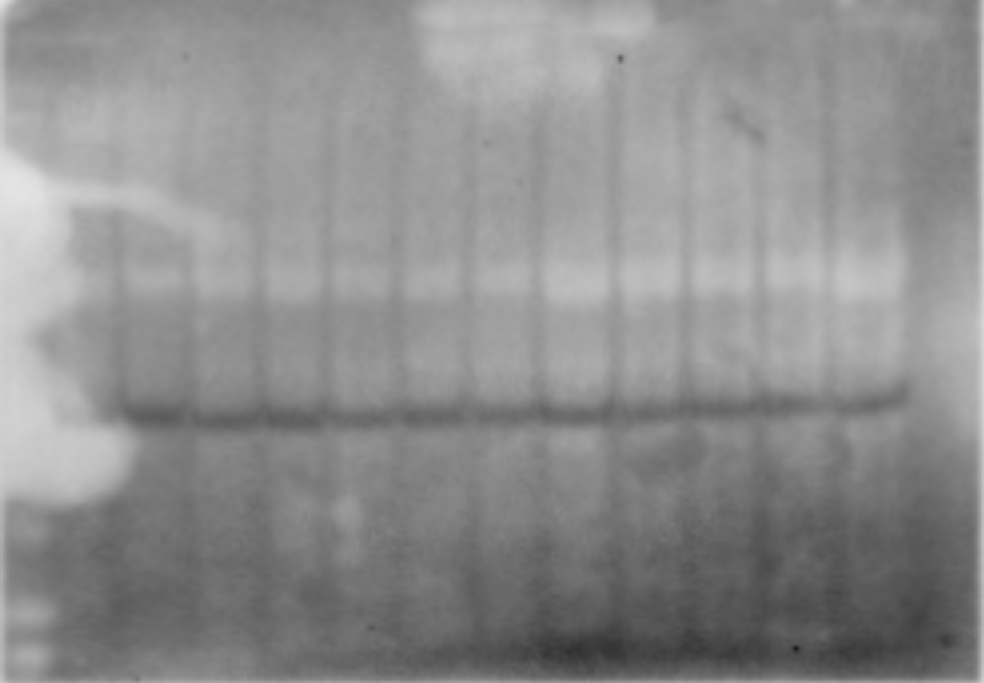
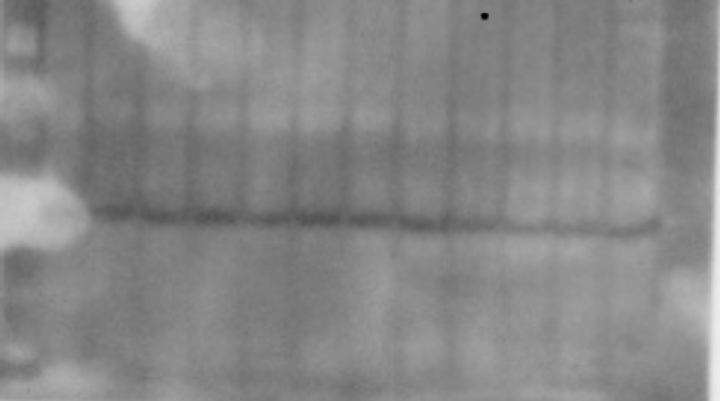
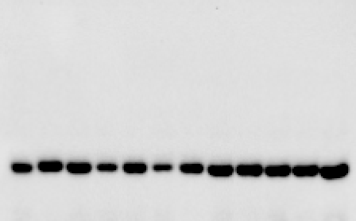
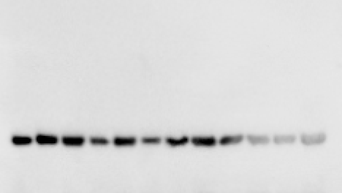
Supplementary Figure 1 - Western Blots (uncropped raw files)
D.
Figure 10B.
CON
(1-3)
PI
(1-3)
PIE
(1-3)
EX
(1-3)
CON
(4-6)
PI
(4-6)
PIE
(4-6)
EX
(4-6)
MW (kDa)
MW (kDa)
ATG13
(72kDa)
100
ATG13
(72kDa)
100
75
75
63
63
48
48
35
35
MW (kDa)
MW (kDa)
63
63
β-actin
48
β-actin
48
35
35
20
20

Slide 14
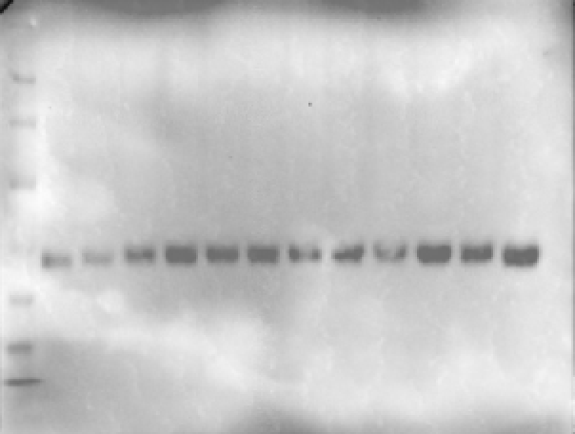
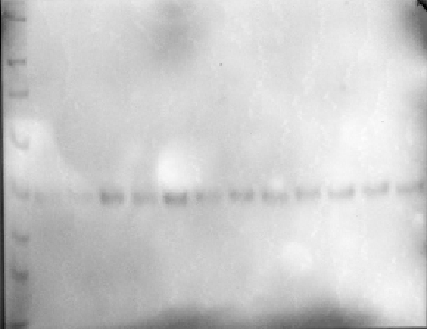
Supplementary Figure 1 - Western Blots (uncropped raw files)
D.
Figure 10C.
CON
(1-3)
PI
(1-3)
PIE
(1-3)
EX
(1-3)
MW (kDa)
CON
(4-6)
PI
(4-6)
PIE
(4-6)
EX
(4-6)
MW (kDa)
100
100
75
ATG 101
(72kDa)
75
63
63
ATG101
(25kDa)
48
48
35
35
20
20
17
17

Slide 15
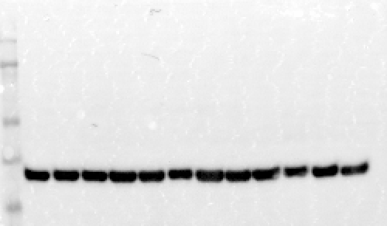
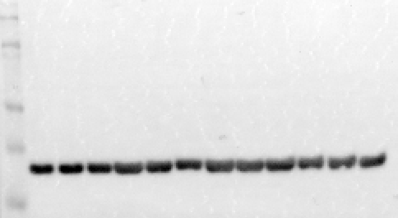
Supplementary Figure 1 - Western Blots (uncropped raw files)
D.
Figure 10D.
CON
(1-3)
PI
(1-3)
PIE
(1-3)
EX
(1-3)
MW (kDa)
CON
(4-6)
PI
(4-6)
PIE
(4-6)
EX
(4-6)
MW (kDa)
100
100
75
Parkin2
(48kDa)
75
Parkin2
(48kDa)
63
63
48
48
35
35

Slide 16
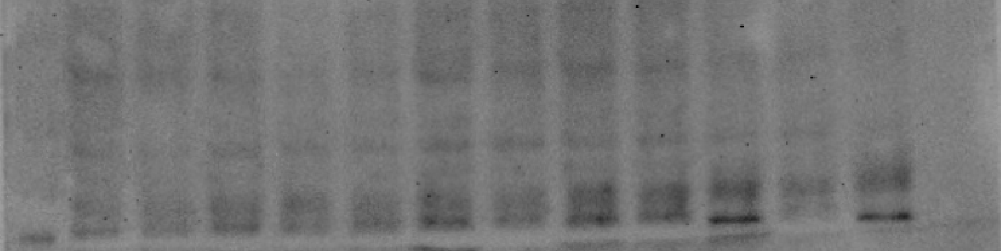
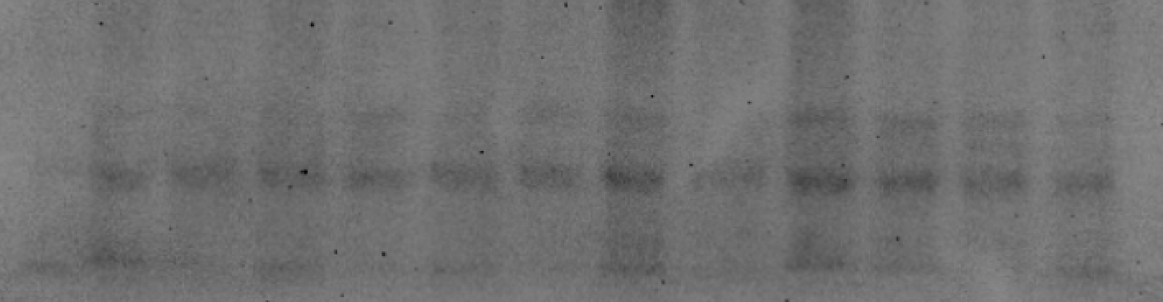
Supplementary Figure 1 - Western Blots (uncropped raw files)
D.
Figure 10E.
MW (kDa)
CON
(1-3)
PI
(1-3)
PIE
(1-3)
EX
(1-3)
CON
(4-6)
PI
(4-6)
PIE
(4-6)
EX
(4-6)
MW (kDa)
LC3
(16kDa)
LC3
(16kDa)
20
20
17
17
15
15

Slide 17
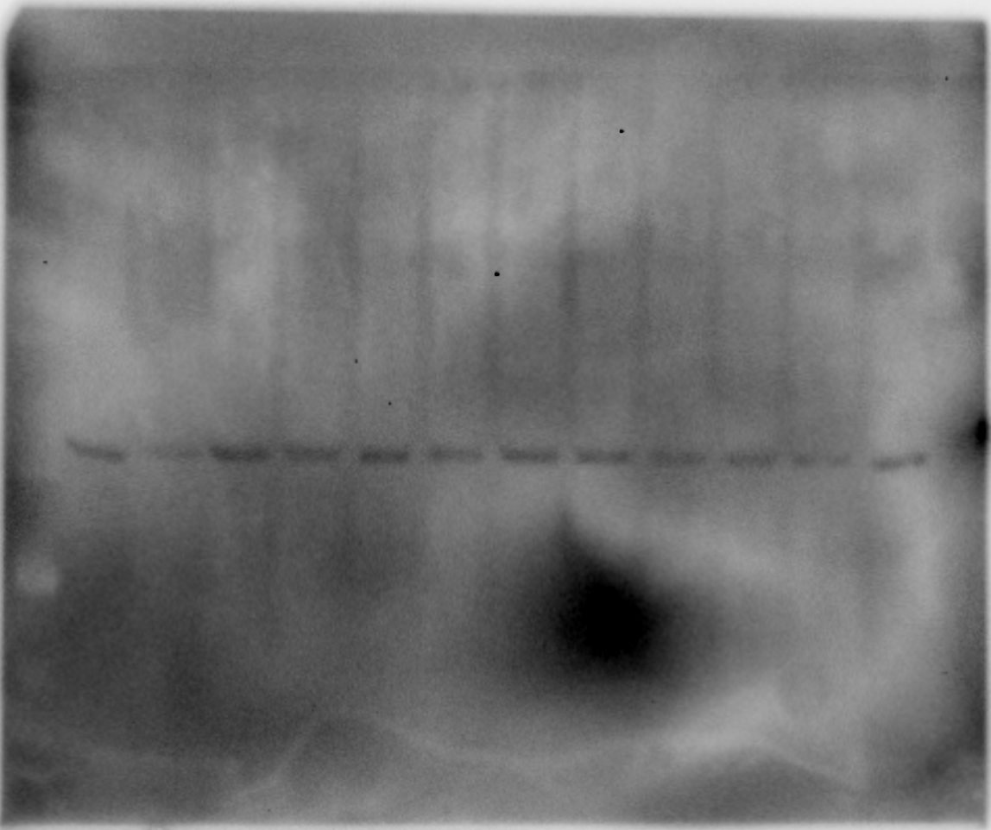
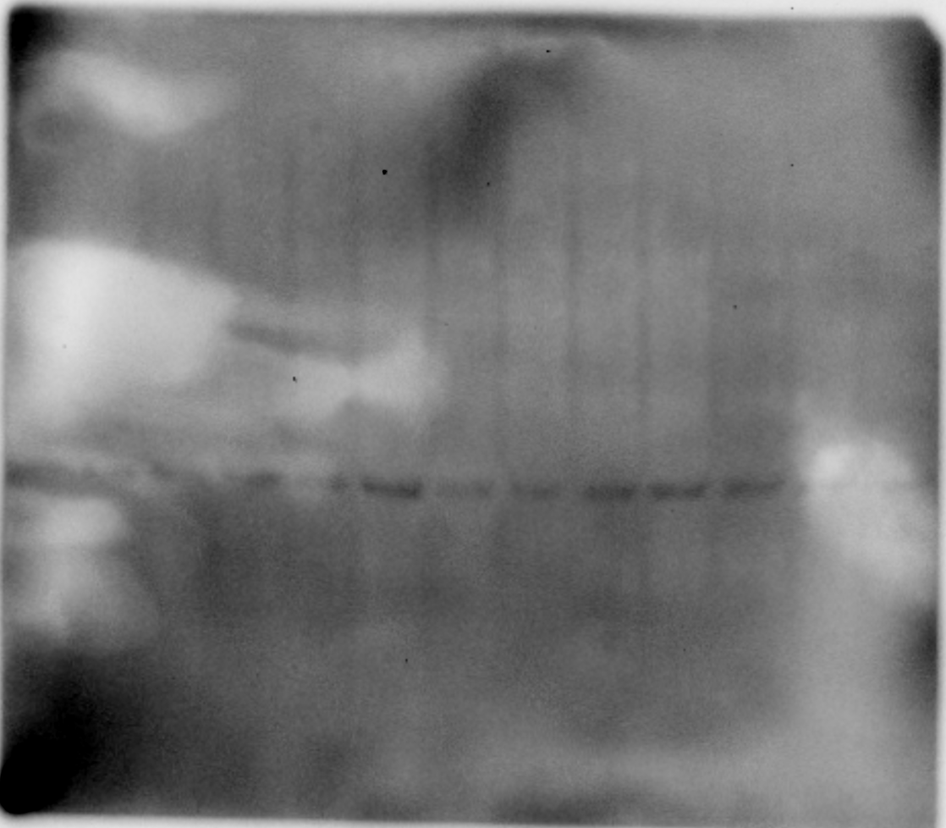
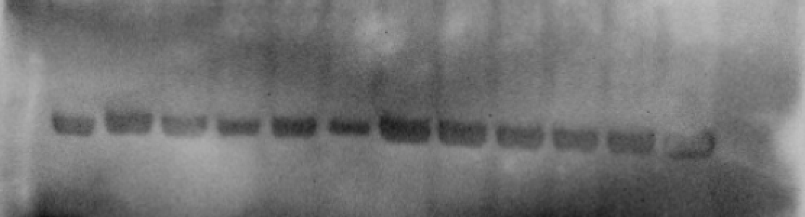
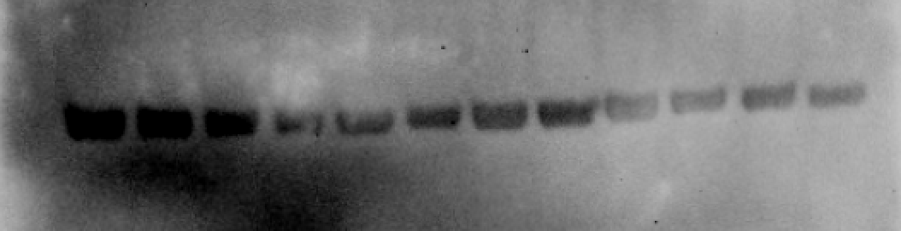
Supplementary Figure 1 - Western Blots (uncropped raw files)
F.
Figure 11B.
CON
(1-3)
PI
(1-3)
PIE
(1-3)
EX
(1-3)
CON
(4-6)
PI
(4-6)
PIE
(4-6)
EX
(4-6)
MW (kDa)
MW (kDa)
100
100
AKT
(60kDa)
75
AKT
(60kDa)
75
63
63
48
48
35
35
20
20
MW (kDa)
MW (kDa)
63
63
β-actin
48
β-actin
48
35
35

Slide 18
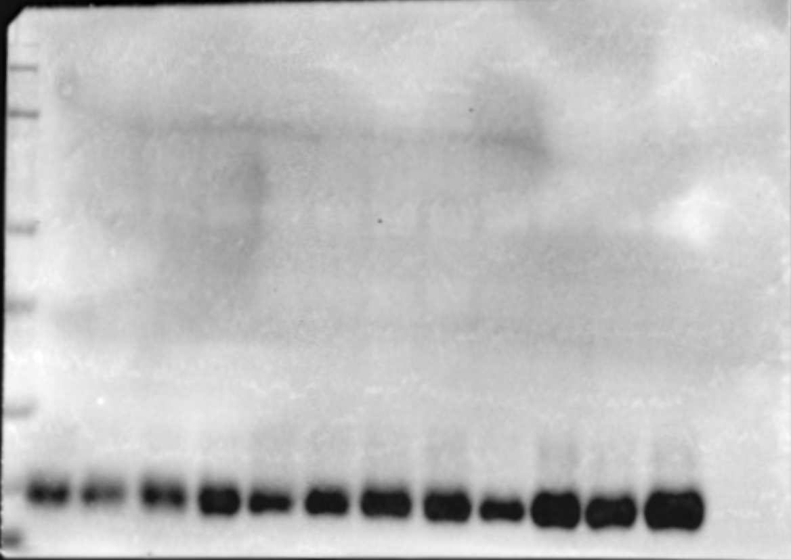
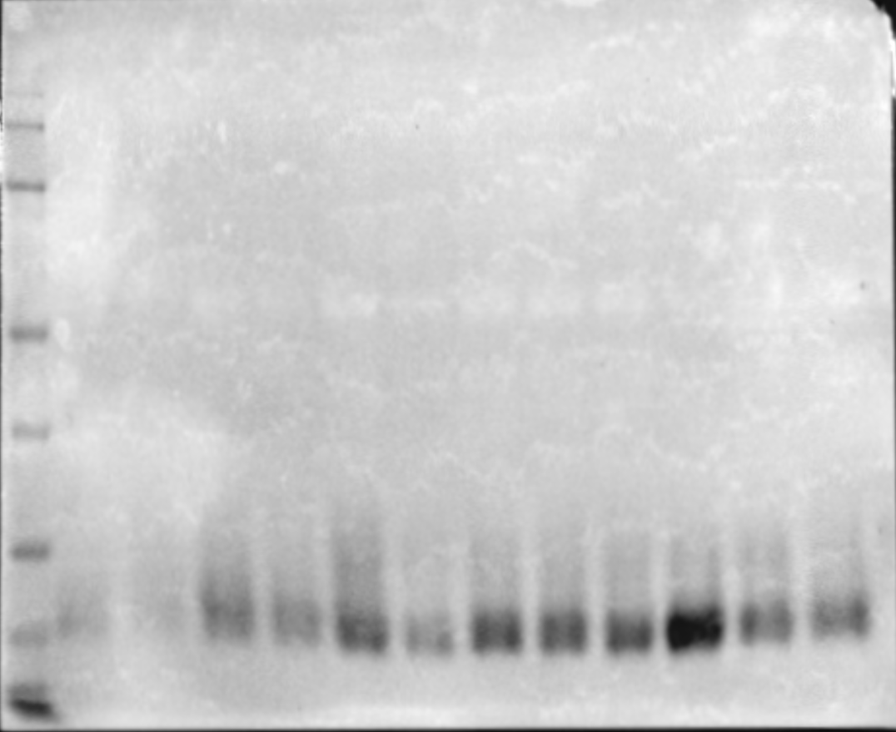
Supplementary Figure 1 - Western Blots (uncropped raw files)
F.
Figure 11C.
CON
(1-3)
PI
(1-3)
PIE
(1-3)
EX
(1-3)
CON
(4-6)
PI
(4-6)
PIE
(4-6)
EX
(4-6)
MW (kDa)
MW (kDa)
100
75
100
63
BID
(22kDa)
75
BID
(22kDa)
48
63
35
48
20
35
20

Slide 19
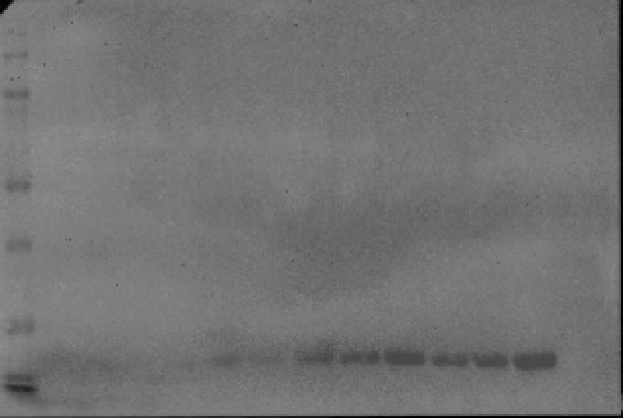

Supplementary Figure 1 - Western Blots (uncropped raw files)
F.
Figure 11D.
CON
(1-3)
PI
(1-3)
PIE
(1-3)
EX
(1-3)
CON
(4-6)
PI
(4-6)
PIE
(4-6)
EX
(4-6)
MW (kDa)
MW (kDa)
100
100
75
75
Bcl2
(26kDa)
63
Bcl2
(26kDa)
63
48
48
35
35
20
20

Slide 20


Supplementary Figure 1 - Western Blots (uncropped raw files)
F.
Figure 11E.
CON
(1-3)
PI
(1-3)
PIE
(1-3)
EX
(1-3)
CON
(4-6)
PI
(4-6)
PIE
(4-6)
EX
(4-6)
MW (kDa)
MW (kDa)
35
Bax
(23kDa)
35
Bax
(23kDa)
20
20

