Slide 1
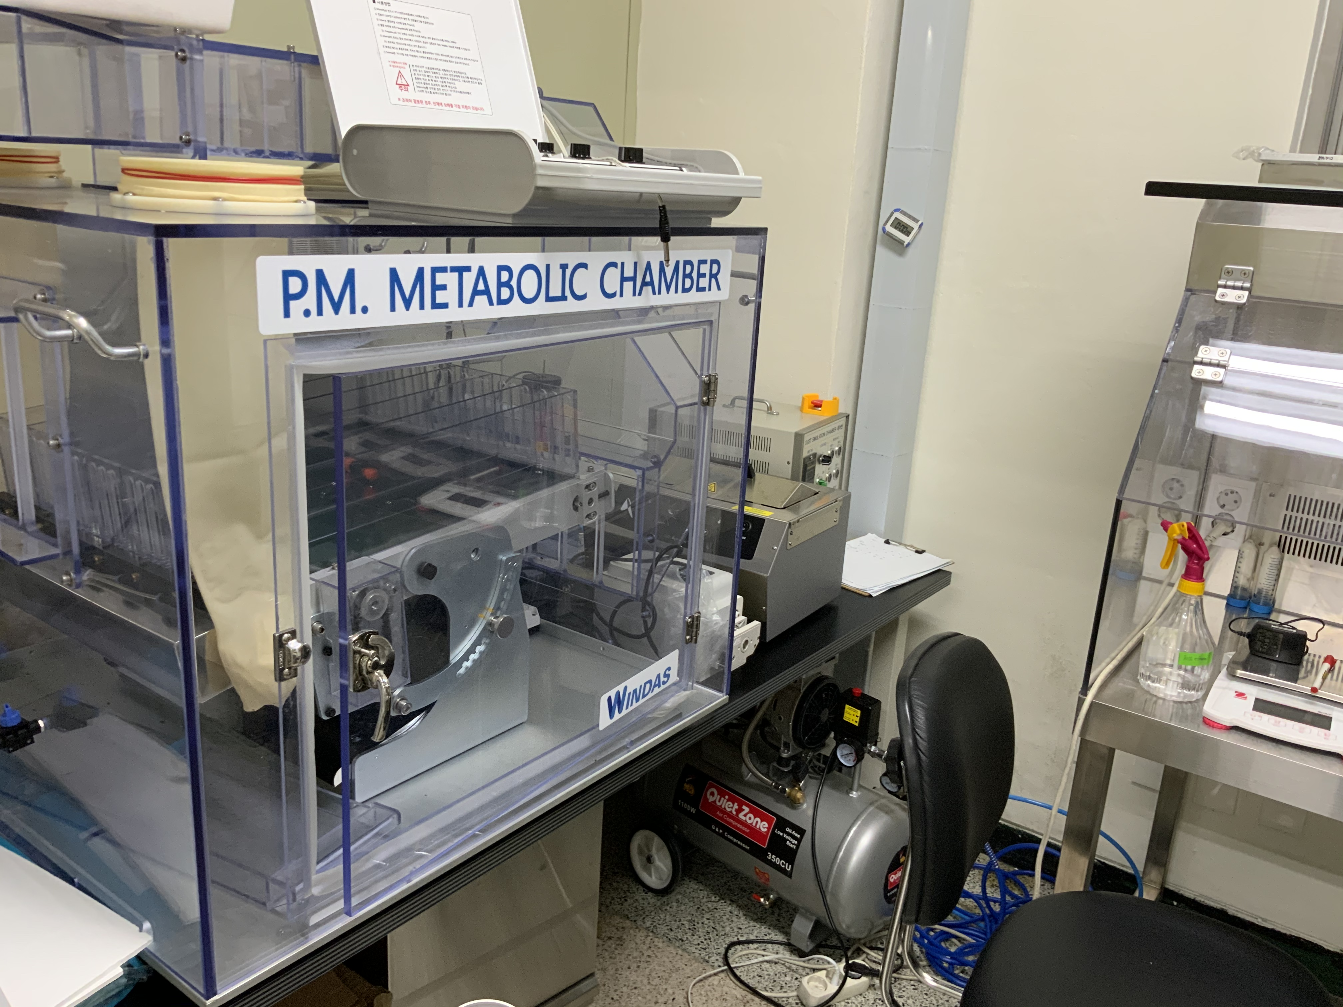
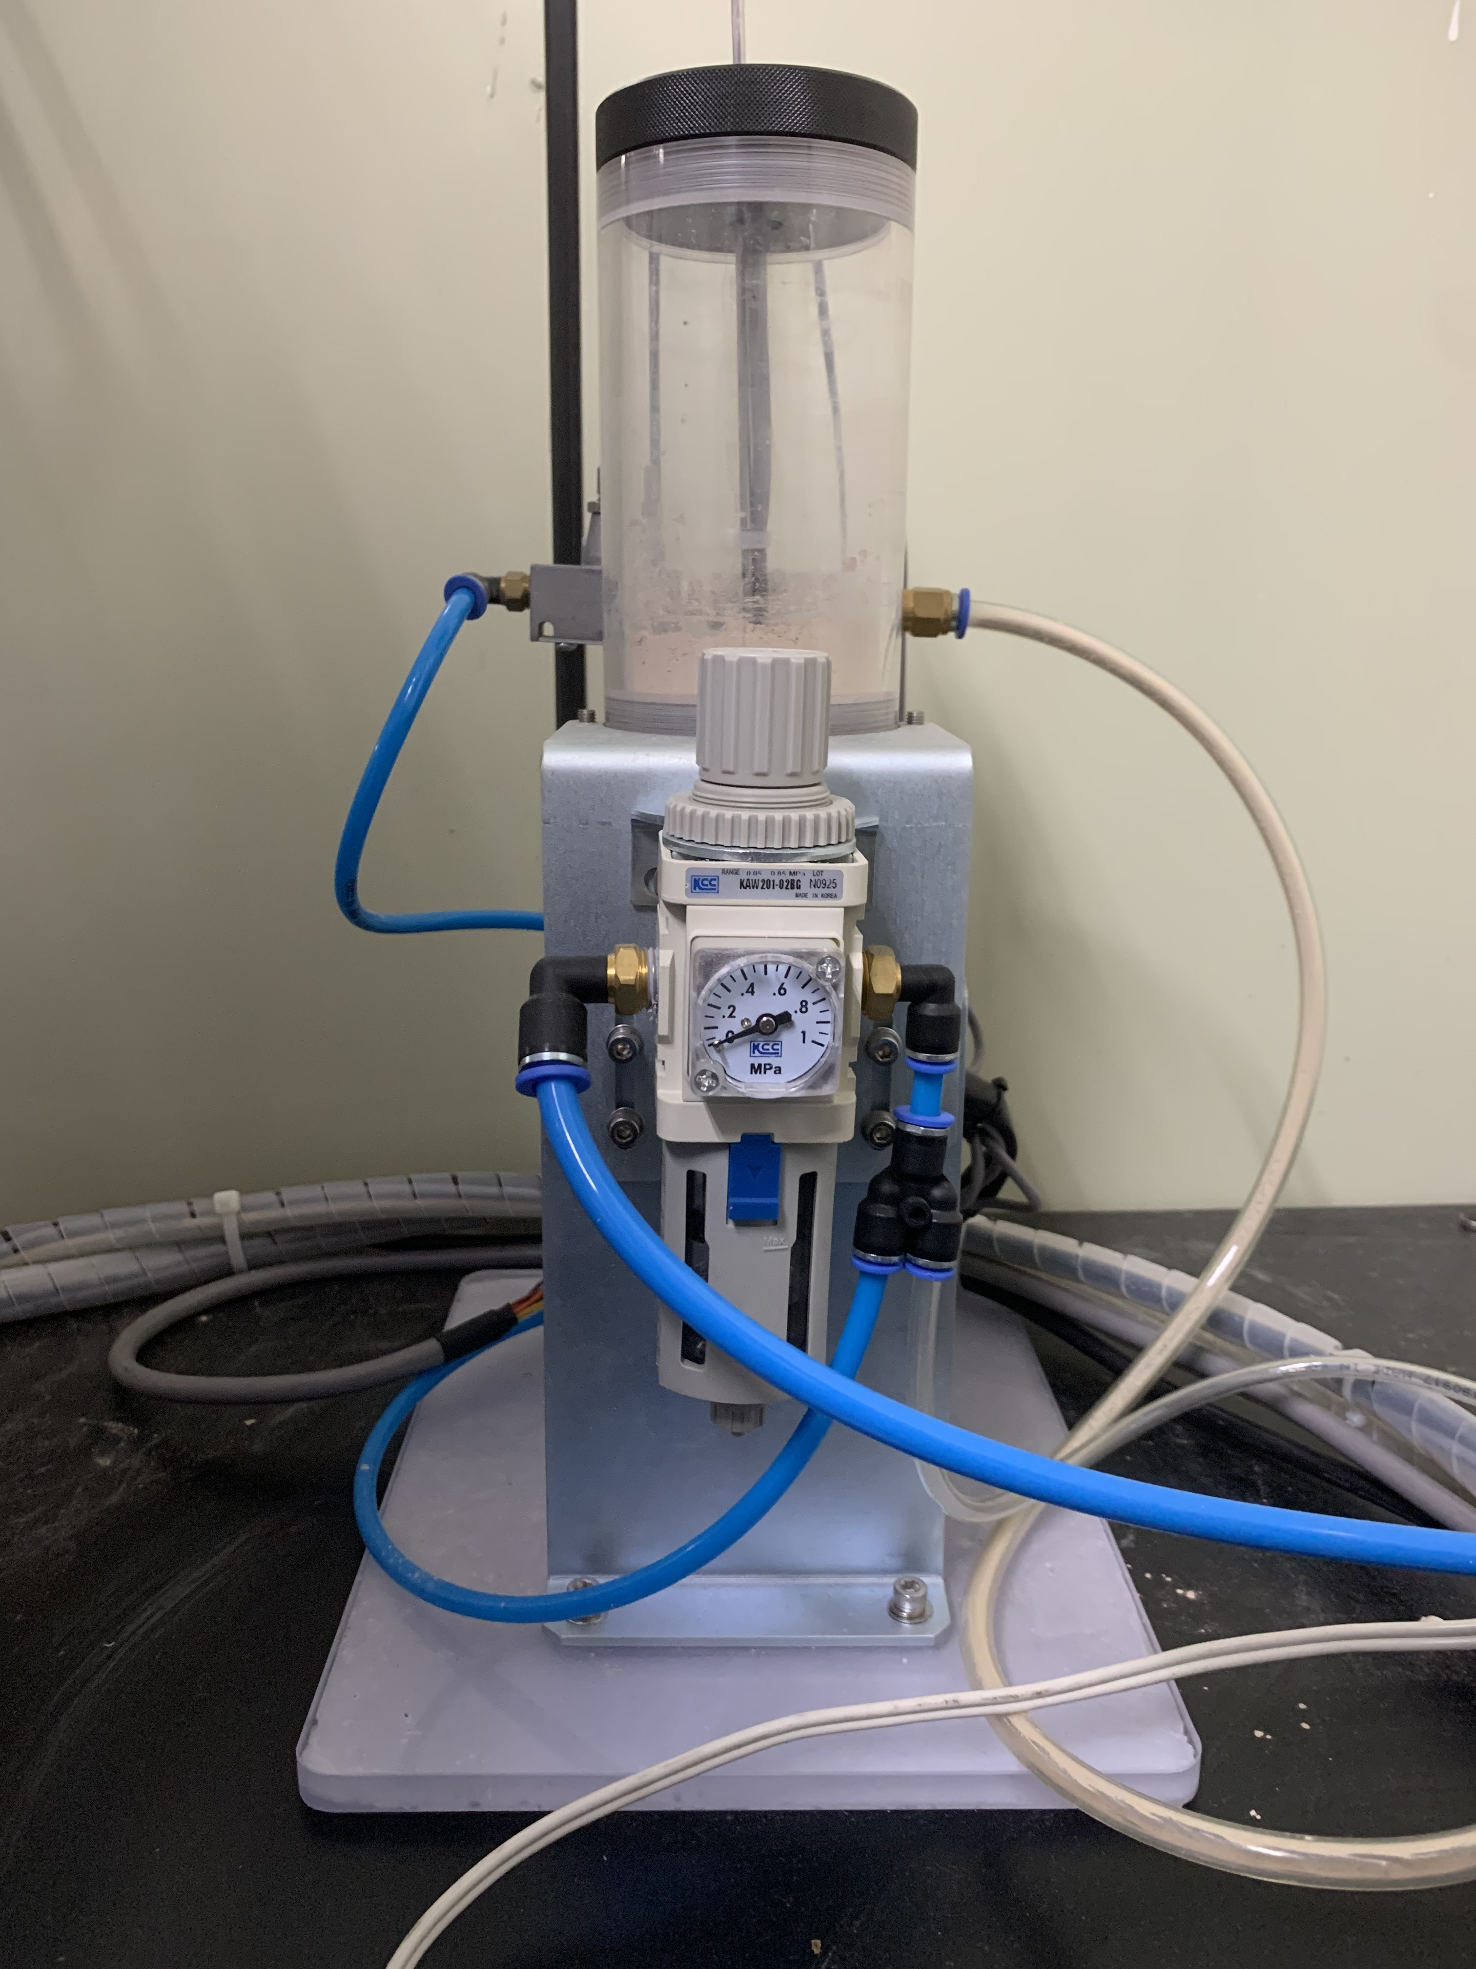
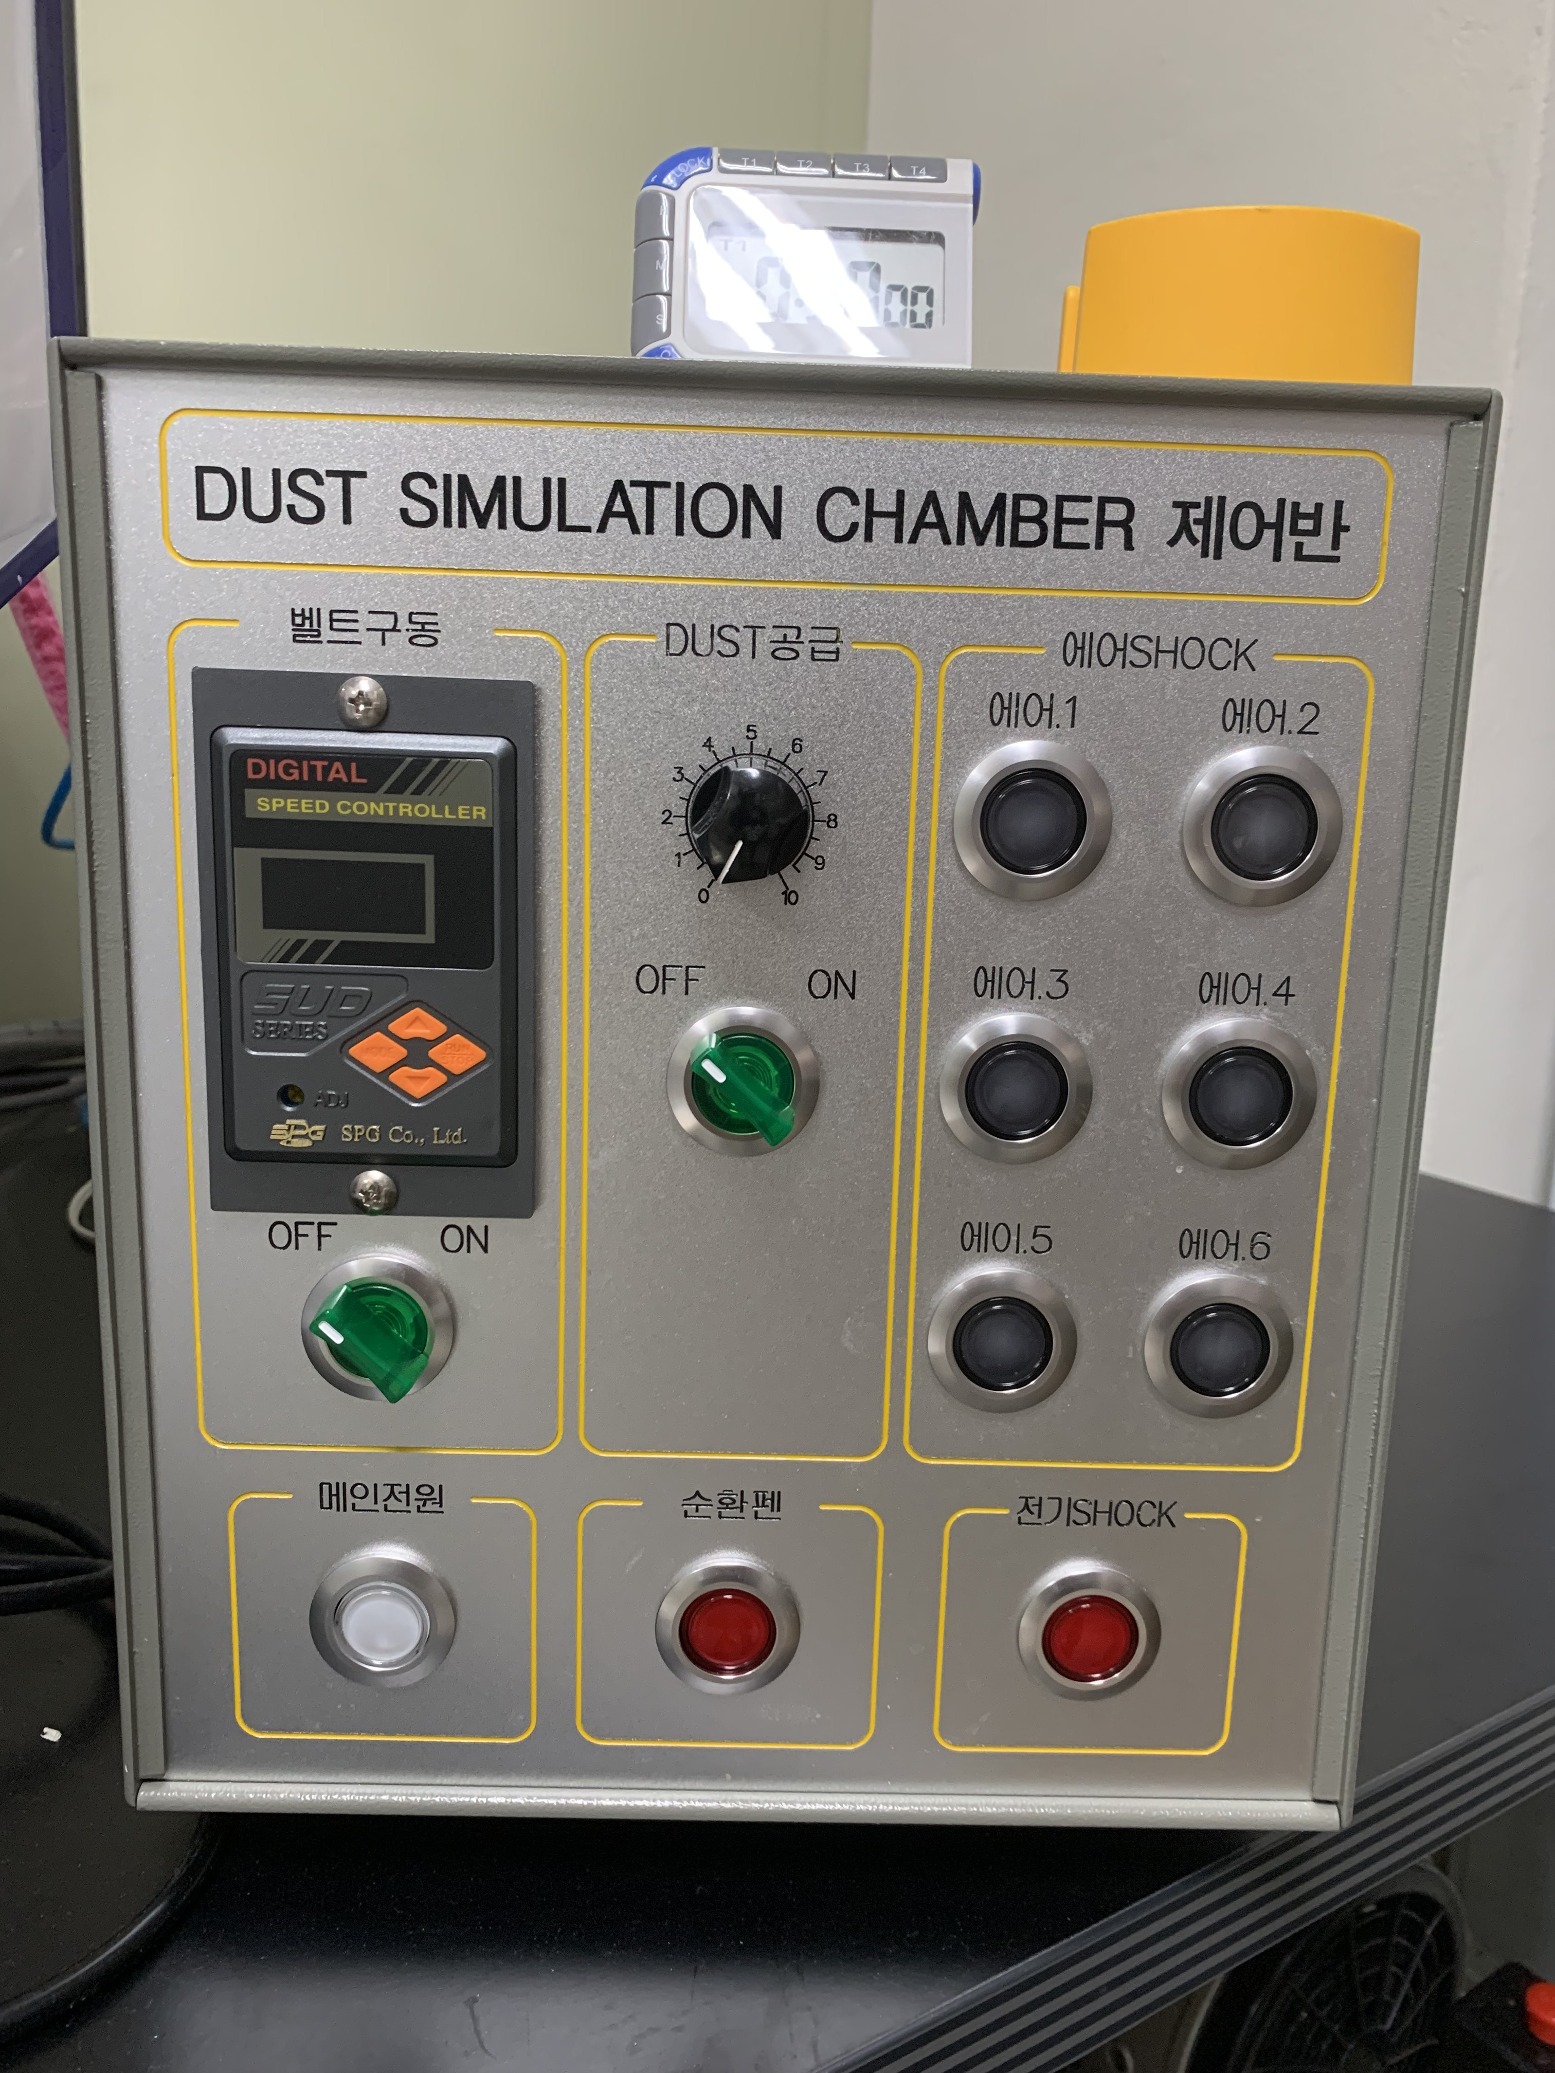
Supplementary Figure 2 – Schematic diagram of PM Chamber
A
B
PM supplier
Main controller
PM chamber

Slide 2
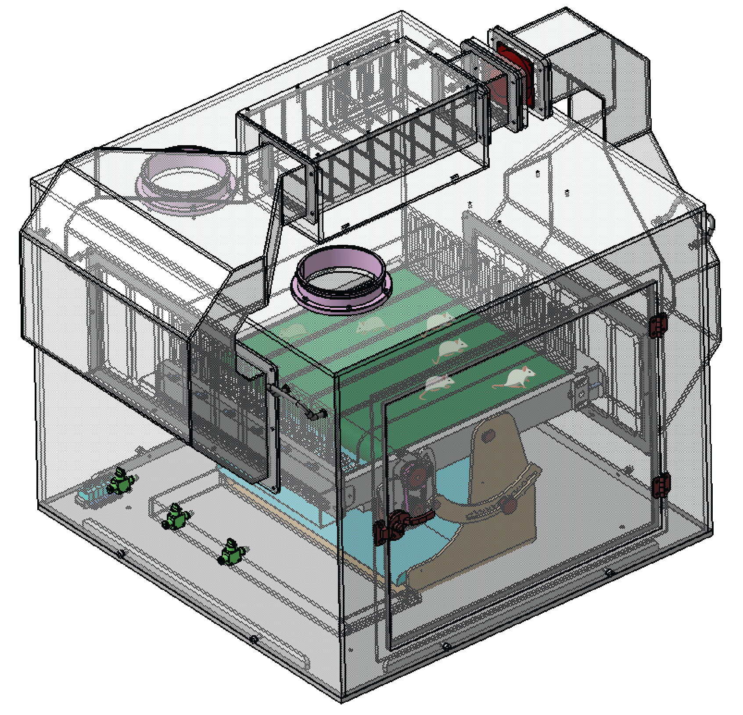
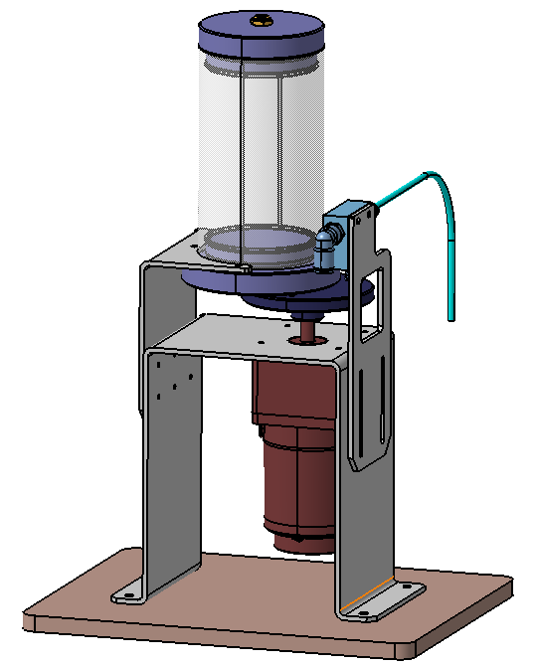
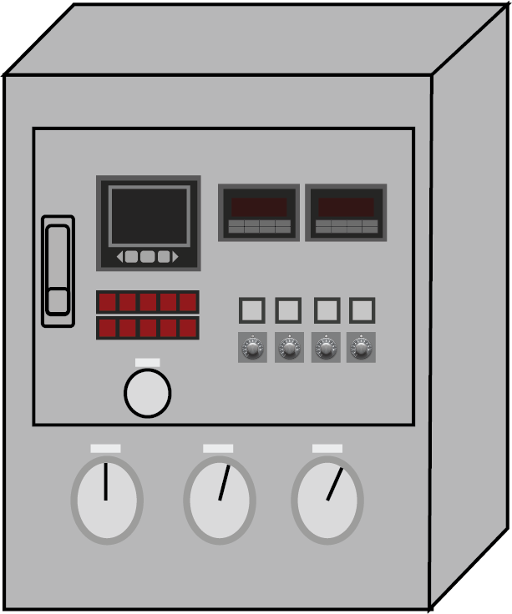
Supplementary Figure 2 – Schematic diagram of PM Chamber
Glove box
Dust Reservoir
Supply Motor
PM storage and built-in vibrator allows the efficient supply of PM
To control the running of mice in the treadmill chamber
A device for rotating the PM disk
Dust Supply Unit
Particle counter
Utilize the rotation disk for supply of the PM to the chamber through a vacuum generator
To measure and maintain real time PM concentration in the chamber
Main controller
- Treadmill control (speed, on/off)
- PM supply control (on/off)
Mouse Treadmill
- Air Shock : Release of compressed air in every lane
- Total 6 lanes
- Control of Incline and decline of treadmill
(maximum 20 degree, adjusted at 5 degree)
- Emergency stop button

