Slide 1
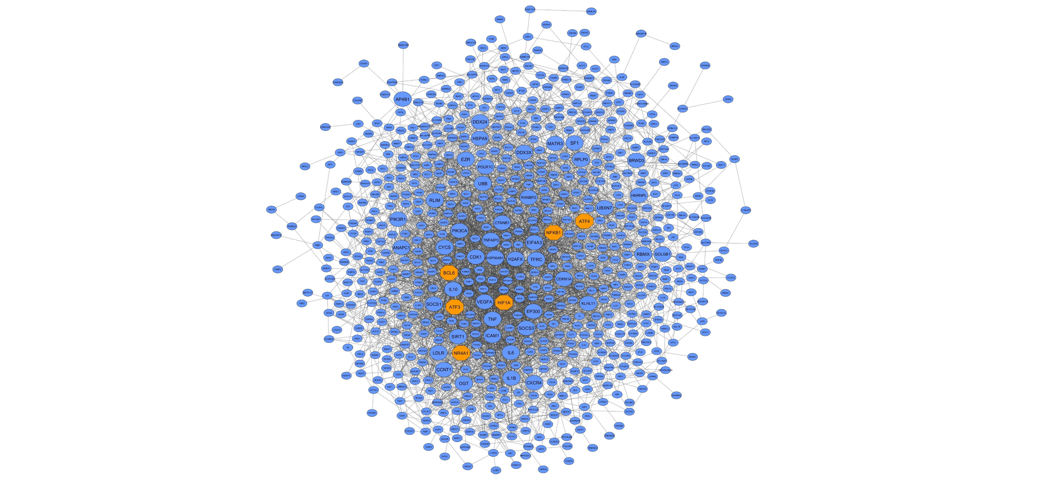
Supplementary Figure 1: PPI networks based on the hub genes of the nine candidate modules. Large circles and orange octagons represent hub-high traffic genes and TFs, respectively.
blue module

Slide 2
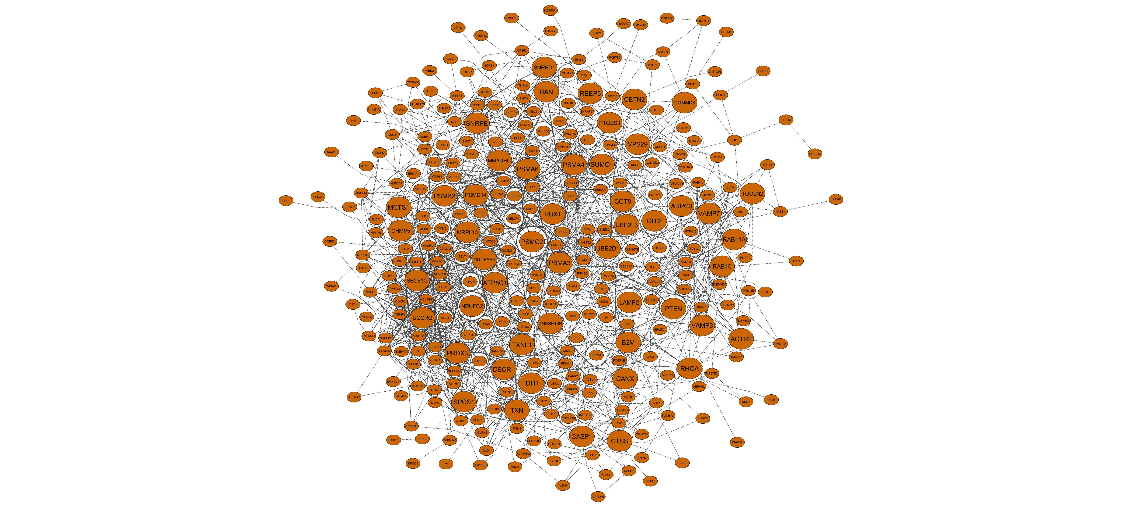
Supplementary Figure 1: PPI networks based on the hub genes of the nine candidate modules. Large circles and orange octagons represent hub-high traffic genes and TFs, respectively.
brown module

Slide 3
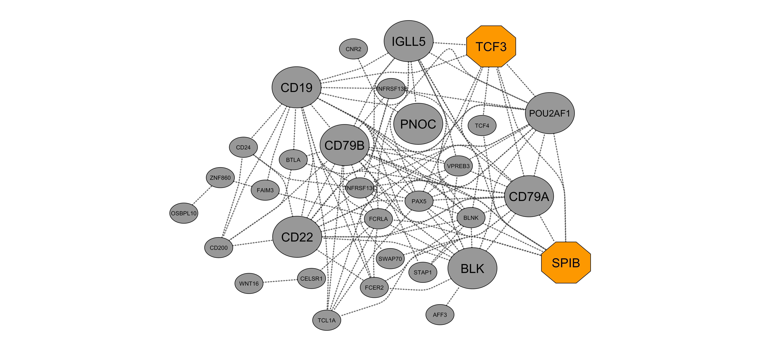
Supplementary Figure 1: PPI networks based on the hub genes of the nine candidate modules. Large circles and orange octagons represent hub-high traffic genes and TFs, respectively.
grey60 module

Slide 4
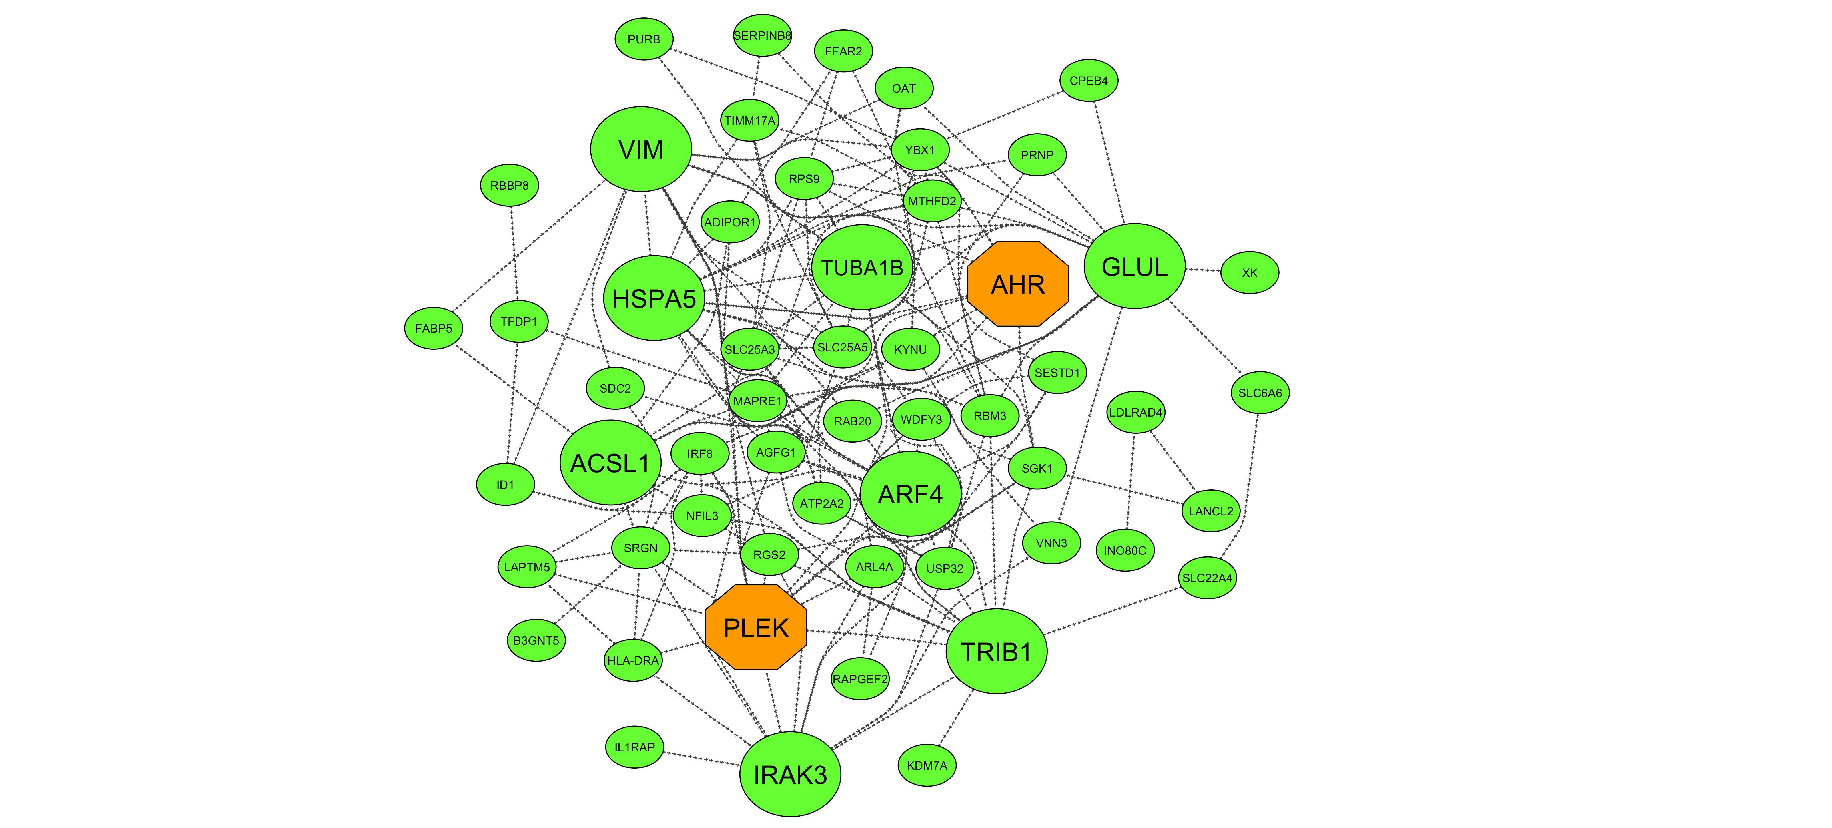
Supplementary Figure 1: PPI networks based on the hub genes of the nine candidate modules. Large circles and orange octagons represent hub-high traffic genes and TFs, respectively.
lightgreen module

Slide 5
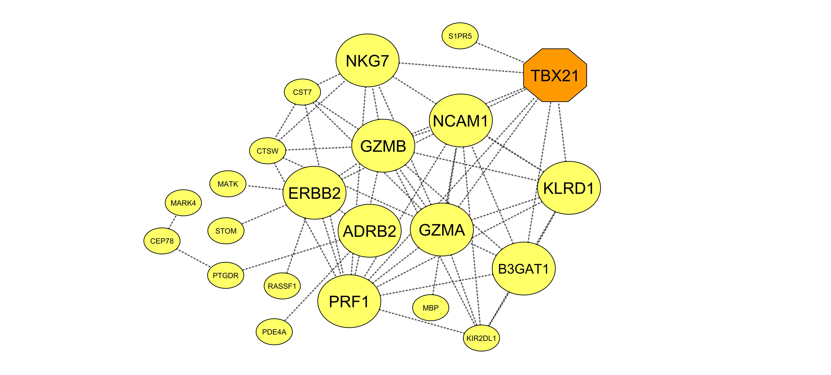
Supplementary Figure 1: PPI networks based on the hub genes of the nine candidate modules. Large circles and orange octagons represent hub-high traffic genes and TFs, respectively.
lightyellow module

Slide 6
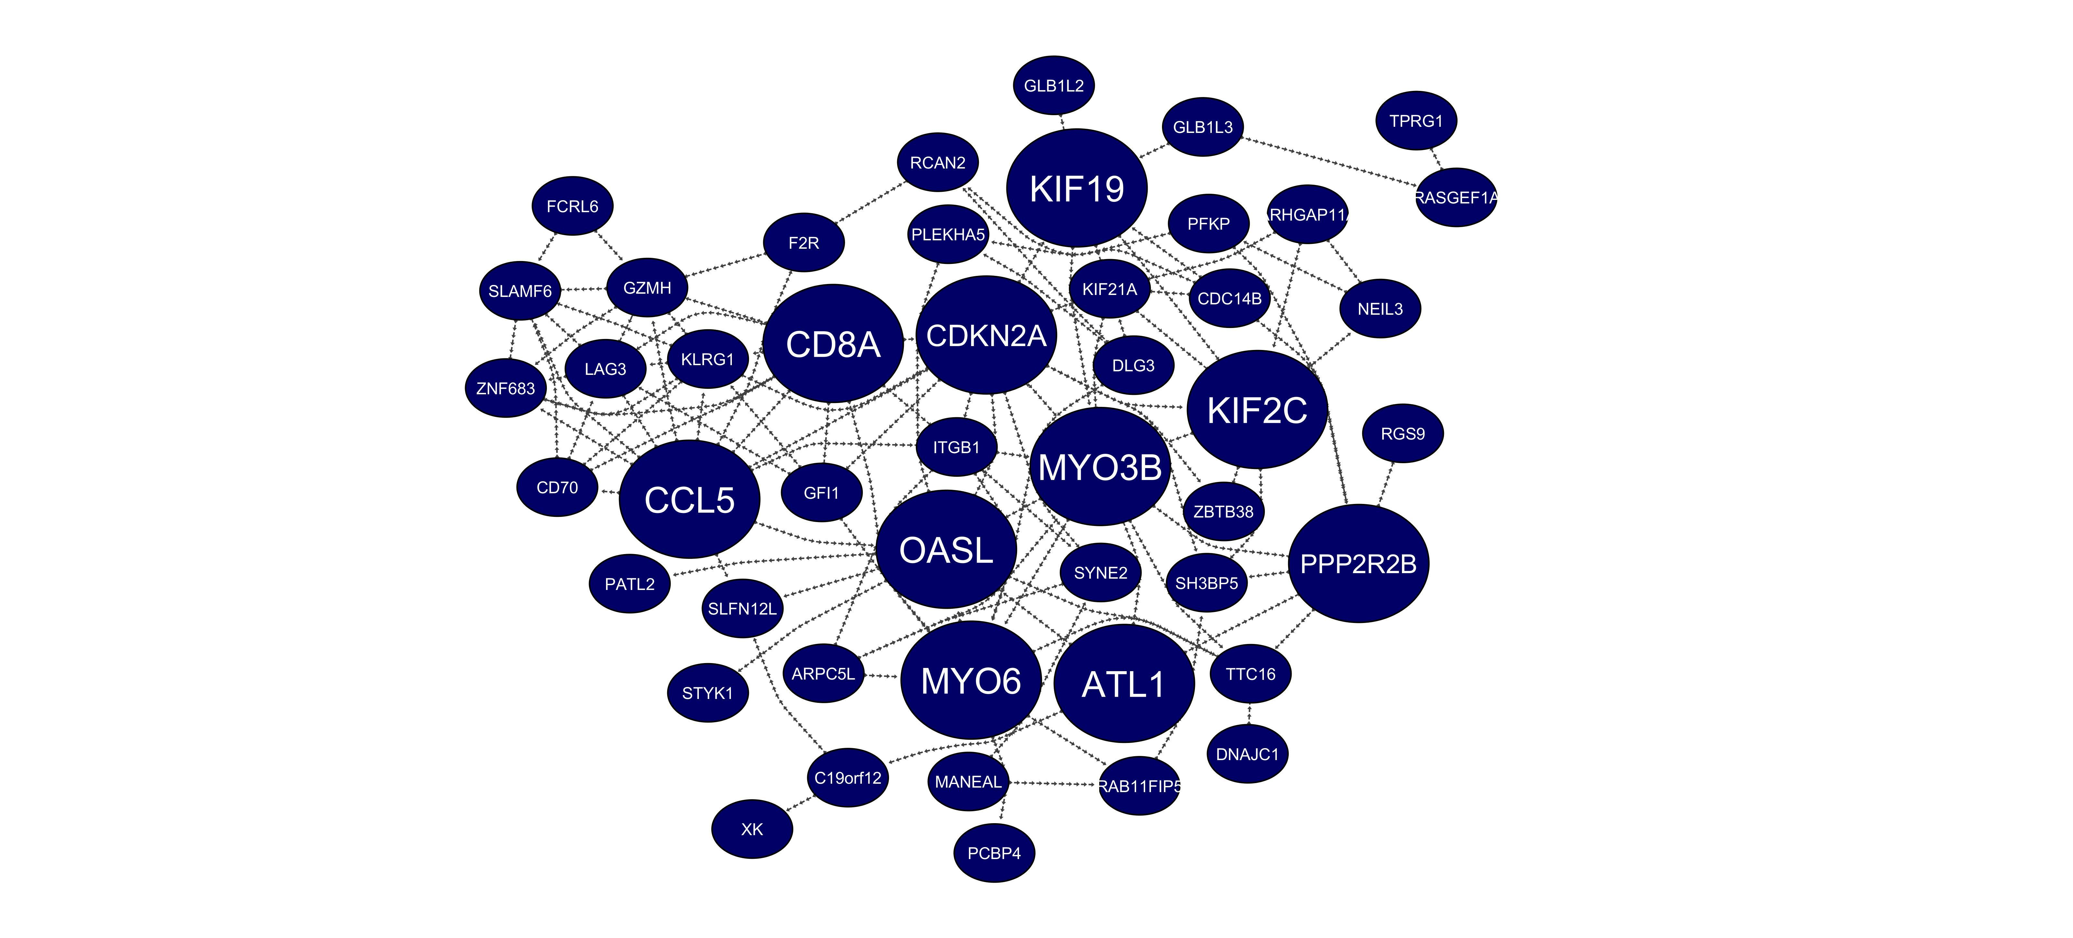
Supplementary Figure 1: PPI networks based on the hub genes of the nine candidate modules. Large circles and orange octagons represent hub-high traffic genes and TFs, respectively.
midnightblue module

Slide 7
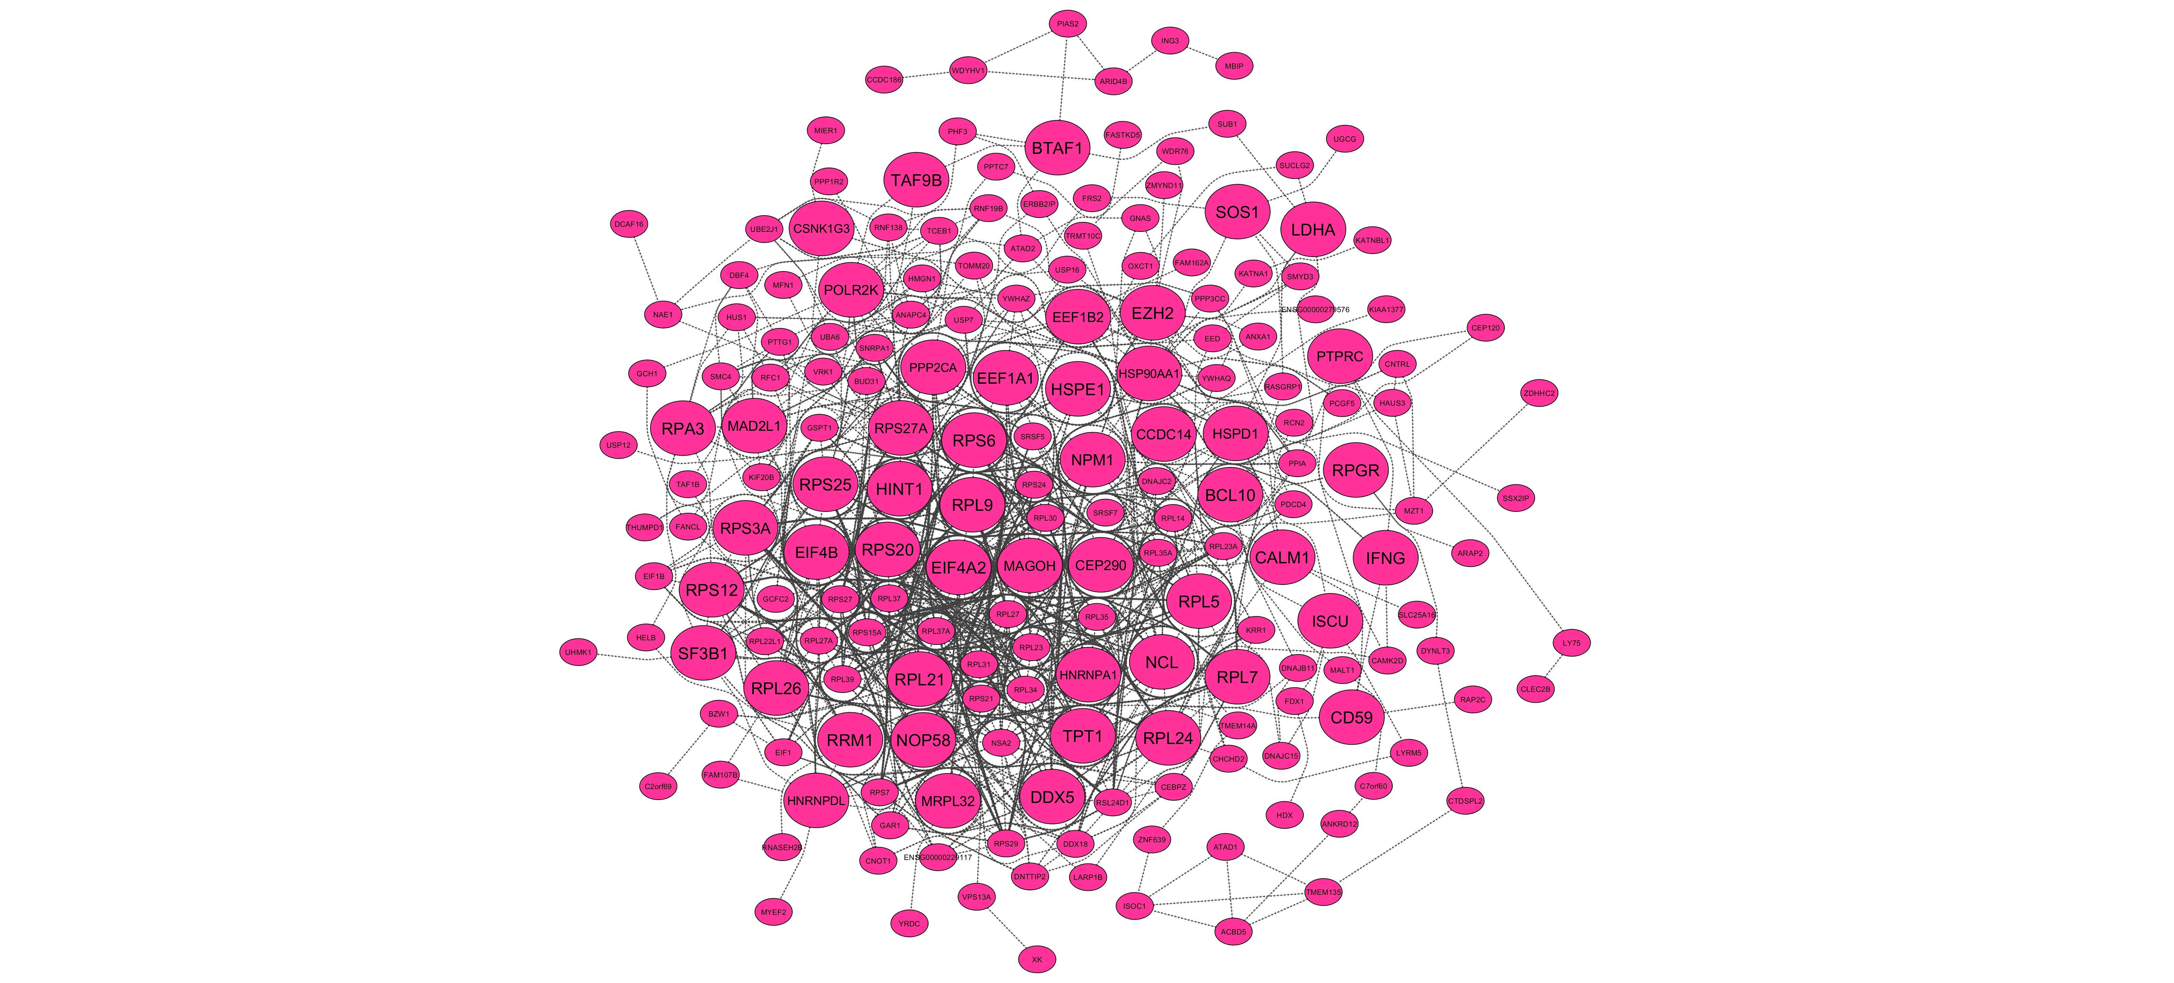
Supplementary Figure 1: PPI networks based on the hub genes of the nine candidate modules. Large circles and orange octagons represent hub-high traffic genes and TFs, respectively.
pink module

Slide 8
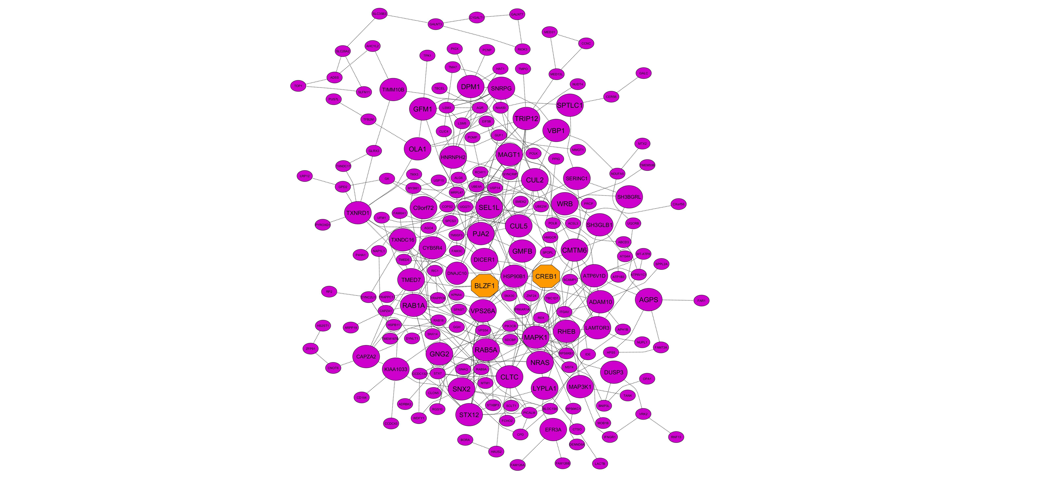
Supplementary Figure 1: PPI networks based on the hub genes of the nine candidate modules. Large circles and orange octagons represent hub-high traffic genes and TFs, respectively.
purple module

Slide 9
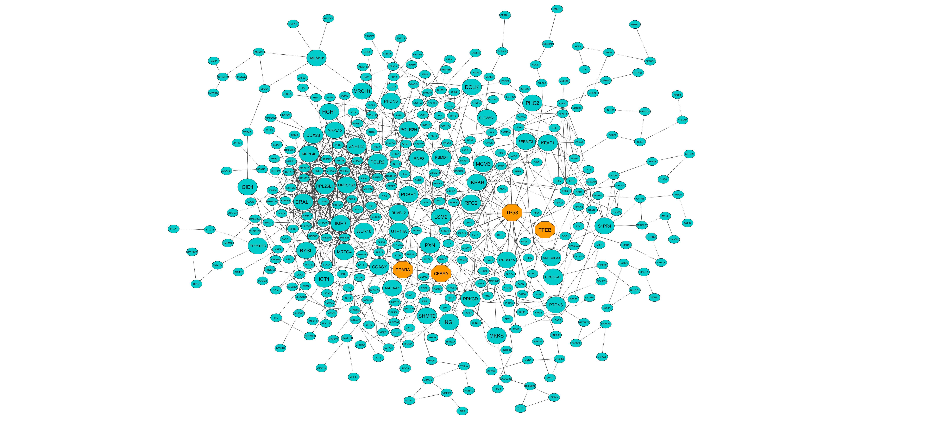
Supplementary Figure 1: PPI networks based on the hub genes of the nine candidate modules. Large circles and orange octagons represent hub-high traffic genes and TFs, respectively.
turquoise module

