Slide 1
Figure S1 Rarefaction curves (a). fungal community analysis using ITS primers (b). Arbuscular mycorrhizal fungus analysis using 18S RNA primers
(a)
(b)

Slide 2
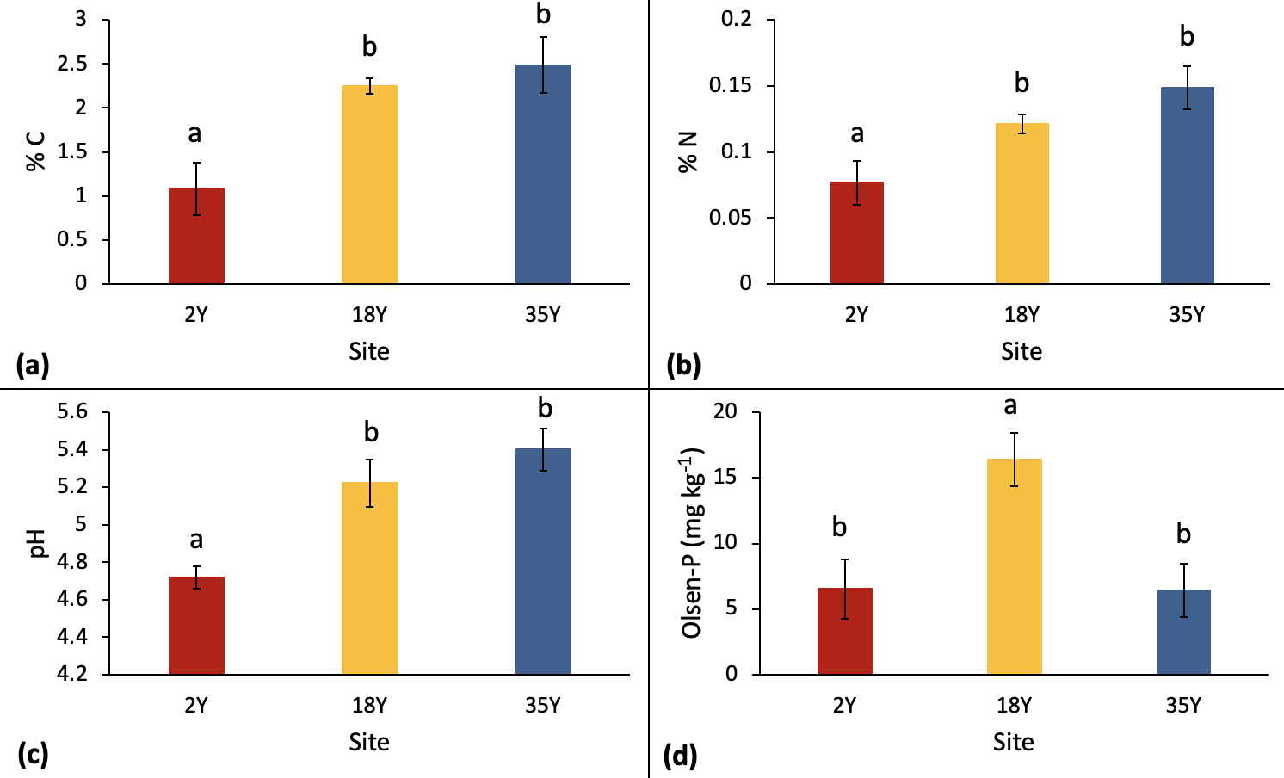
Figure S2. Soil characteristics in 2, 18 and 35 years old oil palm plantations a) total carbon, (b) total nitrogen, (c) pH and (d) Olsen-P. Bars with different letters are significantly different (P<0.05). Error bars represent +/- standard error of the mean

Slide 3
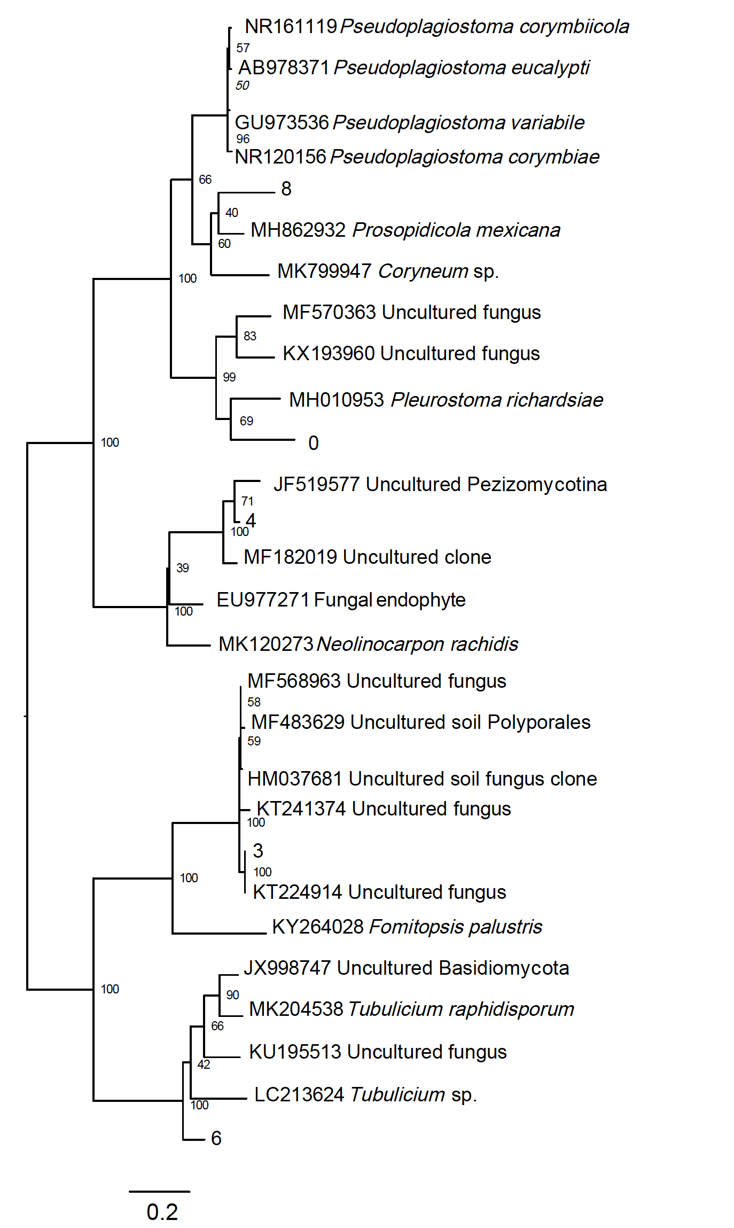
Figure S3. Phylogenetic analysis of fungus ITS gene sequences showing most closely related taxa
Notes:
OTU8 possible plant pathogen (funguild saprotroph)

Slide 4
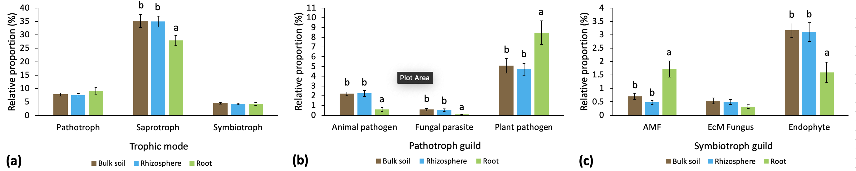
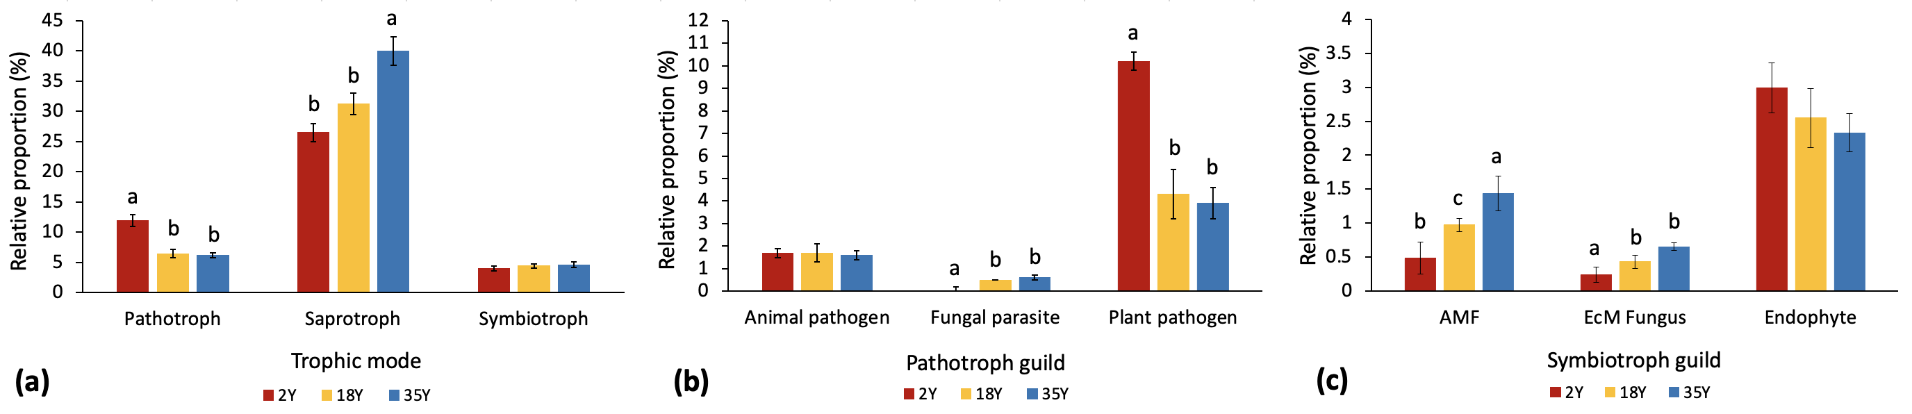
Figure S4. Fungal ecological guilds analysis. a. Guilds in bulk soil, rhizosphere soil and root compartments; i) tropic mode ii). pathotroph guilds and iii). symbiotroph guilds. Data is combined data across 2, 18 and 35 year old plantations. b. Guilds in 2, 18 and 35 year old plantations i). trophic mode ii).. pathotroph guilds iii) symbiotroph guilds. Data is combined across root, rhizosphere soil and bulk soil for each plantation. AMF: Arbuscular mycorrhizal fungus, EcM: Ectomycorrhizal fungus. Bars with different letters are significantly different (p<0.05). Error bars represent +/- standard error of the mean
a.
i)
ii)
iii)
b.
i)
ii)
iii)

Slide 5
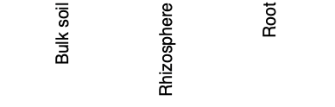
Fig S5. Relative abundance of a. Arbuscular mycorrhizal fungal sequences and B. Plant pathogen sequences in i). 2 year old plantation ii). 18 year old plantation iii). 35 year old plantation. Data includes only OTU annotated as highly probable and probable. Bars with different letters are significantly different (p<0.05).
a.
i). 2Y
ii). 18Y
iii). 35Y
b
b
b
ab
a
ab
a
a
a
b.
i). 2Y
ii). 18Y
iii). 35Y
b
a
a
Notes:
A AM fungi B Plant pathogens
Bars are SE of the mean
Different letters for each site mean sig different.

Slide 6
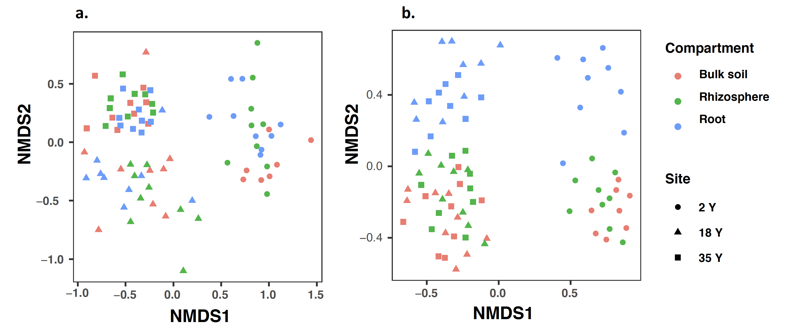
Figure S6. Non metric multidimensional scaling analysis of Bray Curtis dissimilarity of a. arbuscular mycorrhizal fungus and b. plant pathogen communities in bulk soil, rhizosphere soil and roots of 2, 18 and 35 year old oil palm plantations. Data includes only OTU annotated as highly probable and probable AMF or plant pathogens.
Bulk soil
Rhizosphere
Root
2Y
18 Y
35 Y
Stress= 0.169
Stress= 0.144

Slide 7
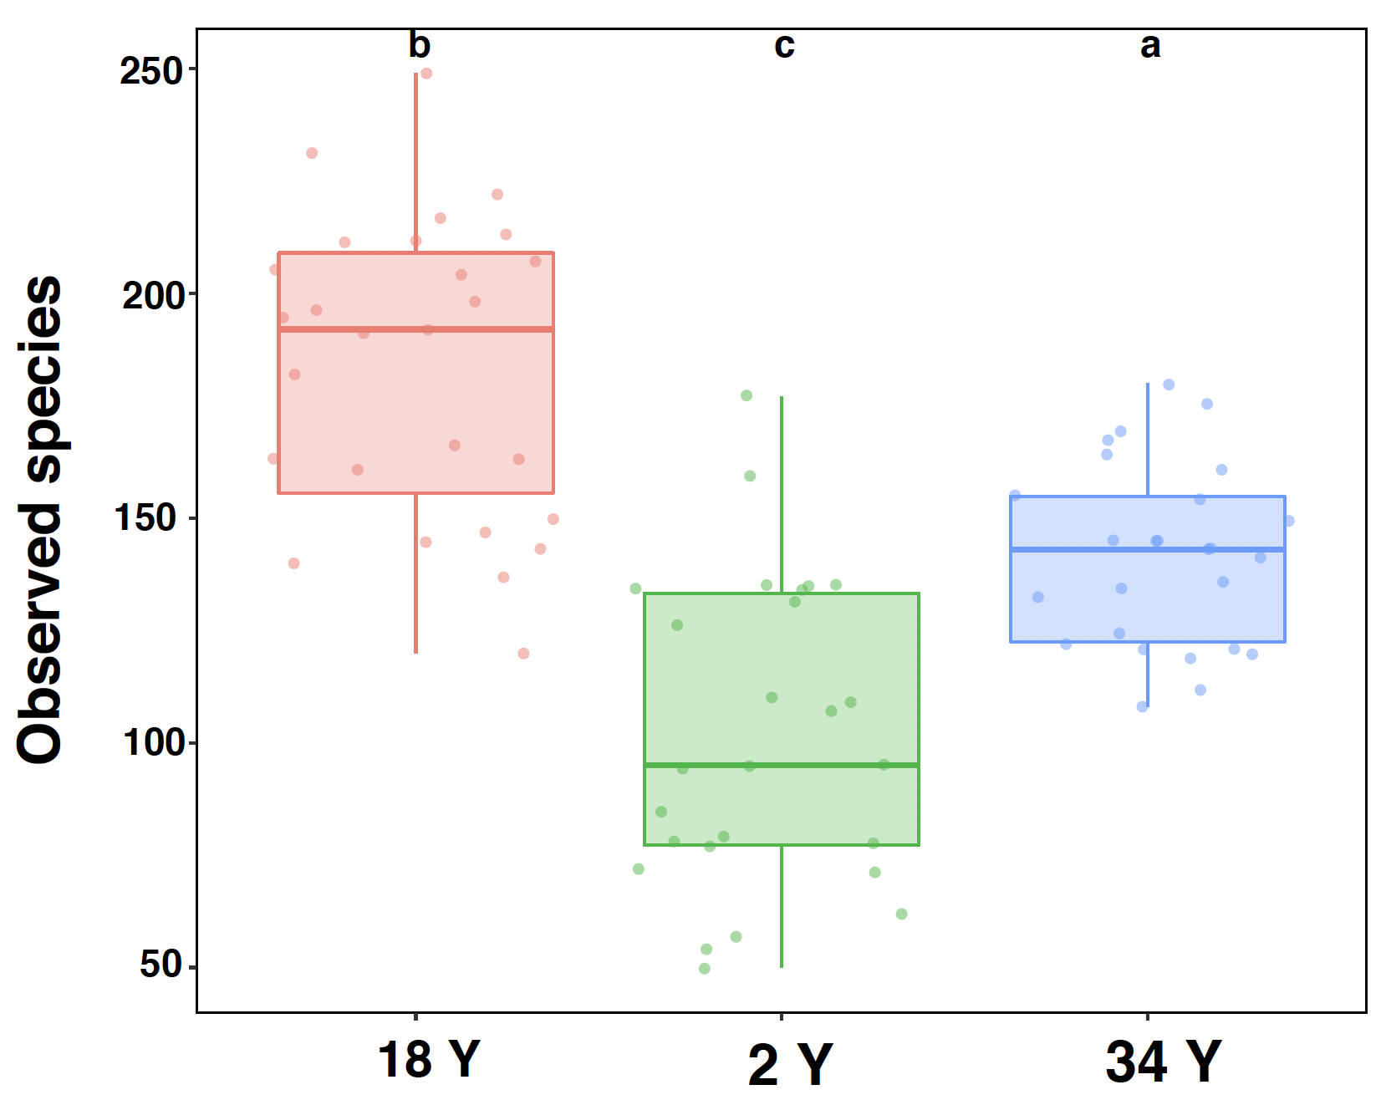
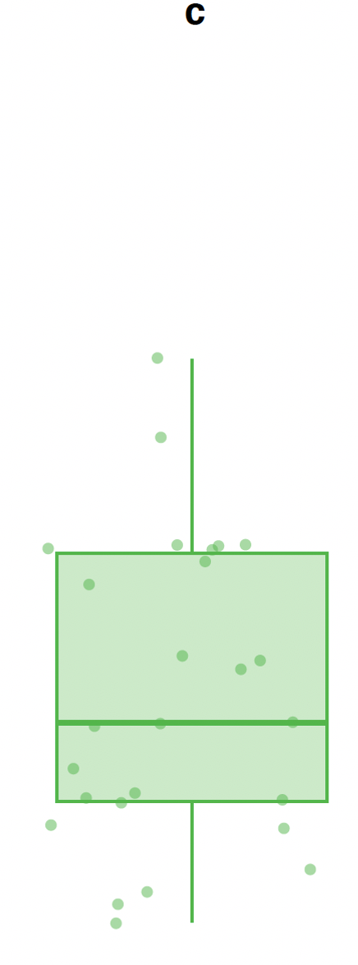
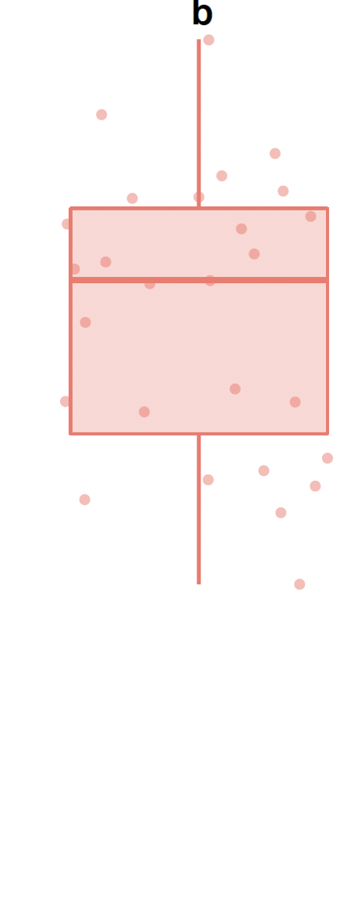
Figure S7. Arbuscular mycorrhizal fungus community alpha diversity in 2, 18 and 35 year old plantations. Compartments within each plantation are combined. Bars with different letters are significantly different (p<0.05). Error bars represent the minimum and maximum values, excluding outliers.
2 Y
18 Y
34 Y

