Slide 1
Figure 1. Weather parameters for duration of cultivation from November to April for two years

Slide 2
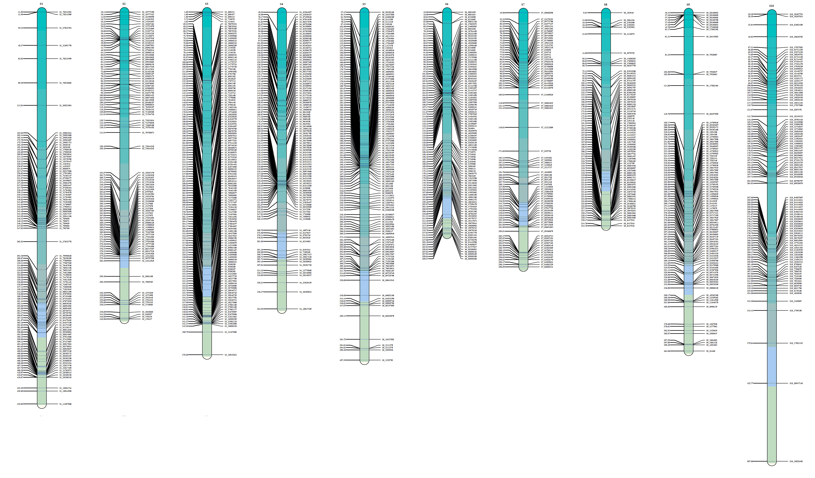
Figure 2: Linkage map for every one-dimensional scanning position from Inclusive Composite Interval Mapping (IC)

Slide 3
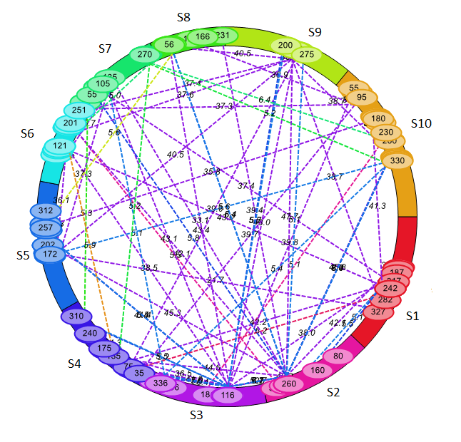
Figure 3: The epistatic QTLs for dry biomass weight and digestibility trait studied in ICSV1× ICSV700 RIL population.
PH_C
FW_C
NDM_C
ADF_C
ADL_C
ME_C
FW_S
DW_S
GW_S
ADF_S
ME_S

