Slide 1
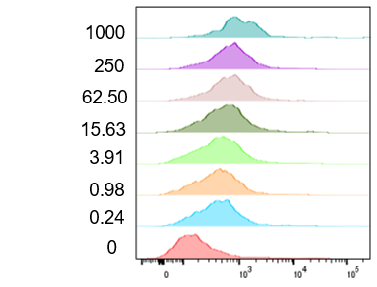
Supplementary Figure 1: Graphical depiction of antigen surface expression in HeLa [A*02(-)MSLN(-)] cells. (A) Flow cytometry data depicting constant amounts of A*02 mRNA used for activation dose-response 2D titration. Titrated MSLN mRNA amounts are shown on the left. (B) Standard curves showing MSLN molecules/cell resulting from MSLN mRNA titration with different constant A*02 mRNA amounts (left). Graph depicting effect of MSLN mRNA titration on constant amounts of A*02 mRNA expression (right). (C) Flow cytometry data depicting constant amounts of MSLN mRNA used for inhibition dose-response 2D titration. Titrated A*02 mRNA amounts are shown on the left. (D) Standard curves showing MSLN molecules/cell resulting from A*02 mRNA titration with different constant MSLN mRNA amounts (left). Graph depicting effect of A*02 mRNA titration on constant amounts of MSLN mRNA expression (right). (E) MSLN activator and A*02 blocker expression in transduced Jurkat cells.
A.
0 ng A*02 mRNA (constant)
2.5 ng A*02 mRNA (constant)
50 ng A*02 mRNA (constant)
1000 ng A*02 mRNA (constant)
MSLN mRNA (ng)
HeLa target
A-Ag
B-Ag
Activator
Blocker
A*02 protein (MFI)
A*02 protein (MFI)
A*02 protein (MFI)
A*02 protein (MFI)
Molecules vs. mRNA
MSLN mRNA effect on A*02 protein
B.
MSLN mRNA vs. protein
MSLN mRNA (ng)
MSLN mRNA (ng)
C.
A*02 mRNA (ng)
2 ng MSLN mRNA (constant)
10 ng MSLN mRNA (constant)
50 ng MSLN mRNA (constant)
250 ng MSLN mRNA (constant)
HeLa target
A-Ag
B-Ag
Activator
Blocker
MSLN protein (MFI)
MSLN protein (MFI)
MSLN protein (MFI)
MSLN protein (MFI)
D.
A*02 mRNA vs. protein
A*02 mRNA effect on MSLN protein
A*02 molecules/cell
MSLN molecules/cell
A*02 mRNA (ng)
A*02 mRNA (ng)
E.
MSLN Activator
A*02 Blocker
UTD
MSLN Activator
MSLN Activator/A*02 Blocker

Slide 2
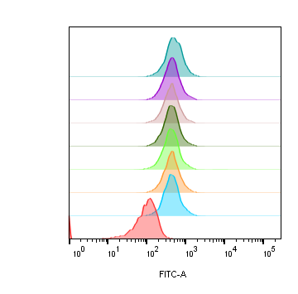
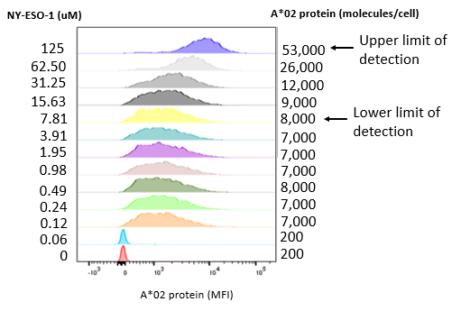
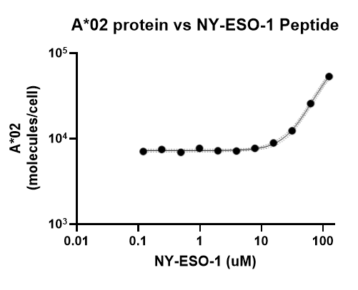
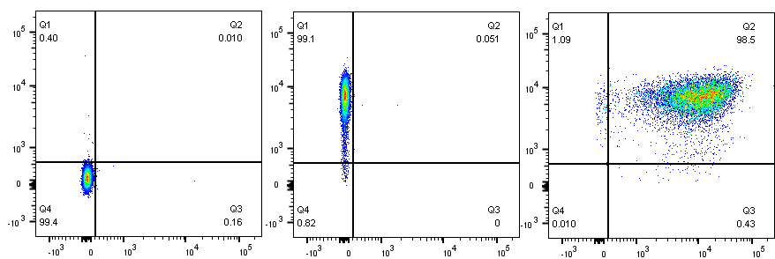
Supplementary Figure 2: Graphical depiction of A*02 surface expression in T2 A*11 cells . (A) Effect of KRAS peptide titration on constant A*02 mRNA expression. Titrated KRAS peptide is shown on the left, and A*02 molecules/cell is shown on the right. (B) Stabilizing effect of NY-ESO-1 peptide on A*02 surface expression. NY-ESO-1 peptide concentration is shown on the left, and A*02 molecules/cell is shown on the right. Standard curve showing A*02 surface expression vs. NY-ESO-1 peptide concentration is shown on the far right. (C) Standard curve showing A*02 molecules/cell resulting from A*02 mRNA titration in T2 A*11 cells. (D) KRAS TCR activator and A*02 blocker expression in transduced Jurkat cells.
A.
KRAS peptide (uM)
A*02 protein (molecules/cell)
B.
100
14,000
11
12,000
A-Ag
B-Ag
1.2
11,000
0.14
12,000
T2 cell
0.015
11,000
0.0051
12,000
0
12,000
0
2,000
A*02 protein (MFI)
C.
D.
A-Ag
B-Ag
T2 cell
A*02 molecules/cell
KRAS Activator
Activator
Blocker
UTD
KRAS Activator
KRAS Activator/A*02 Blocker
A*02 mRNA (ng)
A*02 Blocker

Slide 3
Supplementary Figure 3: Two-dimensional target Ag (MSLN and A*02) mRNA titration in HeLa [A*02(-)MSLN(-)] GFP target cells with primary T effector cells (Donor 2). See Figure 4 for target cell staining/expression data; see Supplementary Figure 4 for primary T effector cell receptor expression data. Dose-response of MSLN and A*02 target Ag variation with constant activator/blocker ratio on primary T effector cells. (A) IFNγ release of primary T effector cells co-cultured for 12 hours with HeLa target cells. Target cells have titrated MSLN A-Ag with varying A*02 B-Ag levels held constant (EC50 and Emax vs B-Ag levels). Fold-change is calculated by normalizing to the lowest B-Ag value. Red point is treated as an outlier due to inaccurate curve-fitting. (B) IFNγ release of primary T effector cells co-cultured for 12 hours with HeLa target cells. Target cells have titrated A*02 B-Ag with varying MSLN A-Ag levels held constant (IC50 and Imax vs. A-Ag levels). Purple and green points are treated as outliers due to inaccurate curve-fitting. (C) Acute killing data after 12 hours of co-culture. Fold-change is calculated by normalizing to the lowest A-Ag value. Dashed lines are meant to convey trends and are not fit mathematically. * p<0.05, ** p < 0.01, *** p < 0.001, **** p < 0.0001, n = 2
A.
EC50
Span of activation: Emax - Emin
Activation dose-response
HeLa target
A-Ag
B-Ag
Primary T effector
Fold-change
Fold-change
Activator
Blocker
MSLN mRNA (ng)
A*02 (molecules/cell)
A*02 (molecules/cell)
IC50
Span of blocking: Imin - Imax
B.
Inhibition dose-response
HeLa target
A-Ag
B-Ag
Fold-change
Primary T effector
Fold-change
Activator
Blocker
A*02 mRNA (ng)
C.
MSLN (molecules/cell)
MSLN (molecules/cell)
Activation dose-response
Inhibition dose-response

Slide 4
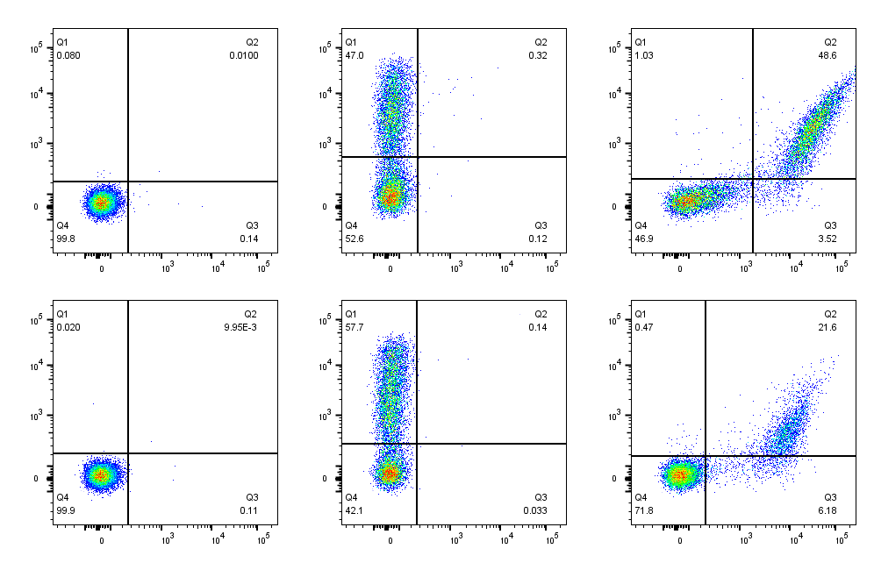
Supplementary Figure 4: MSLN CAR and A*02 blocker expression in transduced primary T cells (Donors 1 & 2).
UTD
MSLN Activator
MSLN Activator/A*02 Blocker
Donor 1
Donor 2
MSLN Activator
A*02 Blocker

Slide 5
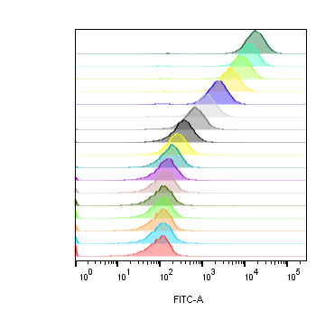
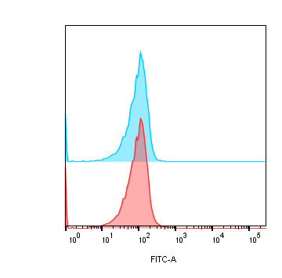
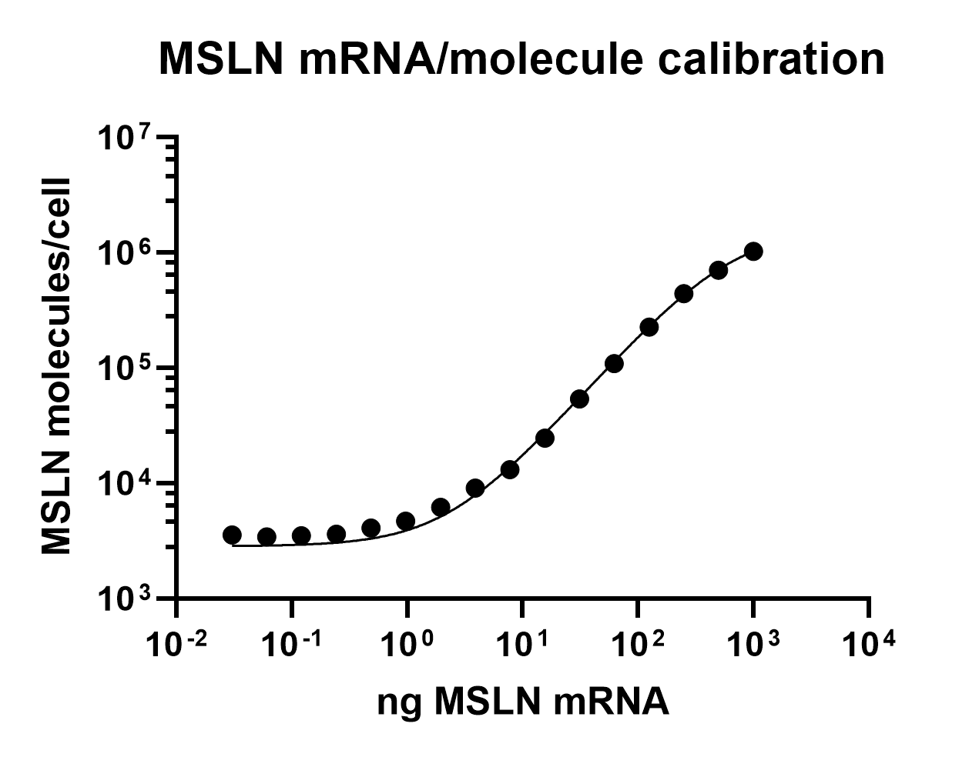
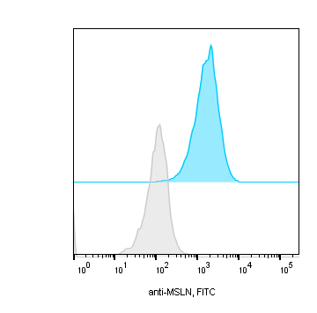
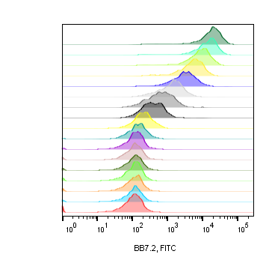
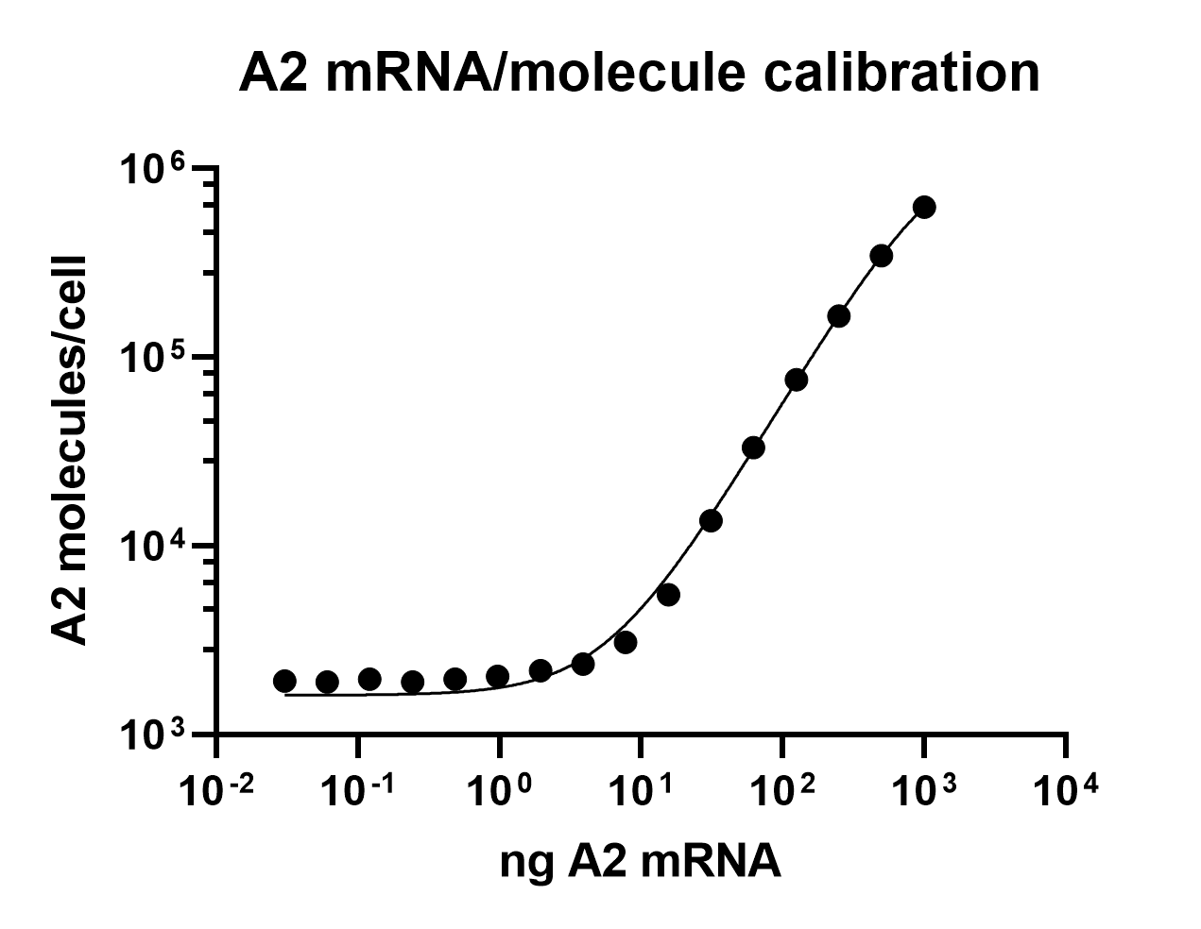
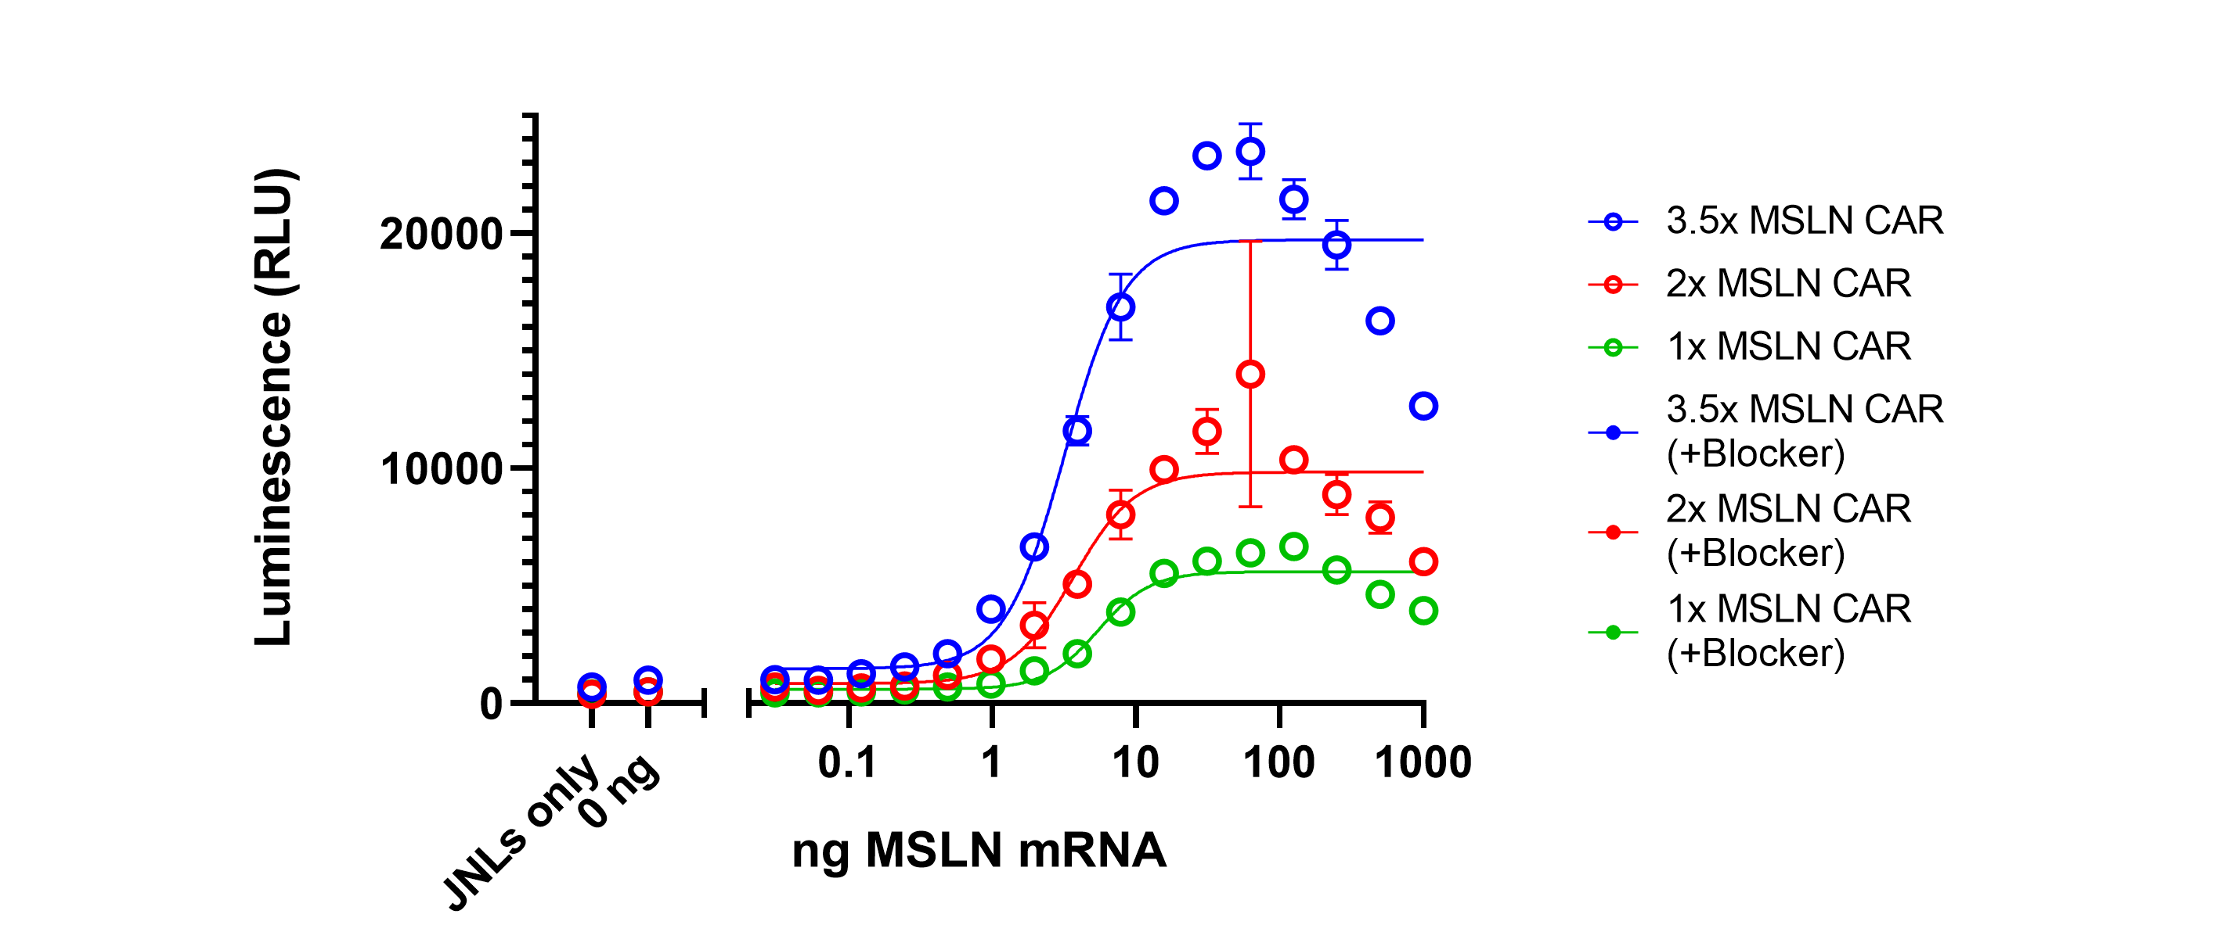
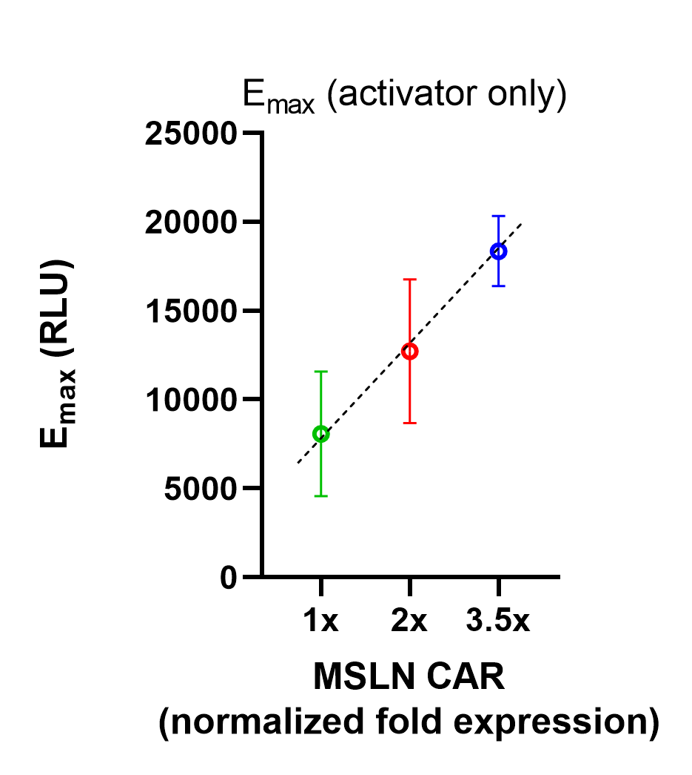
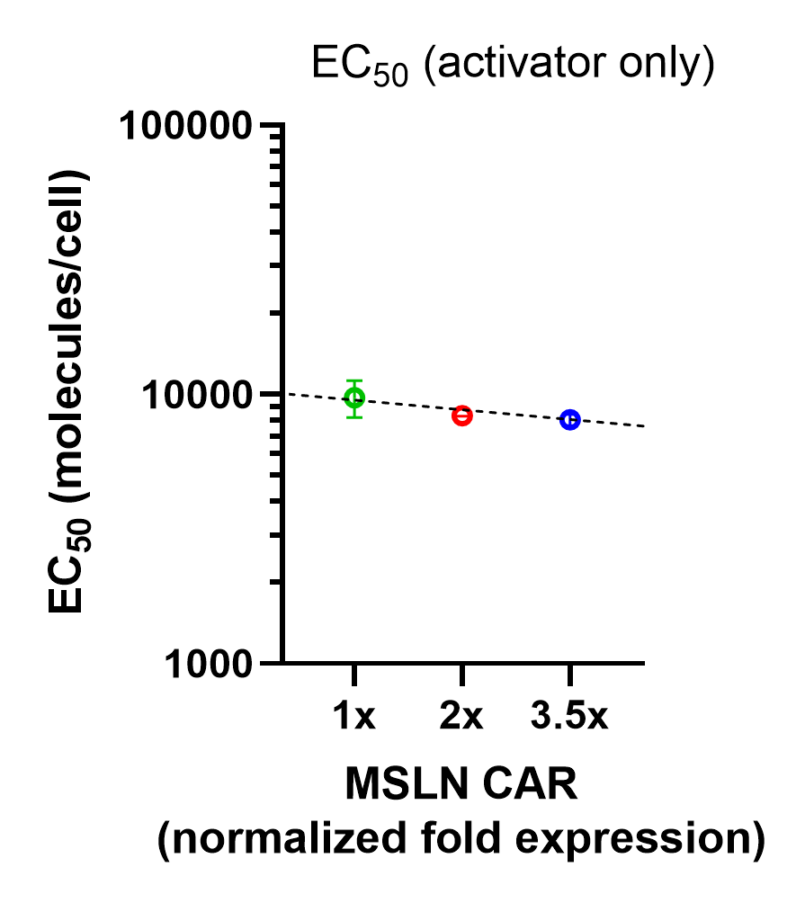
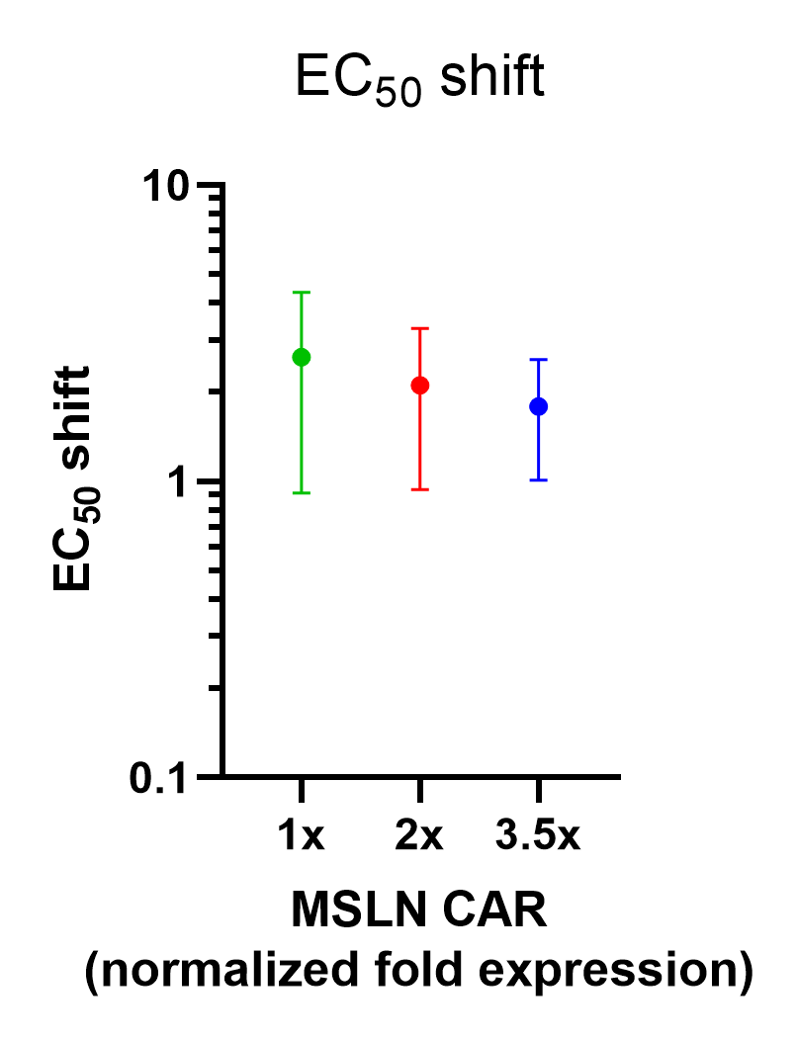
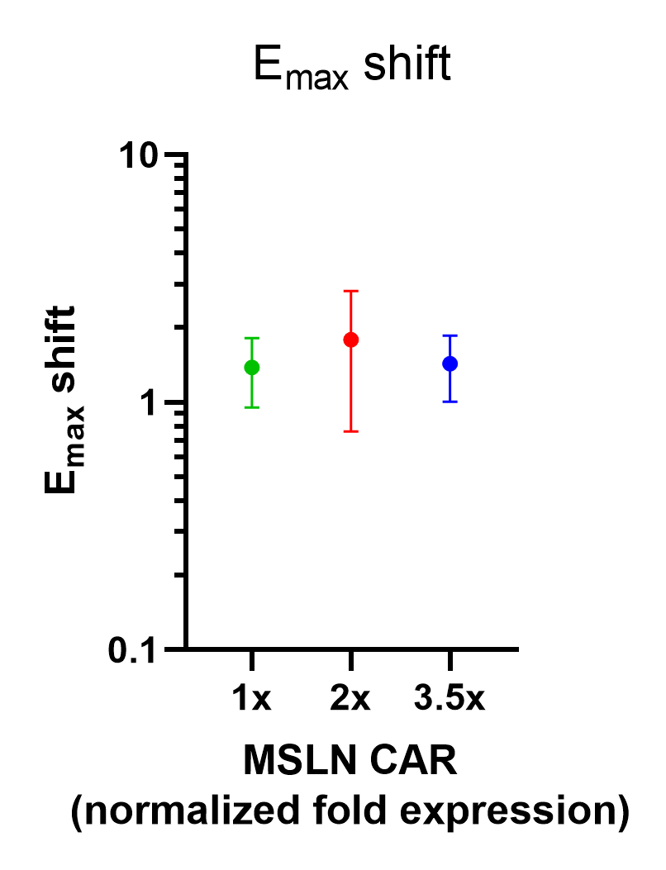
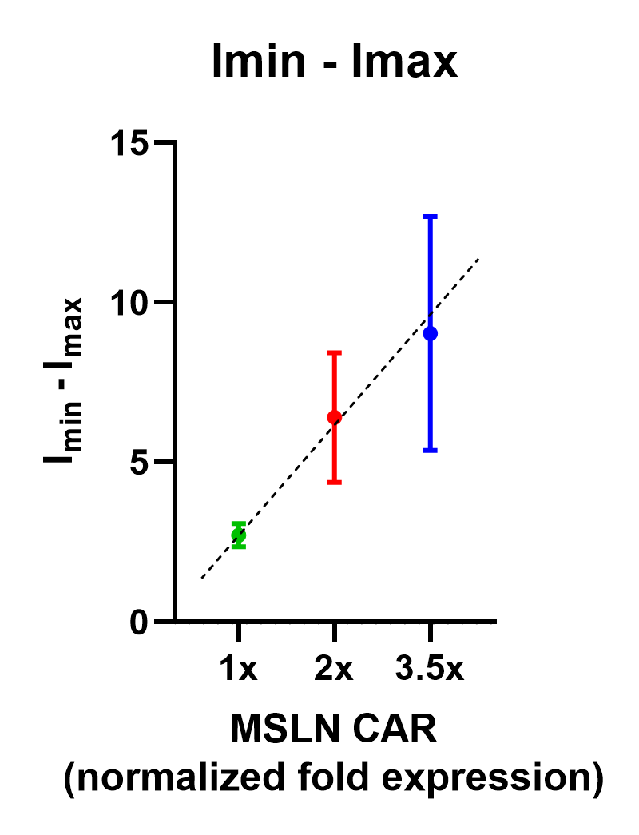
Supplementary Figure 5: Target A- and B-Ag staining for receptor mRNA experiments (MSLN). (A) Titrated MSLN mRNA and constant A*02 mRNA surface expression in HeLa [A*02(-)MSLN(-)] target cells. Standard curve showing MSLN molecules/cell resulting from MSLN mRNA titration with constant A*02 mRNA (far right). (B) Titrated A*02 mRNA and constant endogenous MSLN surface expression in HeLa WT target cells. Standard curve showing A*02 molecules/cell resulting from A*02 mRNA titration (far right). (C) Activator only data, raw data (not normalized). Activation dose-response curves showing activation of Jurkat cells with differing amounts of MSLN activator and no blocker (left). The decrease in activation at the highest amounts of MSLN is due to cell death induced by high mRNA concentrations. Graphical representation of EC50 and Emax values for activator-only Jurkat cells on the left (right). (D) Graphical depiction of non-normalized EC50 shift, Emax shift, and Imin-Imax values for Jurkat cells with different MSLN activator:A*02 blocker ratios. Dashed lines are meant to convey trends and are not fit mathematically.
A.
MSLN mRNA (ng)
MSLN protein (molecules/cell)
A*02 mRNA (ng)
A*02 protein (molecules/cell)
MSLN mRNA vs. protein
1000
>1,000,000
A-Ag
B-Ag
500
700,000
2
2,970
250
450,000
Hela MSLN KO
125
226,000
0
2,920
62.5
110,000
MSLN molecules/cell
31.25
54,000
15.625
25,000
A*02 protein (MFI)
7.813
13,000
Activator
Blocker
3.906
9,100
1.953
6,200
0.977
4,700
0.488
4,100
0.244
3,600
0.122
3,500
MSLN mRNA (ng)
0.061
3,400
0.031
3,600
0
3,000
B.
MSLN protein (MFI)
HeLa WT
MSLN protein (molecules/cell)
A*02 mRNA (ng)
A*02 protein (molecules/cell)
A*02 mRNA vs. protein
1000
770,000
50,000
500
560,000
250
310,000
blank
1,900
125
160,000
62.5
93,000
MSLN protein (MFI)
31.25
35,000
A*02 molecules/cell
15.625
16,000
A-Ag
B-Ag
7.813
9,300
3.906
4,400
1.953
2,800
Hela WT
0.977
2,200
0.488
2,100
0.244
2,100
0.122
2,000
A*02 mRNA (ng)
Activator
Blocker
0.061
2,000
0.031
2,000
0
1,900
C.
A*02 protein (MFI)
D.
Notes:
Figure 1. (a) The ratio of activator to blocker receptors (A:B) in Jurkat NFAT-luciferase (JNL) effector cells was varied by using decreasing amounts of activator mRNA. The amount of mRNA shown was used per 1.5e6 JNLs. Corresponding changes in receptor expression levels were verified using flow cytometric staining for activator- and blocker-antigen tetramer probes (representative data shown). (b) Target cells with either a constant endogenous expression of activator antigen (A-antigen) or constant exogenous A-antigen (introduced via mRNA transfection or peptide-loading) were transfected with titrated amount of blocker antigen (B-antigen) mRNA. The effect of A:B receptor ratios on blocker sensitivity, or IC50 (measured via NFAT-luciferase luminescence), was then determined. (c) Target cells were transfected or loaded with a titrated amount of A-antigen and a constant amount of B-antigen (corresponding to the IC50 in part (b).

Slide 6
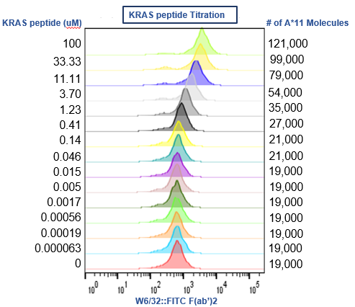
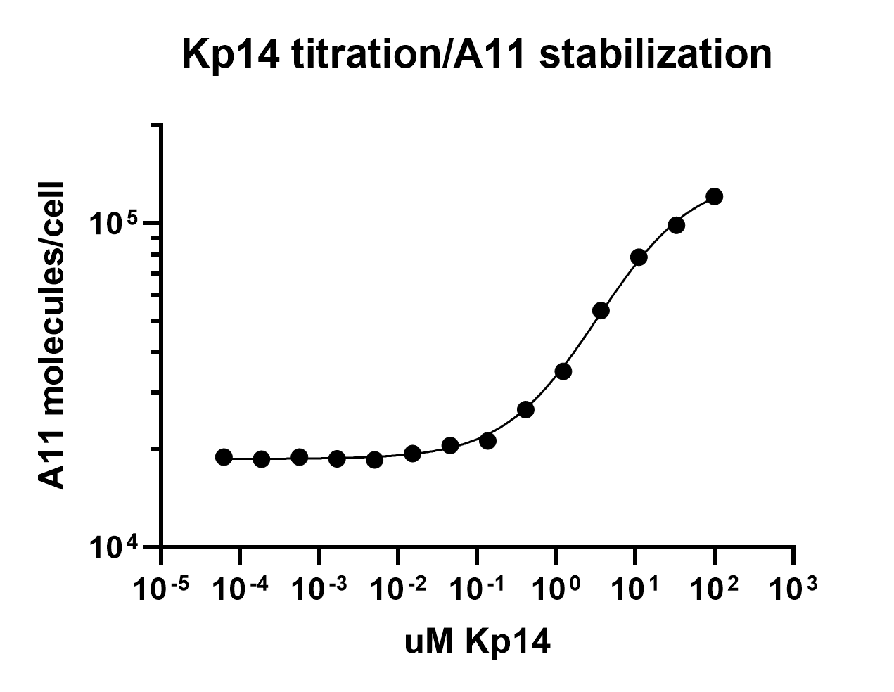
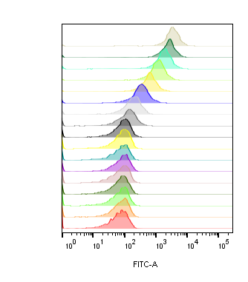
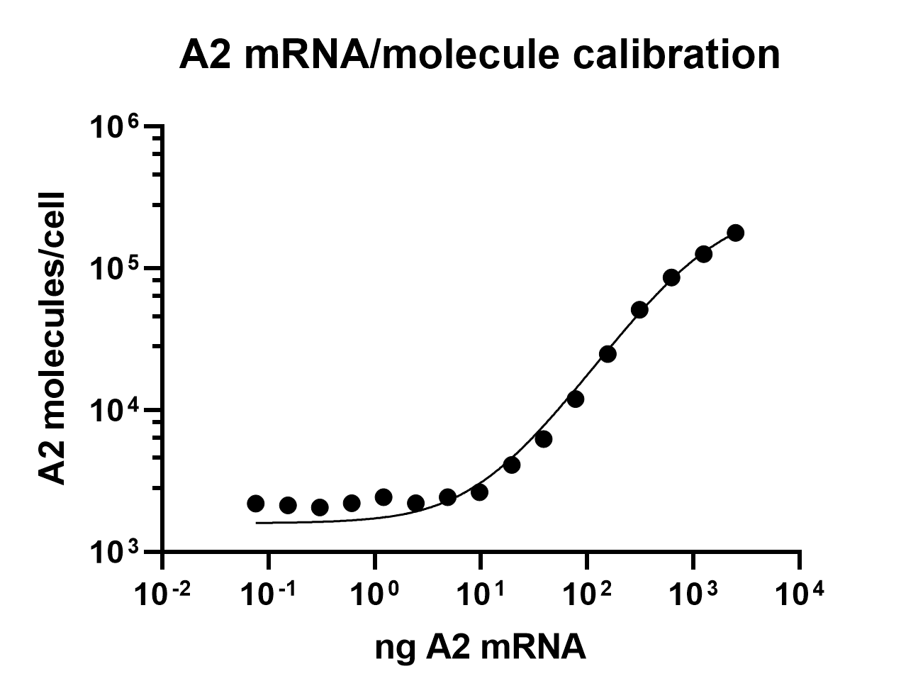
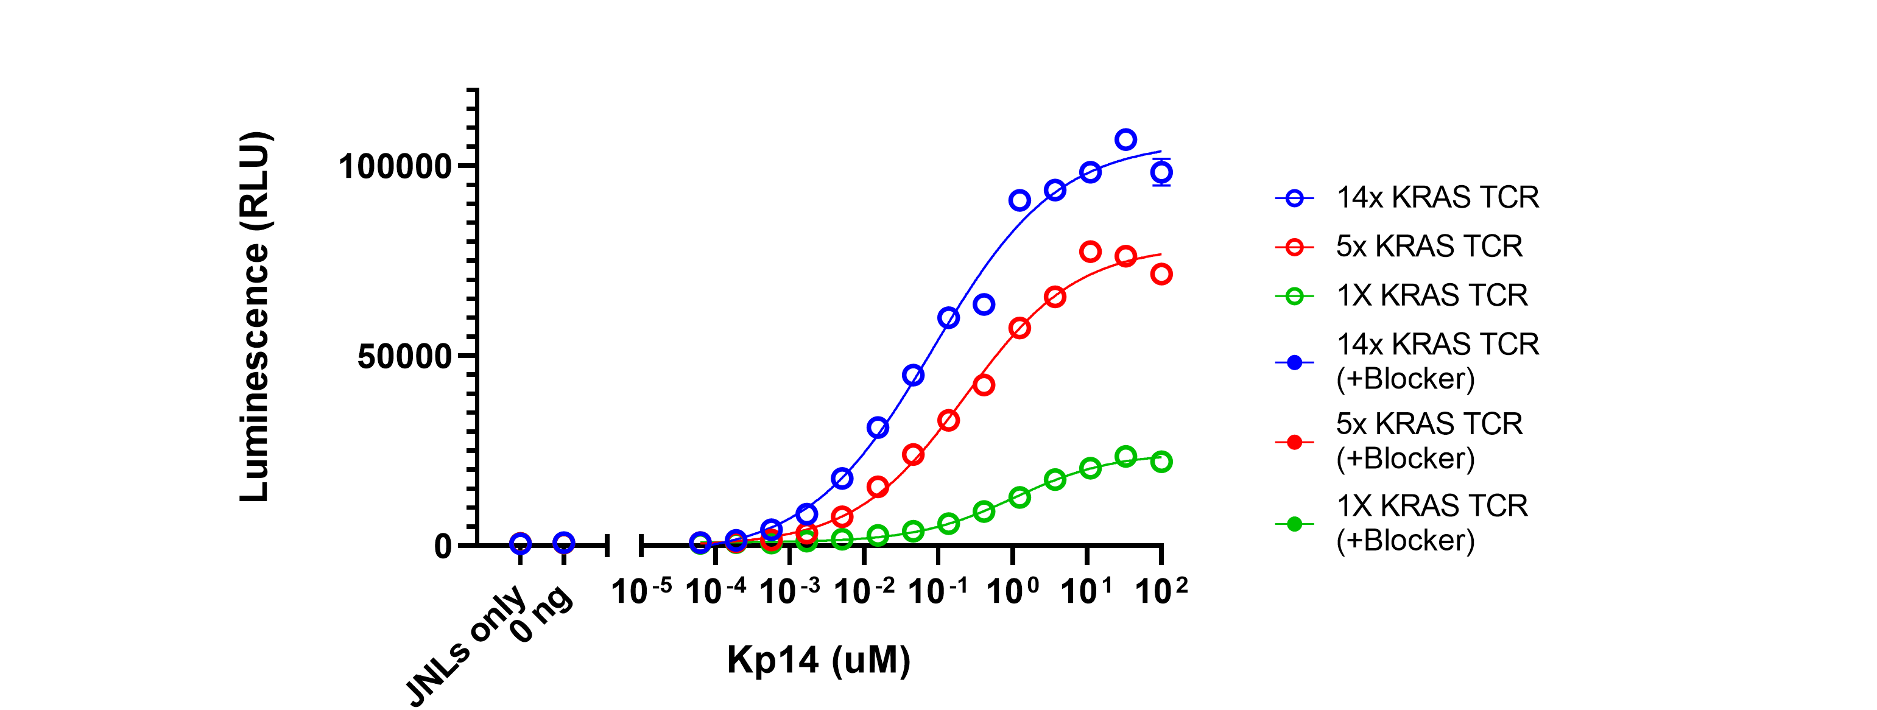
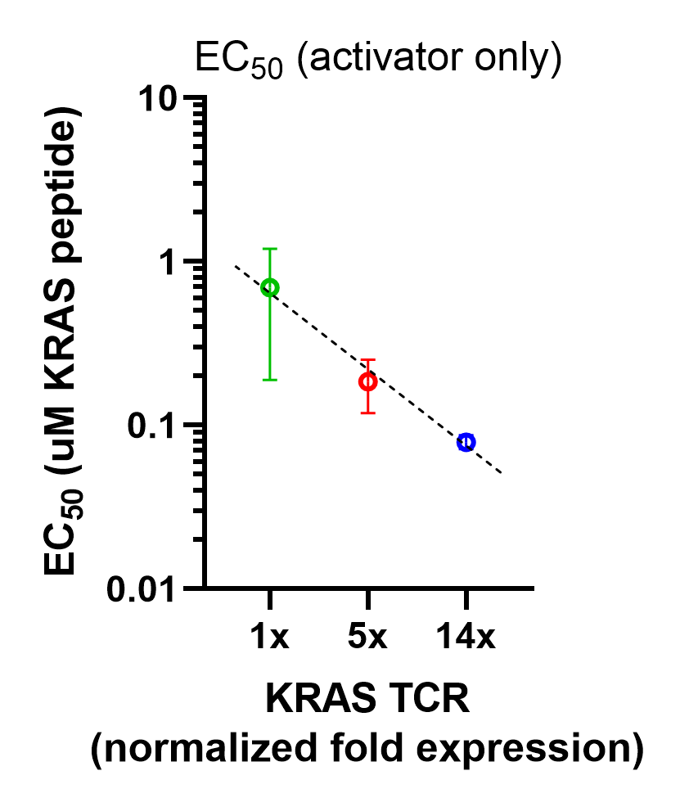
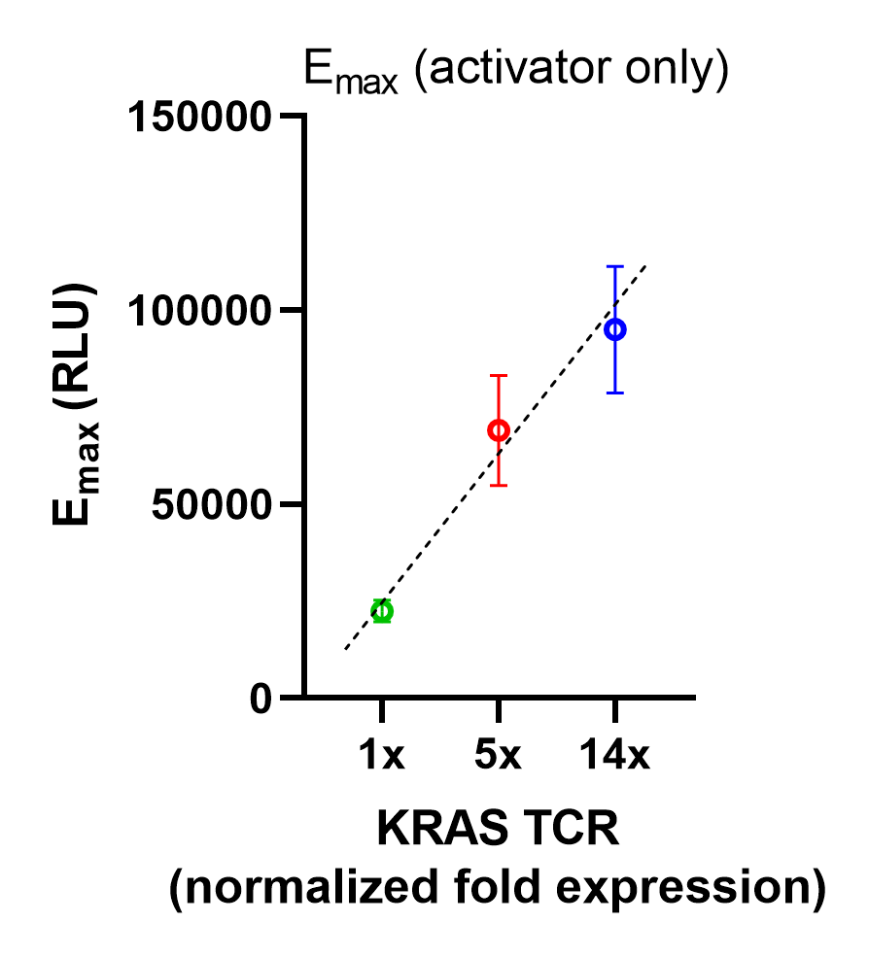
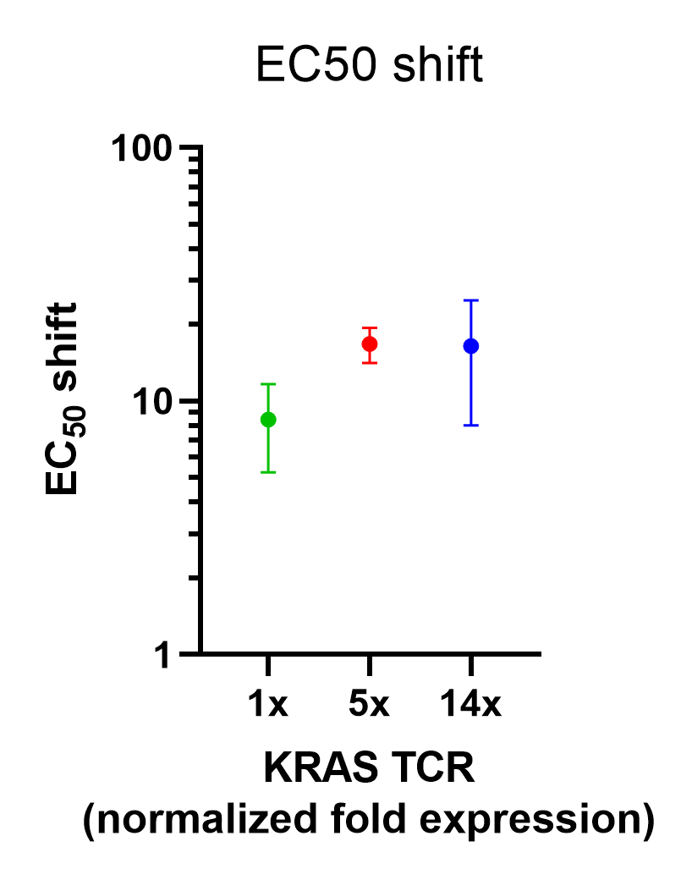
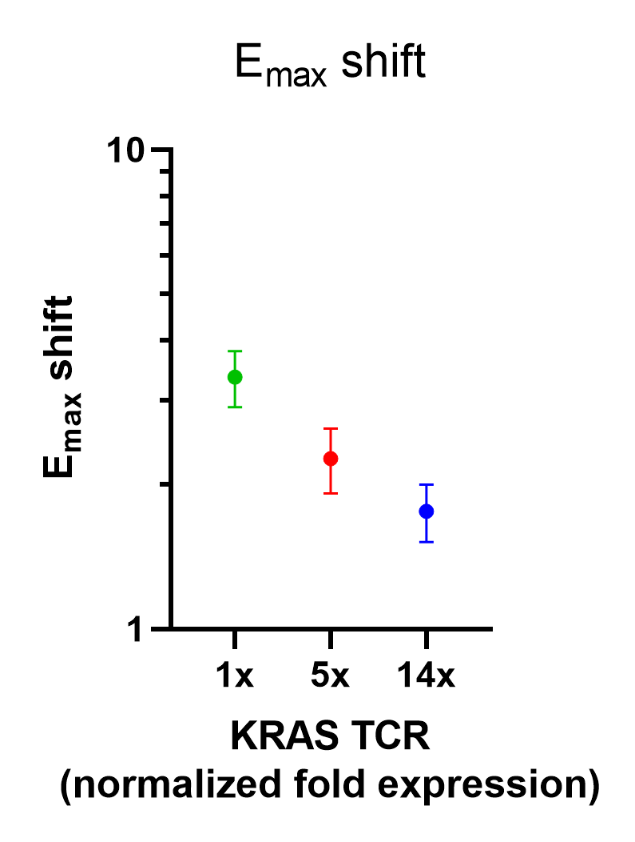
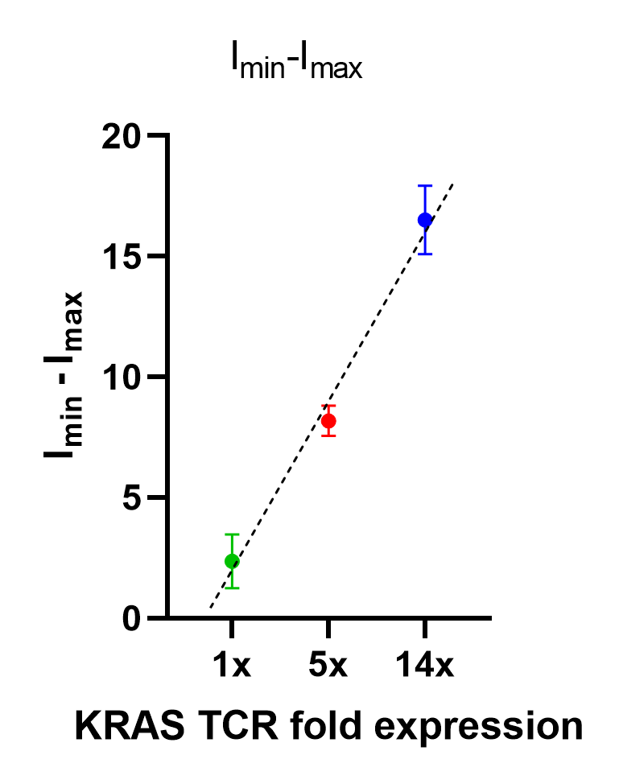
Supplementary Figure 6. T2 A*11 A- and B-Ag staining for receptor mRNA experiments (KRAS). (A) Stabilization of A*11 protein with KRAS peptide titration – evidence of successful peptide loading (left). Standard curve depicting the effect of increasing KRAS peptide concentration on A*11 surface expression (middle). Effect of KRAS peptide titration on constant A*02 mRNA (200 ng) surface expression (right). (B) Titrated A*02 mRNA surface expression with constant KRAS peptide (20 nM). Standard curve depicting A*02 molecules/cell resulting from A*02 mRNA titration in T2 A*11 target cells (right). (C) Activator-only and raw data (not normalized) for KRAS TCR Tmod. Activation dose-response curves showing activation of Jurkat cells with differing amounts of KRAS activator and no blocker (left). Graphical representation of EC50 and Emax values for activator-only Jurkat cells on the left (right). (D) Graphical depiction of non-normalized EC50 shift, Emax shift, and Imin-Imax values for Jurkat cells with different KRAS activator:A*02 blocker ratios. Dashed lines are meant to convey trends and are not fit mathematically.
A.
KRAS peptide (uM)
A*11 pMHC (molecules/cell)
KRAS peptide vs. A*11 protein
KRAS peptide (uM)
A*02 protein (molecules/cell)
T2 A*11 cell
A-Ag
B-Ag
100
14,000
A*11 molecules/cell
11
12,000
1.2
11,000
Activator
Blocker
0.14
12,000
Lower limit
of detection
0.015
11,000
0.0051
12,000
0
12,000
KRAS peptide (uM)
0
2,000
A*11 protein (MFI)
A*02 protein (MFI)
B.
A*02 mRNA (ng)
A*02 protein (molecules/cell)
A*02 mRNA vs. protein
2500
180,000
1250
126,000
625
86,000
312.5
51,000
156.25
25,000
A*02 molecules/cell
78.125
12,000
A-Ag
B-Ag
39.063
6,200
19.531
4,100
T2 A*11 cell
9.766
2,600
Lower limit
of detection
4.883
2,400
2.441
2,200
1.221
2,400
0.610
2,200
0.305
2,100
Activator
Blocker
0.153
2,100
A*02 mRNA (ng)
0.076
2,200
0
1,900
A*02 protein (MFI)
C.
KRAS peptide (uM)
D.
Notes:
Figure 1. (a) The ratio of activator to blocker receptors (A:B) in Jurkat NFAT-luciferase (JNL) effector cells was varied by using decreasing amounts of activator mRNA. The amount of mRNA shown was used per 1.5e6 JNLs. Corresponding changes in receptor expression levels were verified using flow cytometric staining for activator- and blocker-antigen tetramer probes (representative data shown). (b) Target cells with either a constant endogenous expression of activator antigen (A-antigen) or constant exogenous A-antigen (introduced via mRNA transfection or peptide-loading) were transfected with titrated amount of blocker antigen (B-antigen) mRNA. The effect of A:B receptor ratios on blocker sensitivity, or IC50 (measured via NFAT-luciferase luminescence), was then determined. (c) Target cells were transfected or loaded with a titrated amount of A-antigen and a constant amount of B-antigen (corresponding to the IC50 in part (b).

Slide 7
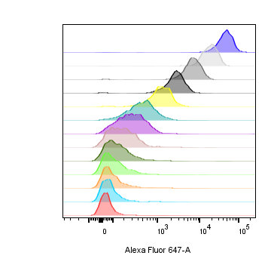
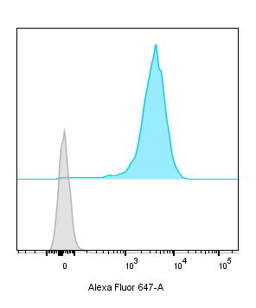
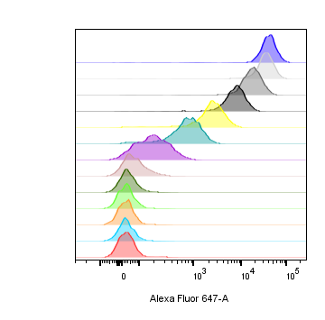
Supplementary Figure 7: Target A- and B-Ag staining for receptor mRNA experiments (MSLN, primary T cells). (A) Titrated MSLN mRNA and constant A*02 mRNA surface expression in HeLa MSLN knockout GFP target cells. Standard curve showing MSLN molecules/cell resulting from MSLN mRNA titration with constant A*02 mRNA (far right). (B) Titrated A*02 mRNA and constant endogenous MSLN surface expression in HeLa wild-type target cells with GFP. Standard curve showing A*02 molecules/cell resulting from A*02 mRNA titration (far right). Activator only data, raw data (not normalized) for Donor 1. (C) Activation dose-response curves showing killing of GFP-labeled target cells by primary T cells (Donor 1) with differing amounts of MSLN activator and no blocker (left). Graphical representation of EC50 and Emax values for activator-only primary T cells (right). (D) Graphical depiction of non-normalized EC50 shift, Emax shift, and Imin-Imax values for primary T cells with different MSLN activator:A*02 blocker ratios (Donor 1). Dashed lines are meant to convey trends and are not fit mathematically.
A.
MSLN mRNA (ng)
MSLN protein (molecules/cell)
A*02 mRNA (ng)
A*02 protein (molecules/cell)
MSLN mRNA vs. protein
A.
1000
A-Ag
B-Ag
333
431,000
Upper limit
of detection
Hela MSLN KO
111
127,000
50
58,000
37
39,000
0
170
12
15,000
Activator
Blocker
4.1
5,100
1.4
2,900
0.46
1,700
0.15
1,300
0.051
930
0.017
820
0.0056
510
0
340
B.
A*02 mRNA (ng)
A*02 protein (molecules/cell)
A*02 mRNA vs. protein
1000
860,000
Upper limit
of detection
333
585,000
111
196,000
37
53,000
12
11,000
A-Ag
B-Ag
4.1
1,900
1.4
360
Lower limit
of detection
Hela WT
0.46
170
0.15
180
0.051
170
0.017
180
Activator
Blocker
0.0056
180
0
213
C.
D.

Slide 8
Supplementary Figure 8: Cytotoxicity at different timepoints during co-culture (MSLN, Donor 1 primary T cells). (A) Activation dose-response curves for primary T cells with 1x (green), 2x (red), and 3x (blue) activator expression at different timepoints (6 hours, 18 hours, 24 hours) during co-culture with target cells. (B) Inhibition dose-response curves for primary T cells at different timepoints (6 hours, 18 hours, 24 hours) during co-culture with target cells.
6 hours
18 hours
24 hours
A.
6 hours
18 hours
24 hours
B.

Slide 9
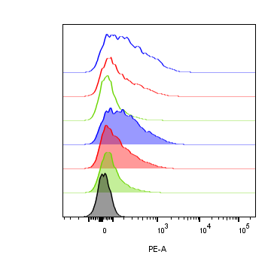
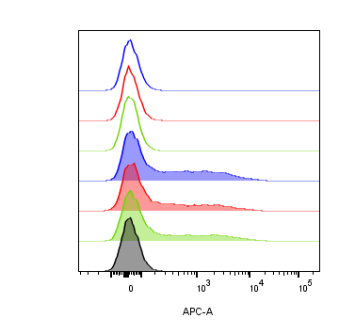
Supplementary Figure 9: Altering the ratio of MSLN CAR activator to A*02 blocker in primary T cells (Donor 2). Cell surface staining of activator and blocker receptors vs. various MSLN CAR mRNA amounts, analyzed by flow cytometry. Blocker was held constant at 5000 ng mRNA and activator (MSLN CAR) was varied at 0, 1250, 2500 and 5000 ng as shown. (A) MSLN CAR and A*02 blocker. MSLN CAR was stained with labeled MSLN tetramer (see Methods). To calculate fold-expression, background was subtracted before normalization to the lowest value. Bar chart colors match flow histogram colors. (B) Blocker protein level is minimally affected by varying activator level. Surface expression of blocker at different mRNA amounts of CAR activator. Blocker was stained with A*02 pMHC tetramer (see Methods). Fold-changes shown on graphs (i.e., 1x, 2x, 3x) are based on surface protein estimates, not mRNA amount. Compared to Donor 1 (Figure 7A,B), Donor 2 did not transfect as well with MSLN CAR or A*02 blocker mRNA, resulting in weaker blocking (see C,D below). MFI, geometric mean fluorescence intensity. (C) Activation response (killing of GFP-labeled target cells) to varied ratios of MSLN CAR to A*02 blocker after 12 hours of co-culture with target cells. Activation dose-response curves are shown for each ratio of CAR to blocker tested. Open circles = CAR only, filled circles = CAR + blocker. MSLN-knockout HeLa cells provided the stimulus. MSLN A-Ag levels were varied with constant B-Ag (50 ng A*02 mRNA, ~58,000 molecules/cell). Shifting of EC50 and Emax with blocker present is shown for each activator amount. (D) Inhibition response to varied MSLN CAR to A*02 blocker ratios after 12 hours of co-culture with target cells. Wildtype HeLa cells provided the A-Ag stimulus (endogenously expressed ~50,000 MSLN molecules/cell), and B-Ag (A*02 mRNA) was varied. Dashed lines are meant to convey trends and are not fit mathematically.
Receptor levels: CAR mRNA titration
A.
CAR (ng)
CAR protein (MFI)
A-Ag
B-Ag
5000
231
- blocker
- blocker
2500
156
1250
76
Primary T effector
5000
210
+ blocker
Activator
Blocker
2500
140
+ blocker
1250
87
0
24
CAR protein (MFI)
B.
Receptor levels: Blocker mRNA (5000 ng constant)
Blocker (ng)
Blocker protein (MFI)
A-Ag
B-Ag
0
30
- blocker
- blocker
0
29
0
28
Primary T effector
5000
243
+ blocker
Activator
Blocker
5000
189
+ blocker
5000
189
0
27
Blocker protein (MFI)
C.
Activation dose-response at different Activator:Blocker mRNA ratios
1x Activator
2x Activator
3x Activator
EC50 shift
Emax shift
HeLa target
A-Ag
B-Ag
Primary T effector
% Killing
% Killing
% Killing
Fold-change
Fold-change
Activator
Blocker
MSLN mRNA (ng)
MSLN mRNA (ng)
MSLN mRNA (ng)
Activator (fold-level)
Activator (fold-level)
D.
Inhibition dose-response at different Activator:Blocker mRNA ratios
HeLa target
A-Ag
B-Ag
Primary T effector
Activator
Blocker

