Slide 1
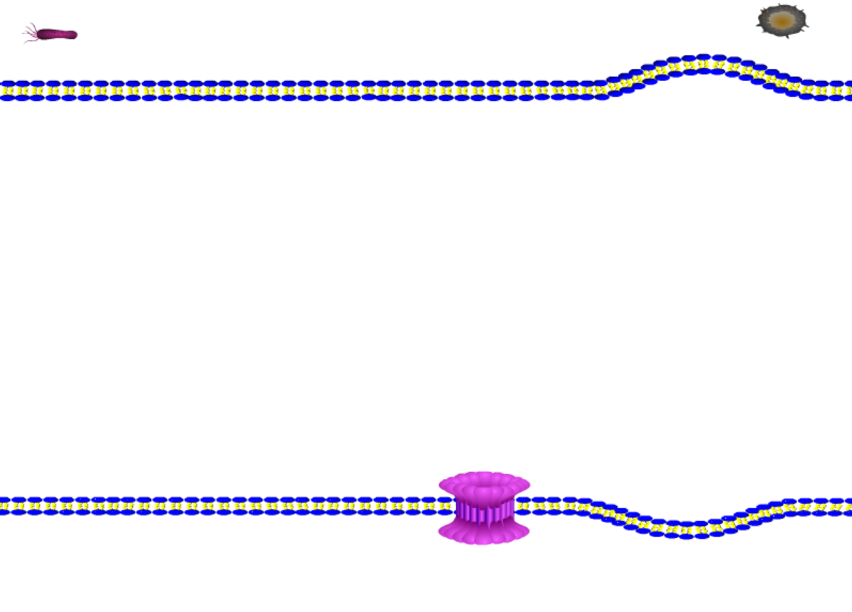
miR-214
LPS
Chemotherapy drugs
Cytotoxic lymphocytes
Becteria，virus，toxin，dsDNA
Caspase-1
Caspase-4/5/11
Caspase-8
GZMA
Caspase-3
GSDMD
GSDMC
GSDME
GSDMB
GSDMD-NT
GSDMC-NT
GSDME-NT
GSDMB-NT
IL-1β/18
Pore formation
The canonical inflammasome-induced pyroptosis
pyroptosis
The non-canonical inflammasome-induced pyroptosis

