Slide 1
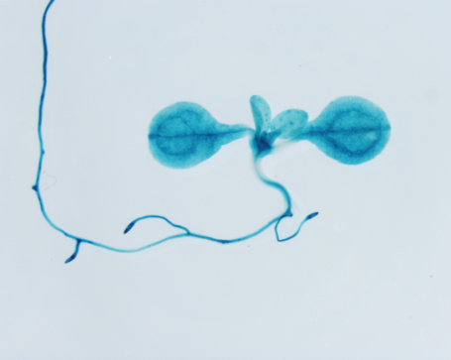
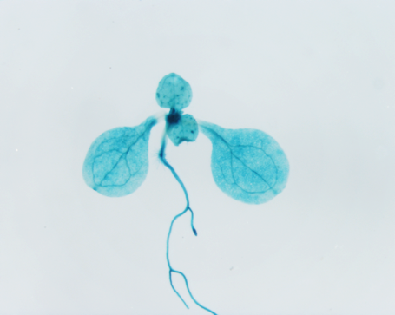
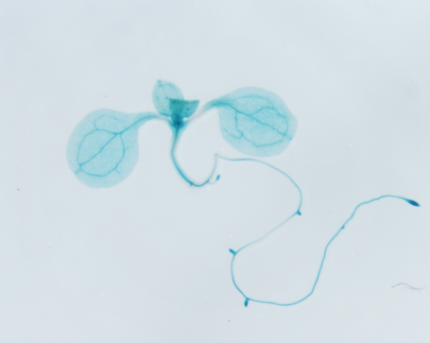
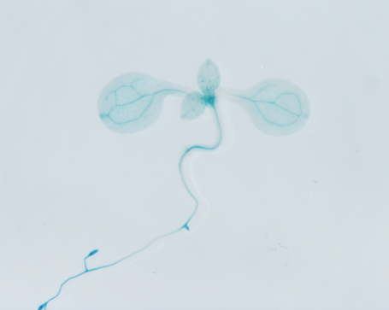
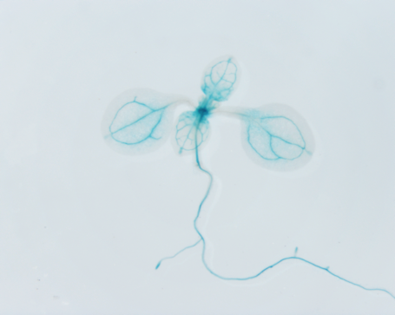
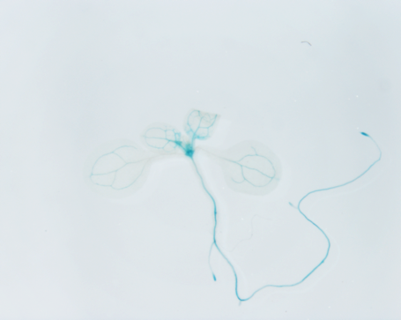
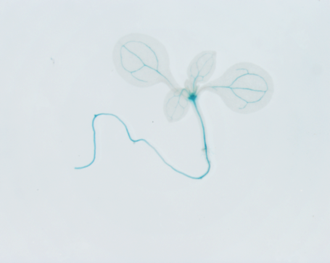
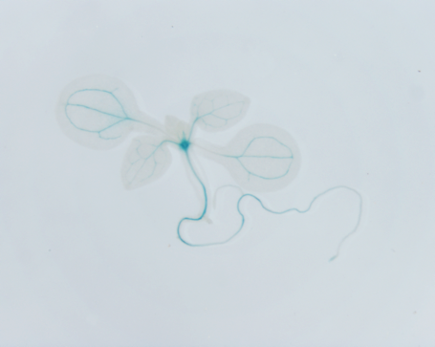
Supplemental Figure 1
FLC::GUS
WT
jmj30 jmj32
NV
V2W
V4W
V6W
Supplemental Figure 1 | GUS staining of seedlings of FLC::GUS and FLC::GUS jmj30 jmj32 in various vernalized conditions. GUS signals were visualized in blue color.

