Slide 1
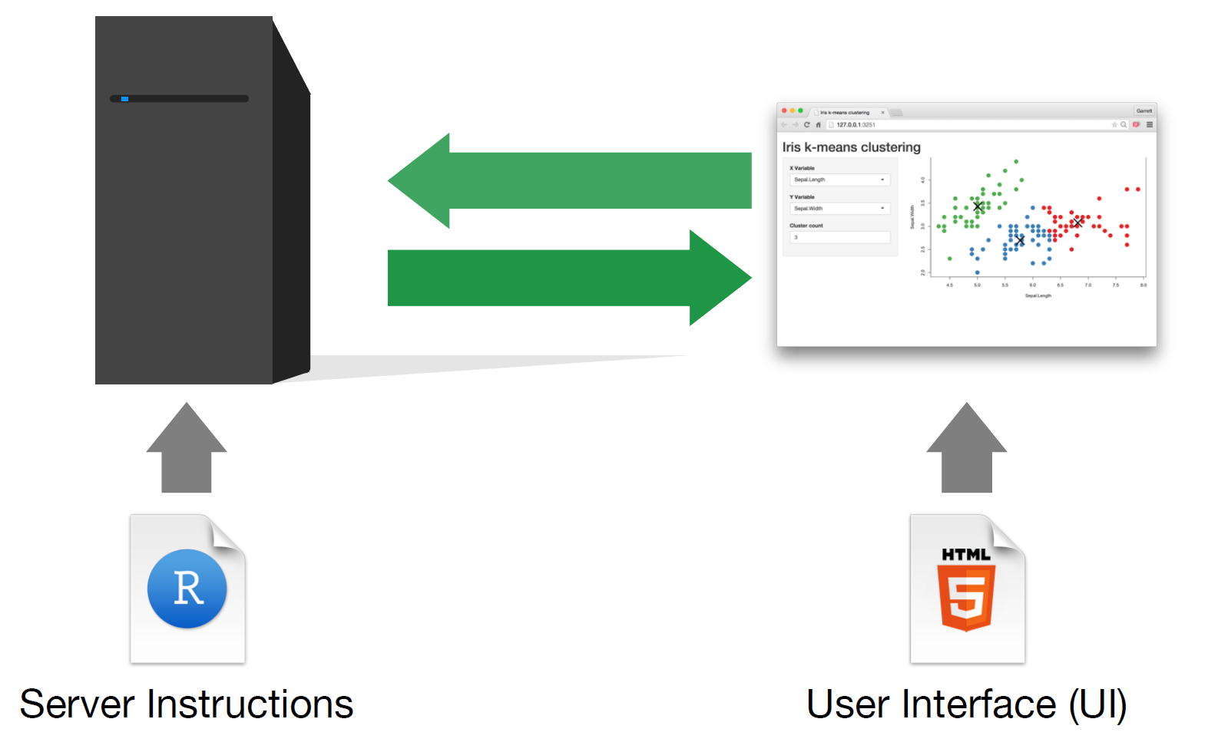
Figure S1
a) Flowchart for methodology followed to extract and analyse the sequencing data
b) Working of Shiny R application
c) List of packages used to read in and visualize the data
Shiny
Pheatmap
DT
Shinydashboard
Tidyr
Diplyr
Ggplot
Dbi
Dbconnect
RMysql
RStudio025

