Slide 1
Supplymentary figure 1 PCA analysis of RNA-Seq data

Slide 2
Supplymentary figure 2 numbers of transcription factors formed through co-expression network.

Slide 3
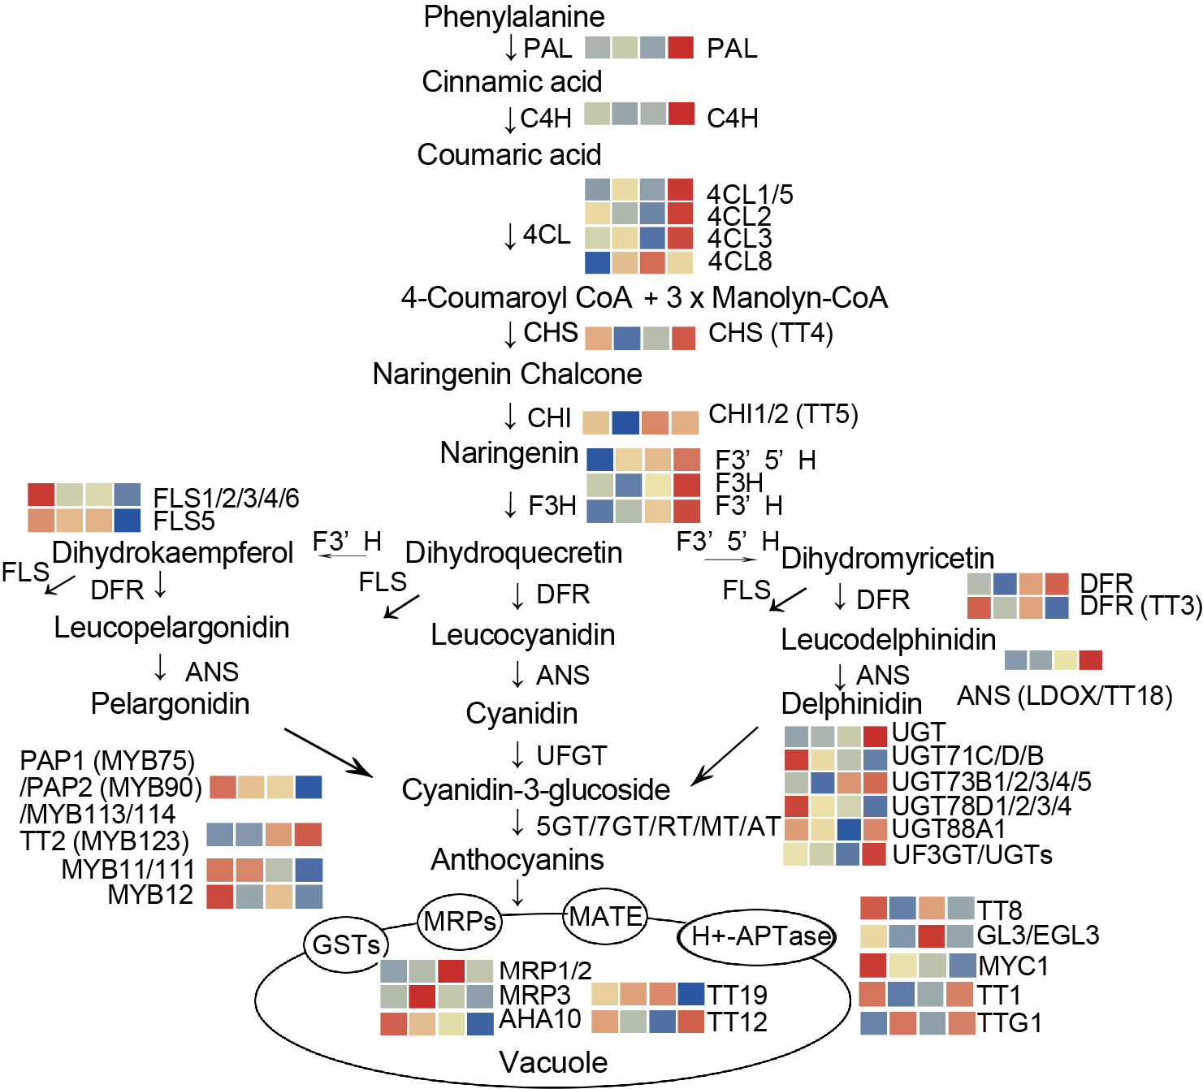
Supplymentary figure 3 The model diagram of the main anthocyanin biosynthesis pathway. R-package heatmaps were applied to map the expression heatmap of these genes. The heatmap data were homogenized via the Z-score normalization.

