Slide 1
Supplementary Figure 1. Seed moisture sorption isotherms from the literature for different species showing the best-fit equation (see Supplementary Table 1). Each slide shows isotherms determined for one species, from the same or different sources. Species are ordered according to oil content. In the respective equations, MC is moisture content (dry weight basis) and, as convention in isotherm equations, water activity, a_{w}, is used rather than equilibrium relative humidity as shown in the graphs. T is temperature (°C). The various equation parameters are indicated by A, B, C, D, K, K’, c, k and k’.

Slide 2
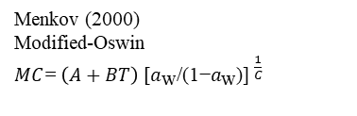
Supplementary Figure S1A.
Menkov (2000)
Modified-Oswin
$MC\text{=}$ ${\left(A+BT\right) \text{[}a_{\text{w}}\text{/(1−}a_{\text{w}}\text{)] }}^{\frac{1}{C}}$
Equilibrium relative humidity (%)

Slide 3

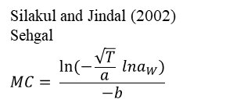
Supplementary Figure S1B.
Sun et al. (1997)
D’Arcy-Watt
$$MC=\frac{KK′(a_{\text{w}})}{1+K(a_{\text{w}})}+ca_{\text{w}}+\frac{kk′a_{\text{w}}}{1−ka_{\text{w}}}$$
Silakul and Jindal (2002)
Sehgal
$$MC= \frac{ln⁡(−\frac{\sqrt{T}}{a} lna_{W})}{−b}$$
Equilibrium relative humidity (%)
Equilibrium relative humidity (%)

Slide 4


Supplementary Figure S1C.
Vertucci and Leopold (1987)
D’Arcy-Watt equation:
$$MC=\frac{KK′(a_{\text{w}})}{1+K(a_{\text{w}})}+ca_{\text{w}}+\frac{kk′a_{\text{w}}}{1−ka_{\text{w}}}$$
Chen (2003)
Modified-Henderson
MC $=$ ${\text{[}\text{ln}\text{(1−}a_{\text{w}}\text{)/}\text{A}\text{(}\text{T}\text{+}\text{B}\text{)] }}^{\frac{1}{C}}$
Equilibrium relative humidity (%)
Equilibrium relative humidity (%)

Slide 5

Supplementary Figure S1D.
Vertucci and Leopold (1987)
D’Arcy-Watt
$$MC=\frac{KK′(a_{\text{w}})}{1+K(a_{\text{w}})}+ca_{\text{w}}+\frac{kk′a_{\text{w}}}{1−ka_{\text{w}}}$$
Equilibrium relative humidity (%)

Slide 6

Supplementary Figure S1E.
Ferreira Junior et al. (2020)
Sigma-Copace
MC $=\exp{(A−\left(BT\right)+[C exp⁡(a_{\text{w}})])}$
Equilibrium relative humidity (%)

Slide 7

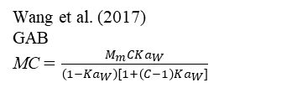
Supplementary Figure S1F.
Zeymer et al. (2019)
Chung-Pfost
MC $=A−B\ln{[−\left(T+C\right)ln⁡(a_{\text{w}})]}$
Wang et al. (2017)
GAB
MC $=\frac{M_{m}CKa_{W}}{\left(1−Ka_{W}\right)[1+\left(C−1\right)Ka_{W}]}$
Equilibrium relative humidity (%)
Equilibrium relative humidity (%)

Slide 8
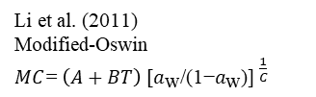
Supplementary Figure S1G.
Li et al. (2011)
Modified-Oswin
$MC\text{=}$ ${\left(A+BT\right) \text{[}a_{\text{w}}\text{/(1−}a_{\text{w}}\text{)] }}^{\frac{1}{C}}$
Equilibrium relative humidity (%)

Slide 9
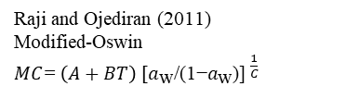
Supplementary Figure S1H.
Raji and Ojediran (2011)
Modified-Oswin
$MC\text{=}$ ${\left(A+BT\right) \text{[}a_{\text{w}}\text{/(1−}a_{\text{w}}\text{)] }}^{\frac{1}{C}}$
Equilibrium relative humidity (%)

Slide 10
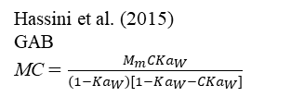
Supplementary Figure S1I.
Hassini et al. (2015)
GAB
MC $=\frac{M_{m}CKa_{W}}{\left(1−Ka_{W}\right)[1−Ka_{W}−CKa_{W}]}$
Equilibrium relative humidity (%)

Slide 11

Supplementary Figure S1J.
Miranda et al. (2012)
Oswin
MC $=$ A ${\left[\text{(}a_{W}\text{/1−}a_{W}\text{)}\right]}^{B}$
Equilibrium relative humidity (%)

Slide 12
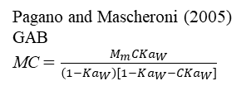
Supplementary Figure S1K.
Pagano and Mascheroni (2005)
GAB
MC $=\frac{M_{m}CKa_{W}}{\left(1−Ka_{W}\right)[1−Ka_{W}−CKa_{W}]}$
Equilibrium relative humidity (%)

Slide 13
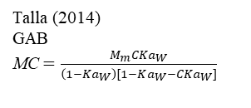
Supplementary Figure S1L.
Talla (2014)
GAB
MC $=\frac{M_{m}CKa_{W}}{\left(1−Ka_{W}\right)[1−Ka_{W}−CKa_{W}]}$
Equilibrium relative humidity (%)

Slide 14
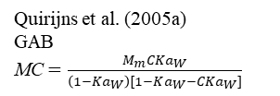

Supplementary Figure S1M.
Chen and Morey (1989)
modified- Henderson
$MC=$ ${\left[\frac{\text{ln}\left(1−a_{w}\right)}{−A(T+C)}\right]}^{\frac{1}{B}}$
Quirijns et al. (2005a)
GAB
MC $=\frac{M_{m}CKa_{W}}{\left(1−Ka_{W}\right)[1−Ka_{W}−CKa_{W}]}$
Equilibrium relative humidity (%)
Equilibrium relative humidity (%)

Slide 15

Supplementary Figure S1N.
Majd et al. (2013)
Modified-Halsey
$$MC={\left[\frac{−Ln{ a}_{W}}{\exp{(A+BT)}}\right]}^{\frac{−1}{C}}$$
Equilibrium relative humidity (%)

Slide 16
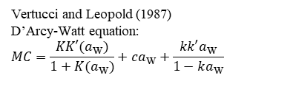
Supplementary Figure S1O.
Vertucci and Leopold (1987)
D’Arcy-Watt equation:
$$MC=\frac{KK′(a_{\text{w}})}{1+K(a_{\text{w}})}+ca_{\text{w}}+\frac{kk′a_{\text{w}}}{1−ka_{\text{w}}}$$
Equilibrium relative humidity (%)

Slide 17

Supplementary Figure S1P.
Goneli et al. (2016)
Modified-Halsey
$$MC={\left[\frac{−Ln{ a}_{W}}{\exp{(A+BT)}}\right]}^{\frac{−1}{C}}$$
Equilibrium relative humidity (%)

Slide 18
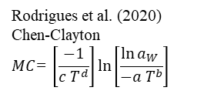
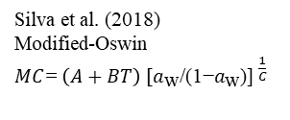
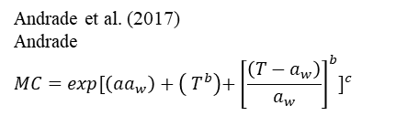
Supplementary Figure S1Q.
Silva et al. (2018)
Modified-Oswin
$MC\text{=}$ ${\left(A+BT\right) \text{[}a_{\text{w}}\text{/(1−}a_{\text{w}}\text{)] }}^{\frac{1}{C}}$
Andrade et al. (2017)
Andrade
$$MC=exp{[\left(aa_{w}\right)+\left( T^{b}\right){+\left[\frac{\left(T−a_{w}\right)}{a_{w}}\right]}^{b}]}^{c}$$
Rodrigues et al. (2020)
Chen-Clayton
$$MC\text{=} \left[\frac{−1}{c T^{d}}\right]ln\left[\frac{\ln{a_{W}} }{−a T^{b}}\right]$$
Equilibrium relative humidity (%)
Equilibrium relative humidity (%)
Equilibrium relative humidity (%)

Slide 19
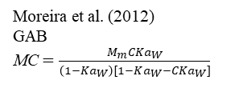
Supplementary Figure S1R.
Moreira et al. (2012)
GAB
MC $=\frac{M_{m}CKa_{W}}{\left(1−Ka_{W}\right)[1−Ka_{W}−CKa_{W}]}$
Equilibrium relative humidity (%)

Slide 20

Supplementary Figure S1S.
Barati et al. (2016)
Peleg
$MC=(A{a_{w}}^{B})$+($C{a_{w}}^{D})$
Oswin
$$MC=A({\frac{a_{w}}{1−a_{w}})}^{B}$$
Equilibrium relative humidity (%)

Slide 21

Supplementary Figure S1T.
Arslan-Tontul (2020)
Peleg
$MC=(A{a_{w}}^{B})$+($C{a_{w}}^{D})$
Equilibrium relative humidity (%)

Slide 22

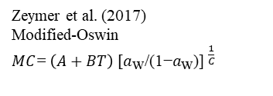
Supplementary Figure S1U.
Zeymer et al. (2017)
Modified-Oswin
$MC\text{=}$ ${\left(A+BT\right) \text{[}a_{\text{w}}\text{/(1−}a_{\text{w}}\text{)] }}^{\frac{1}{C}}$
Bortolotti and Barrozo (2013)
Copace
$$MC=exp⁡[a−bT+c\left(RH\right)]$$
Equilibrium relative humidity (%)
Equilibrium relative humidity (%)

Slide 23
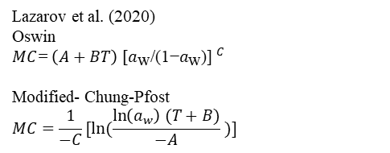
Supplementary Figure S1V.
Lazarov et al. (2020)
Oswin
$MC\text{=}$ ${\left(A+BT\right) \text{[}a_{\text{w}}\text{/(1−}a_{\text{w}}\text{)] }}^{C}$
Modified- Chung-Pfost
$$MC=\frac{1}{−C}[ln⁡(\frac{\ln\left(a_{w}\right) (T+B)}{−A} )]$$
Equilibrium relative humidity (%)

Slide 24



Supplementary Figure S1W.
Bazin et al. (2011)
Adapted D’Arcy-Watt
$$MC=K′+ca_{\text{w}}+\frac{kk′a_{\text{w}}}{1−ka_{\text{w}}}$$
Giner and Gely (2005)
Modified-Halsey
$$MC\text{ (\% }\text{basis}\text{)}={\left[−\frac{\text{exp}\left(a+bT\right)}{\ln{a_{w}}}\right]}^{\frac{1}{c}}$$
Campos et al. (2019)
Smith $MC (\% basis)=a−bT−c\log\left(1−a_{\text{w}}\right)$
Equilibrium relative humidity (%)
Equilibrium relative humidity (%)
Equilibrium relative humidity (%)

Slide 25

Supplementary Figure 1X.
Zhu et al. (2021)
Peleg
$MC=(A{a_{w}}^{B})$+($C{a_{w}}^{D})$
Equilibrium relative humidity (%)

Slide 26

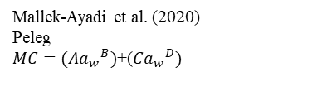
Supplementary Figure S1Y.
Ajibola (1989)
Modified-Halsey
$$MC\text{ (\% }\text{basis}\text{)}={\left[−\frac{\text{exp}\left(a+bT\right)}{\ln{a_{w}}}\right]}^{\frac{1}{c}}$$
Mallek-Ayadi et al. (2020)
Peleg
$MC=(A{a_{w}}^{B})$+($C{a_{w}}^{D})$
Equilibrium relative humidity (%)
Equilibrium relative humidity (%)

Slide 27

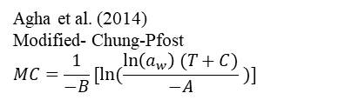
Supplementary Figure S1Z.
Agha et al. (2014)
Modified- Chung-Pfost
$$MC=\frac{1}{−B}[ln⁡(\frac{\ln\left(a_{w}\right) (T+C)}{−A} )]$$
Cladera‐Olivera et al. (2008)
Chirife
$$MC=exp[A+B\ln{(C−\ln{a_{W}})}]$$
Equilibrium relative humidity (%)
Equilibrium relative humidity (%)

