Slide 1
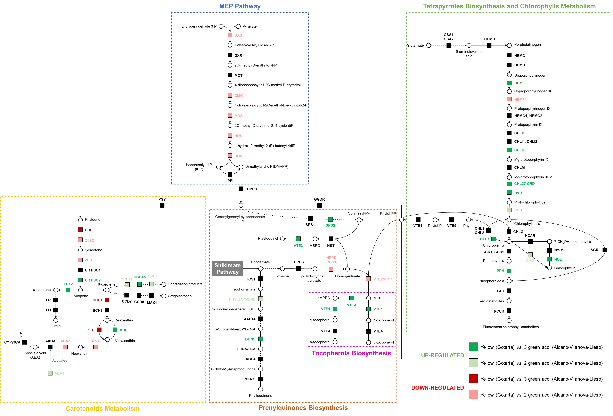
Supplementary Figure S1. Changes in the metabolic pathways related to carotenoids, chlorophylls and prenylquinones of apples grown in mountain or valley orchards. Substrates are shown as circles and enzymes as boxes. The scheme indicates if the genes encoding for the represented enzymes was up-regulated (green) or down-regulated (red) in Gotarta (yellow phenotype) apples peel based on the RNA-seq results.

Slide 2
Geranylgeranyl pyrophosphate
Phytol
Phytyl-PP
Carotenoids
Chlorophyll b
Chlorophyll a
γ-tocopherol
α-tocopherol
A
B
C
D
Levels in Mountain (Gotarta)
Levels in Valley (Vilanova)
Supplementary Figure S2. Evolution of total carotenoids (A), total chlorophylls (B), γ-tocopherols (C) and α-tocopherols (D) levels during ‘Golden Reinders’ apples development/ripening at two different locations. Each point represents the mean of 4 biological replicates and vertical bars indicate the standard error. Different letters indicate significant differences between development stages and locations (p ≤ 0.05). Absence of letters indicates no significant differences between development stages or locations.

Slide 3
A
B
C
D
E
F
Levels in Mountain (Gotarta)
Levels in Valley (Vilanova)
Supplementary Figure S3. Expression profile of carotenoid biosynthetic and degradation related genes at the different developmental stages of ‘Golden Reinders’ apples in both locations. Each bar represents the mean of 4 biological replicates and error bars indicate the standard error. Different letters indicate significant differences between development stages and locations (p ≤ 0.05). Absence of letters indicates no significant differences between development stages or locations.

Slide 4
A
B
Levels in Mountain (Gotarta)
Levels in Valley (Vilanova)
Supplementary Figure S4. Relative gene expression of PAL genes at the different developmental stages of ‘Golden Reinders’ apples in both locations. Each point represents the mean of 4 biological replicates and vertical bars indicate the standard error. Different letters indicate significant differences between development stages (p ≤ 0.05).

Slide 5
A
B
C
Levels in Mountain (Gotarta)
D
E
F
Levels in Valley (Vilanova)
G
H
I
J
Supplementary Figure S5. Expression profile of ROS-scavenging (A to F) and AsA recycling (G to J) genes at the different developmental stages of ‘Golden Reinders’ apples in both locations. Each bar represents the mean of 4 biological replicates and error bars indicate the standard error. Different letters indicate significant differences between development stages and locations (p ≤ 0.05). Absence of letters indicates no significant differences between development stages or locations.

Slide 6
A
B
Levels in Mountain (Gotarta)
Levels in Valley (Vilanova)
Supplementary Figure S6. Expression profile of sirtuins genes at the different developmental stages of ‘Golden Reinders’ apples in both locations. Each bar represents the mean of 4 biological replicates and error bars indicate the standard error. Different letters indicate significant differences between development stages and locations (p ≤ 0.05). Absence of letters indicates no significant differences between development stages or locations.

Slide 7
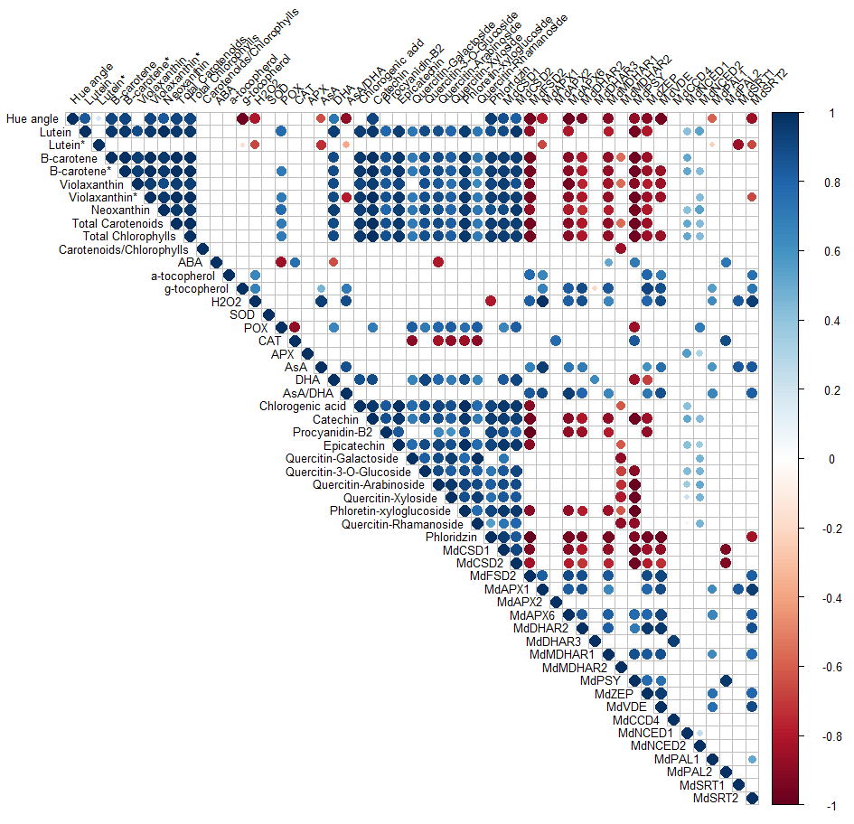
Supplementary Figure S7. Bivariate correlations among the different parameters (Hue angle, metabolites, enzymatic activities and gene expression) studied during the development of ‘Golden Reinders’ apples in both Vilanova and Gotarta orchards. The size of the circle for each correlation and the colour depict the significance and the correlation coefficient, respectively. Positive correlations coefficients are displayed in blue and negative correlations coefficients in red.

Slide 8
Vilanova (Valley)
Gotarta (Mountain)
A
B
C
D
Supplementary Figure S8. Evolution of maximum and minimum temperatures (A, B) and day-night temperature variation (C, D) 165 days before harvest in Vilanova (A, C) and Gotarta (B, D).

Slide 9
A
B
Mountain (Gotarta)
Valley (Vilanova)
C
Supplementary Figure S9. Evolution of total solar radiation (A), relative humidity (B) and evapotranspiration (C) 165 days before harvest in Vilanova (valley location, green) and Gotarta (mountain location, yellow).

Slide 10
Gene | Annotation | Primer name | Primer sequence (5’ – 3’) | Metabolic pathway/function | Localization | Source
MdPSY | Phytoene synthase | MdPSY-Fw MdPSY-Rv | CAGAGACATGGTAGAAGGAATGAG CCAACAGTTCCAGCAACATAGTAG | Carotenoid metabolism | Chloroplast | Ampomah-Dwamena et al., 2012
MdZEP | Zeaxanthin epoxidase | MdZEP-Fw MdZEP-Rv | TCCCTGCTCGTATCCATCCA TAAAGTTACCGGCTTCCGCC | Carotenoid metabolism | Chloroplast | This study
MdVDE | Violaxanthin de-epoxidase | MdVDE-Fw MdVDE-Rv | TAGCAGGATGGAGGAGGCTT ATCAAATCAATCGCGCGTCC | Carotenoid metabolism | Chloroplast | This study
MdNCED1 | 9-cisepoxycarotenoid dioxygenase 1 | MdNCED1-Fw MdNCED1-Rv | GTATCACGTCCAAATCACTGAAAC ATTTGAGGTATGGCTTCTGAACG | Carotenoid metabolism | Chloroplast | This study
MdNCED2 | 9-cisepoxycarotenoid dioxygenase 2 | MdNCED2-Fw MdNCED2-Rv | CCCCGGATTTTCTCCTGGAA TACCGTACCCAAAGGATGACC | Carotenoid metabolism | Chloroplast | This study
MdCCD4 | Carotenoid cleavage dioxygenase 4 | MdCCD4-Fw MdCCD4-Rv | TATTCTTCCCAACGTCTTCTCCG CGCCGAAGAAGGCCAAACT | Carotenoid metabolism | Chloroplast | This study
MdPAL1 | Phenylalanine ammonialyase 1 | MdPAL1-Fw MdPAL1-Rv | TTTGTGAGGGAGGAGTTGG GTTGAATGTGAAGGAATGCAG | Phenylpropanoid pathway | Cytoplasm | Vilanova et al., 2014
MdPAL2 | Phenylalanine ammonialyase 2 | MdPAL2-Fw MdPAL2-Rv | TCTTTCCATTCCCTTCCTTTCC CTACGCAAAACGACTCCAG | Phenylpropanoid pathway | Cytoplasm | Vilanova et al., 2014
MdCSD1 | Cu/Zn uperoxide dismutase 1 | MdCSD1-Fw MdCSD1-Rv | AAGGGTGTTGCTGTTCTCGG AAGGGTGTTGCTGTTCTCGG | ROS-scavenging | Cytoplasm | This study
MdCSD2 | Cu/Zn Superoxide dismutase 2 | MdCSD2-Fw MdCSD2-Rv | CTTGGAAAGGGTGGACACGA AAACTCCAGAACGACAGCAG | ROS-scavenging | Chloroplast | This study
MdFSD2 | Fe Superoxide dismutase 2 | MdFSD2-Fw MdFSD2-Rv | GAGCGATGACTCAGAGACCG TAGTACATGGCGCCGCCTAA | ROS-scavenging | Extracellular | This study
MdAPX1 | Ascorbate peroxidase 1 | MdAPX1-Fw MdAPX1-Rv | TTGTGGAAAAATACGCTGCGG AAAAGAAAGGCGCACAGGC | ROS-scavenging | Cytoplasm | This study
MdAPX2 | Ascorbate peroxidase 2 | MdAPX2-Fw MdAPX2-Rv | CAGCACCCGGATACAAAAACG GGATTTGAGCACAGTGCAGG | ROS-scavenging | Cytoplasm | This study
MdAPX6 | Ascorbate peroxidase 6 | MdAPX6-Fw MdAPX6-Rv | AAACTCAGCAACCTGGGAGC TGCTTTTTACTCCTTGCCAGT | ROS-scavenging | Chloroplast | This study
MdMDHAR1 | Monodehydroascorbate reductase 1 | MdMDHAR1-Fw MdMDHAR1-Rv | CCATACTTCTATTCCCGCTCCT CGACCACCTTCCCGTCTTT | AsA-recycling pathway | Cytoplasm | Li et al., 2016
MdMDHAR2 | Monodehydroascorbate reductase 2 | MdMDHAR2-Fw MdMDHAR2-Rv | TCCTGCTTTGACGAAAGGCT GTTTGCCTATCACCACCGGA | AsA-recycling pathway | Chloroplast/ mitochondrion | This study
MdDHAR2 | Dehydroascorbate reductase 2 | MdDHAR2-Fw MdDHAR2-Rv | TTCCAGCAGATTTGGCCCAT GAGCGGTCTTCACGAAGGAT | AsA-recycling pathway | Cytoplasm | This study
MdDHAR3 | Dehydroascorbate reductase 3 | MdDHAR3-Fw MdDHAR3-Rv | CCCCAAGGATGGAACTGAACA CCAAGCGACAAATCAGCAGC | AsA-recycling pathway | Chloroplast | This study
MdSRT1 | Sirtuin 1 | MdSRT1-Fw MdSRT1-Rv | AGCGATCAAAAATGCACAGGC AAGTTCTTGCCGAACCACCA | Histone deacetylase | Nucleus | Vall-llaura et al., 2021
MdSRT2 | Sirtuin 2 | MdSRT2-Fw MdSRT2-Rv | CAGAGCCTGGTTCAGCTCAT GCACGGTGATGCAACCTATC | Histone deacetylase | Nucleus | Vall-llaura et al., 2021
Md8283 | Reference gene | Md8282-Fw Md8283-Rv | CTCGTCGTCTTGTTCCCTGA GCCTAAGGACAGGTGGTCTATG | Reference gene | - | Giné-Bordonaba et al., 2020
Supplementary Table S1. Real-time PCR primer set, including gene name and annotation, primer name and sequence, metabolic pathway and/or gene function, localization and primer source. Cellular localization was predicted by using the WoLF PSORT software (https://wolfpsort.hgc.jp/).

