Slide 1
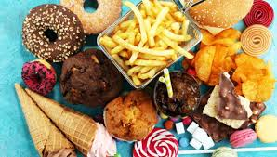
hs-CRP
MCP-1
P=0.50
P=0.51
P=0.71
P=0.56
P=0.86
P=0.91
P=0.99
P=0.91
RMR
RMR per BMI
RMR per FFM
RMR deviation from normal
RMR
RMR per BMI
RMR per FFM
RMR deviation from normal
UPF
P<0.05
P<0.05
P<0.05
P=0.45
UPF
P<0.05
P<0.05
P<0.05
P=0.45
IL-1
PAI-1
P=0.30
P=0.33
P=0.79
P=0.40
P=0.43
P=0.39
RMR
RMR per BMI
RMR per FFM
RMR
RMR per BMI
RMR per FFM
UPF
P<0.05
P<0.05
P<0.05
UPF
P<0.05
P<0.05
P<0.05
UPF: ultra-processed foods; RMR: resting metabolic rate; P value; BMI: body mass index; FFM: free fat mass; hs-CRP: High sensitive C reactive protein; PAI-1: plasminogen activator-1; MCP-1: Monocyte chemoattractant protein; IL-1ꞵ: interleukin-1 beta

