Slide 1
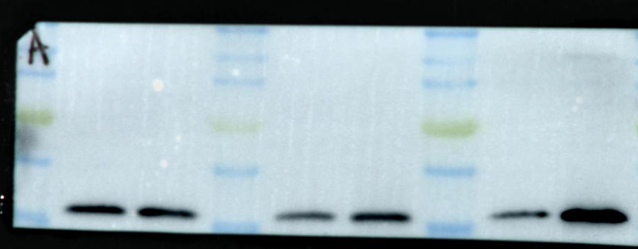
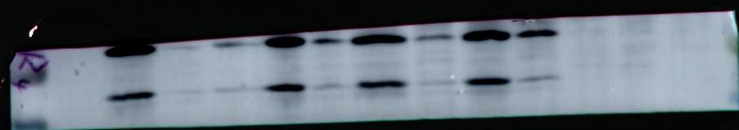
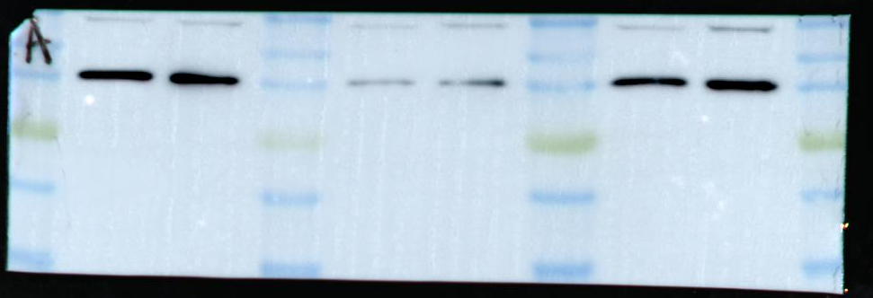
Figure1A
Figure1B
0dpi 3dpi
RNF5
20kDa
0hpi 12hpi
RNF5
20kDa
0dpi 3dpi
0hpi 12hpi
GAPDH
36kDa
GAPDH
36kDa

Slide 2
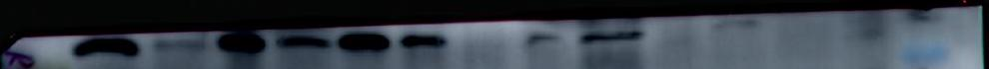
siRNA-Control
siRNA-RNF5
OE-Control
OE-RNF5
Figure2A
RNF5
20kDa
GAPDH
36kDa

Slide 3
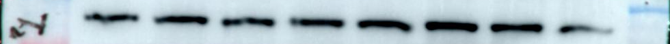
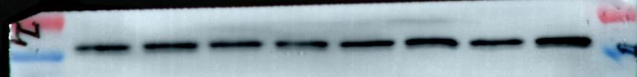
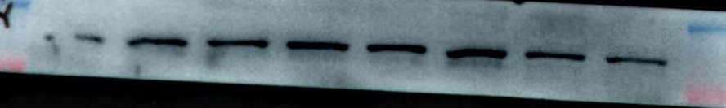
Figure3A
siRNA-RNF5
siRNA-Control
OE-Control
OE-RNF5
STING
39kDa
siRNA-Control
siRNA-RNF5
OE-Control
OE-RNF5
GAPDH
36kDa
TBK1
84kDa
siRNA-RNF5
GAPDH
36kDa
siRNA-Control
OE-Control
OE-RNF5
IRF3
55kDa
siRNA-Control
siRNA-RNF5
GAPDH
36kDa
OE-Control
OE-RNF5
p-TBK1
84kDa
siRNA-Control
siRNA-RNF5
OE-Control
OE-RNF5
GAPDH
36kDa
p-IRF3
55kDa
GAPDH
36kDa

Slide 4
siRNA-Control
siRNA-RNF5
Figure4A
RNF5
20kDa
GAPDH
36kDa

Slide 5
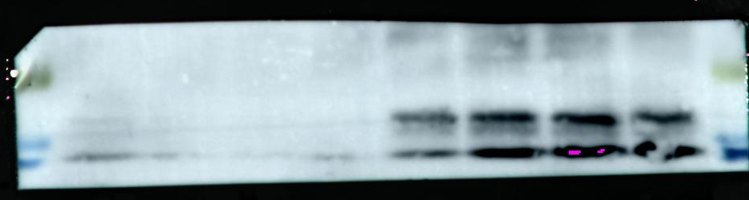


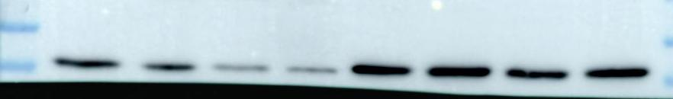
Figure6A
siRNA-Control
siRNA-RNF5
siRNA-Control
siRNA-RNF5
TNF-α
17kDa
IL-6
26kDa
GAPDH
36kDa
GAPDH
36kDa

