Slide 1
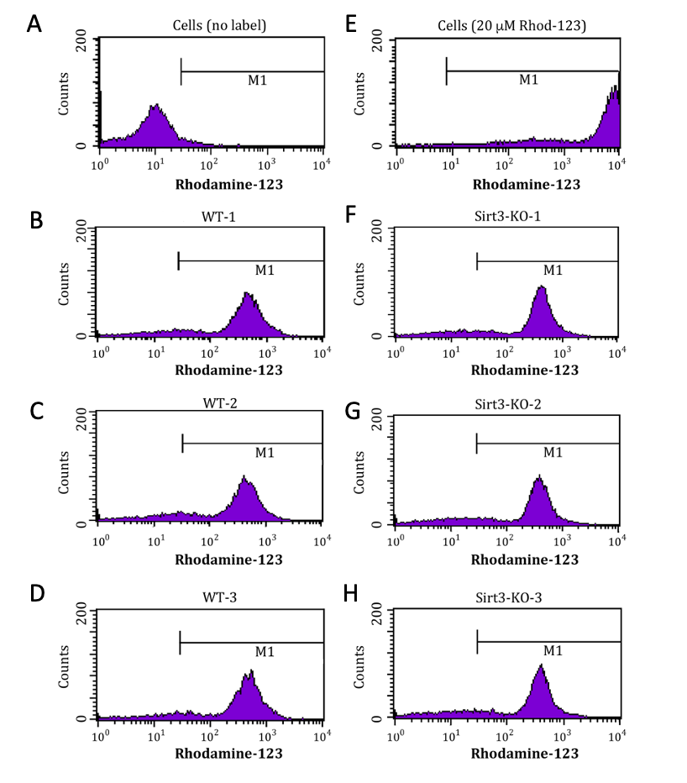
Notes:
Supplementary Figure 1: Sirt3-KO mouse embryonic fibroblasts show no alternation in ΔΨm. Representative flow cytometry histogram of Rhodamine-123 fluorescence intensity in (B-D) WT and (F-H) Sirt3-KO mouse embryonic fibroblasts. Histogram (A) represents unlabeled cells that depict auto-fluorescence. Histogram (E) represents a high dose of rhodamine-123 (20 μM) to illustrate a non-quenched mode.

Slide 2
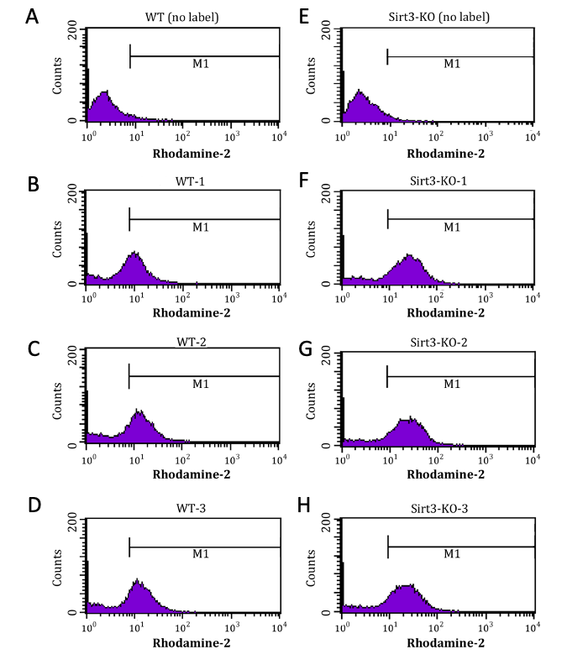
Notes:
Supplementary Figure 2: Sirt3-KO mouse embryonic fibroblasts show elevated mitochondrial Ca²⁺ levels. Representative flow cytometry histogram of Rhodamine-2 fluorescence intensity in (B-D) WT and (F-H) Sirt3-KO mouse embryonic fibroblasts. There is a right-shift in the Rhodamine-2 intensity profile in Sirt3-KO cells, indicative of a higher mitochondrial Ca²⁺ levels compared to (B-D) WT cells. Histograms (A) and (B) represents unlabeled cells that depict auto-fluorescence.

Slide 3
A
F
B
G
C
F
D
H
E
I
Notes:
Supplementary Figure 3: Sirt3-KO mouse embryonic fibroblasts show lower mitochondrial mass. Representative two parameter histogram dot plot displays MTGreen intensity on the x axis vs. propidium iodide intensity on the y axis. Lower right quadrant depicts MTGreen positive mouse embryonic fibroblasts. There is a down-shift in the MTGreen intensity profile in (G- I) Sirt3-KO cells, indicative of a lower mitochondrial mass compared to (B-E) WT cells. Histograms (A) and (B) represents unlabeled cells that depict auto-fluorescence.

Slide 4
Notes:
Supplementary Figure 4: Ponceau-S staining of mitochondrial protein extract blots used in Figure 2. Protein load normalization values for the data presented in Figure 2 were derived from this filter staining.

