Slide 1
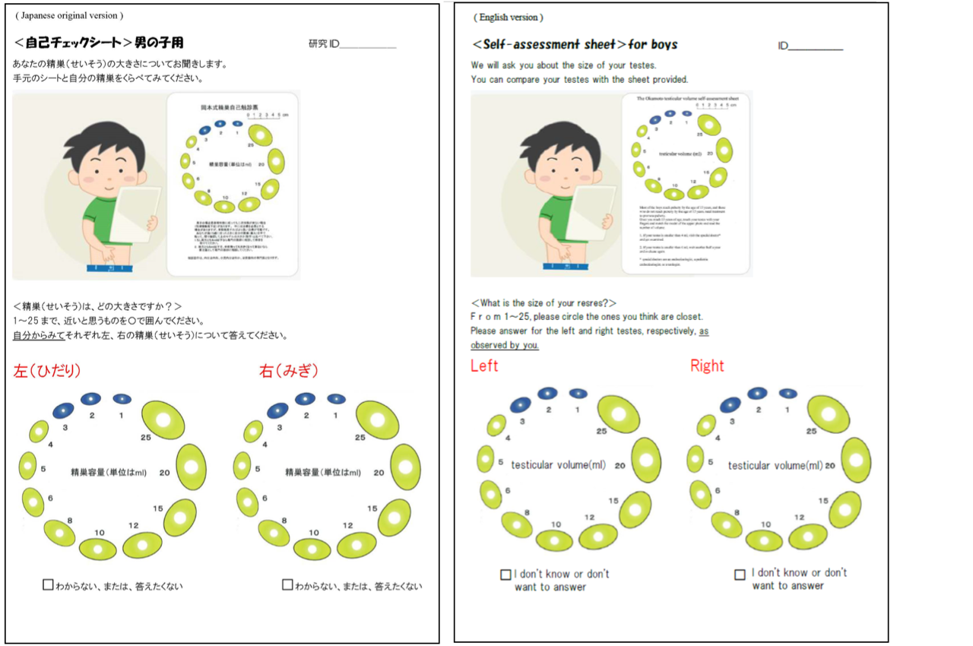
Figure S1. Pubertal self-assessment sheet for boys (Japanese original version and English version). The participants were instructed to determine left and right testicular volumes among a range of 25 levels by comparing with the attached sample illustration in the Okamoto testicular volume self-evaluation sheet.

