Slide 1
Supplementary Figure S1

Slide 2
Supplementary Figure S2

Slide 3
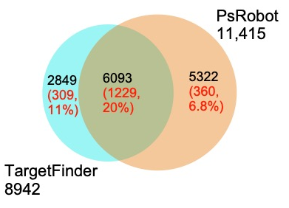
Supplementary Figure S3

Slide 4
Supplementary Figure S4

Slide 5
Supplementary Figure S5

Slide 6
Supplementary Figure S6

Slide 7
Supplementary Figure S7

Slide 8
Supplementary Figure S8

Slide 9
Supplementary Figure S9

