Slide 1
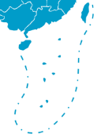
CHINA
Yunnan province

Slide 2
Yunnan province
Lincang city

