Slide 1
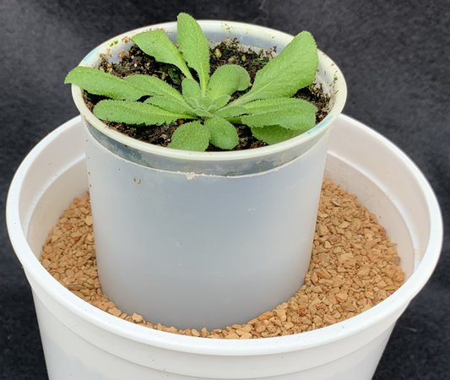
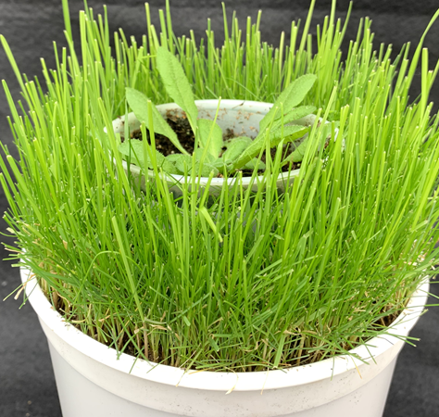
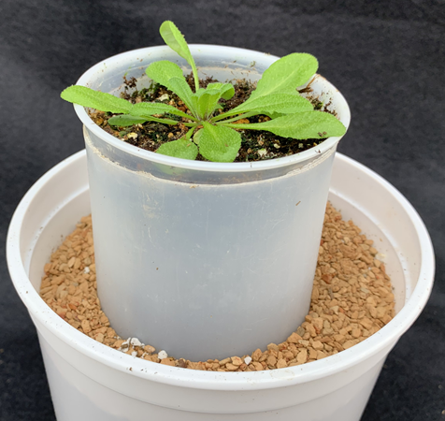
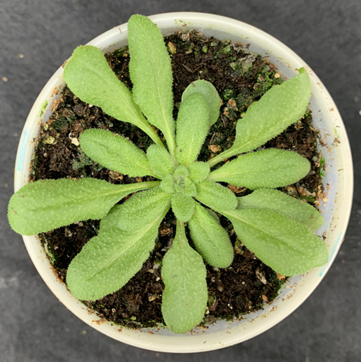
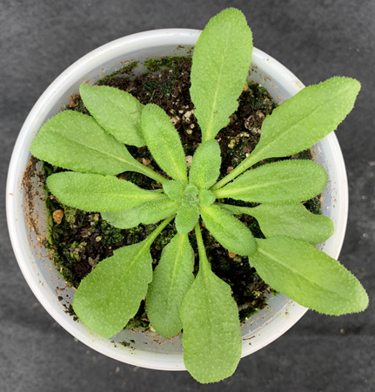
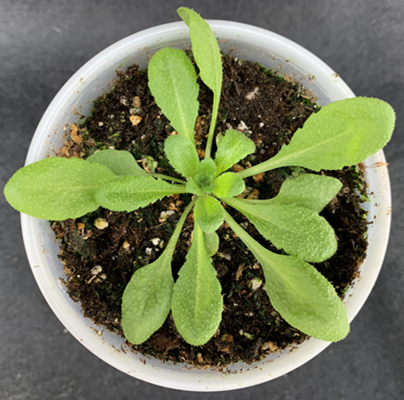
A
Weed-free
B
Biological low R:FR
C
Artificial low R:FR
D
E
F
G
b
b
b
H
a
b
b
c
b
c
a
a
a
7th leaf 9th leaf
Weed-free
Biological low R:FR
Artificial low R:FR

