Slide 1
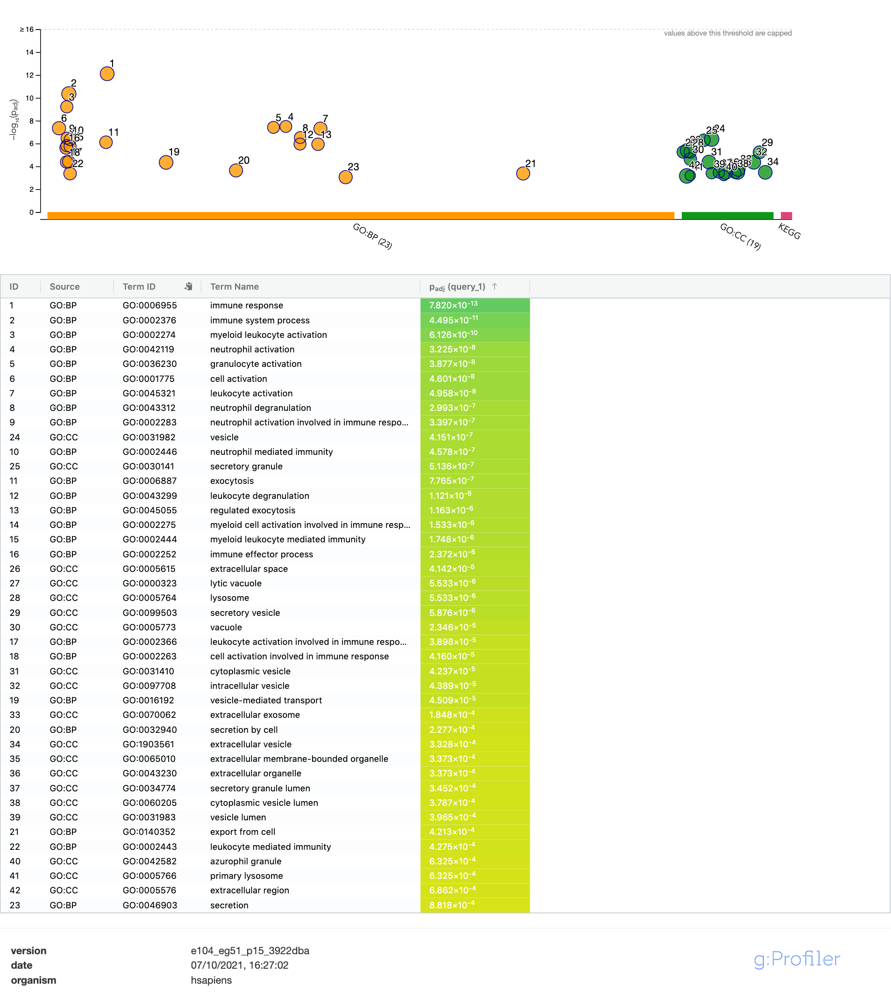
Cluster 1 – Myeloid 1

Slide 2
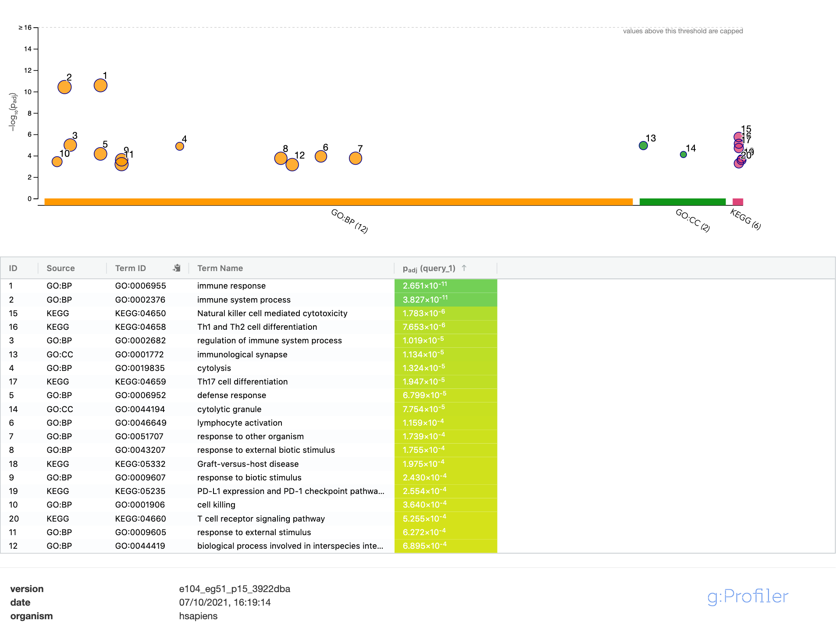
Cluster 2 – Perf- NK Cells

Slide 3
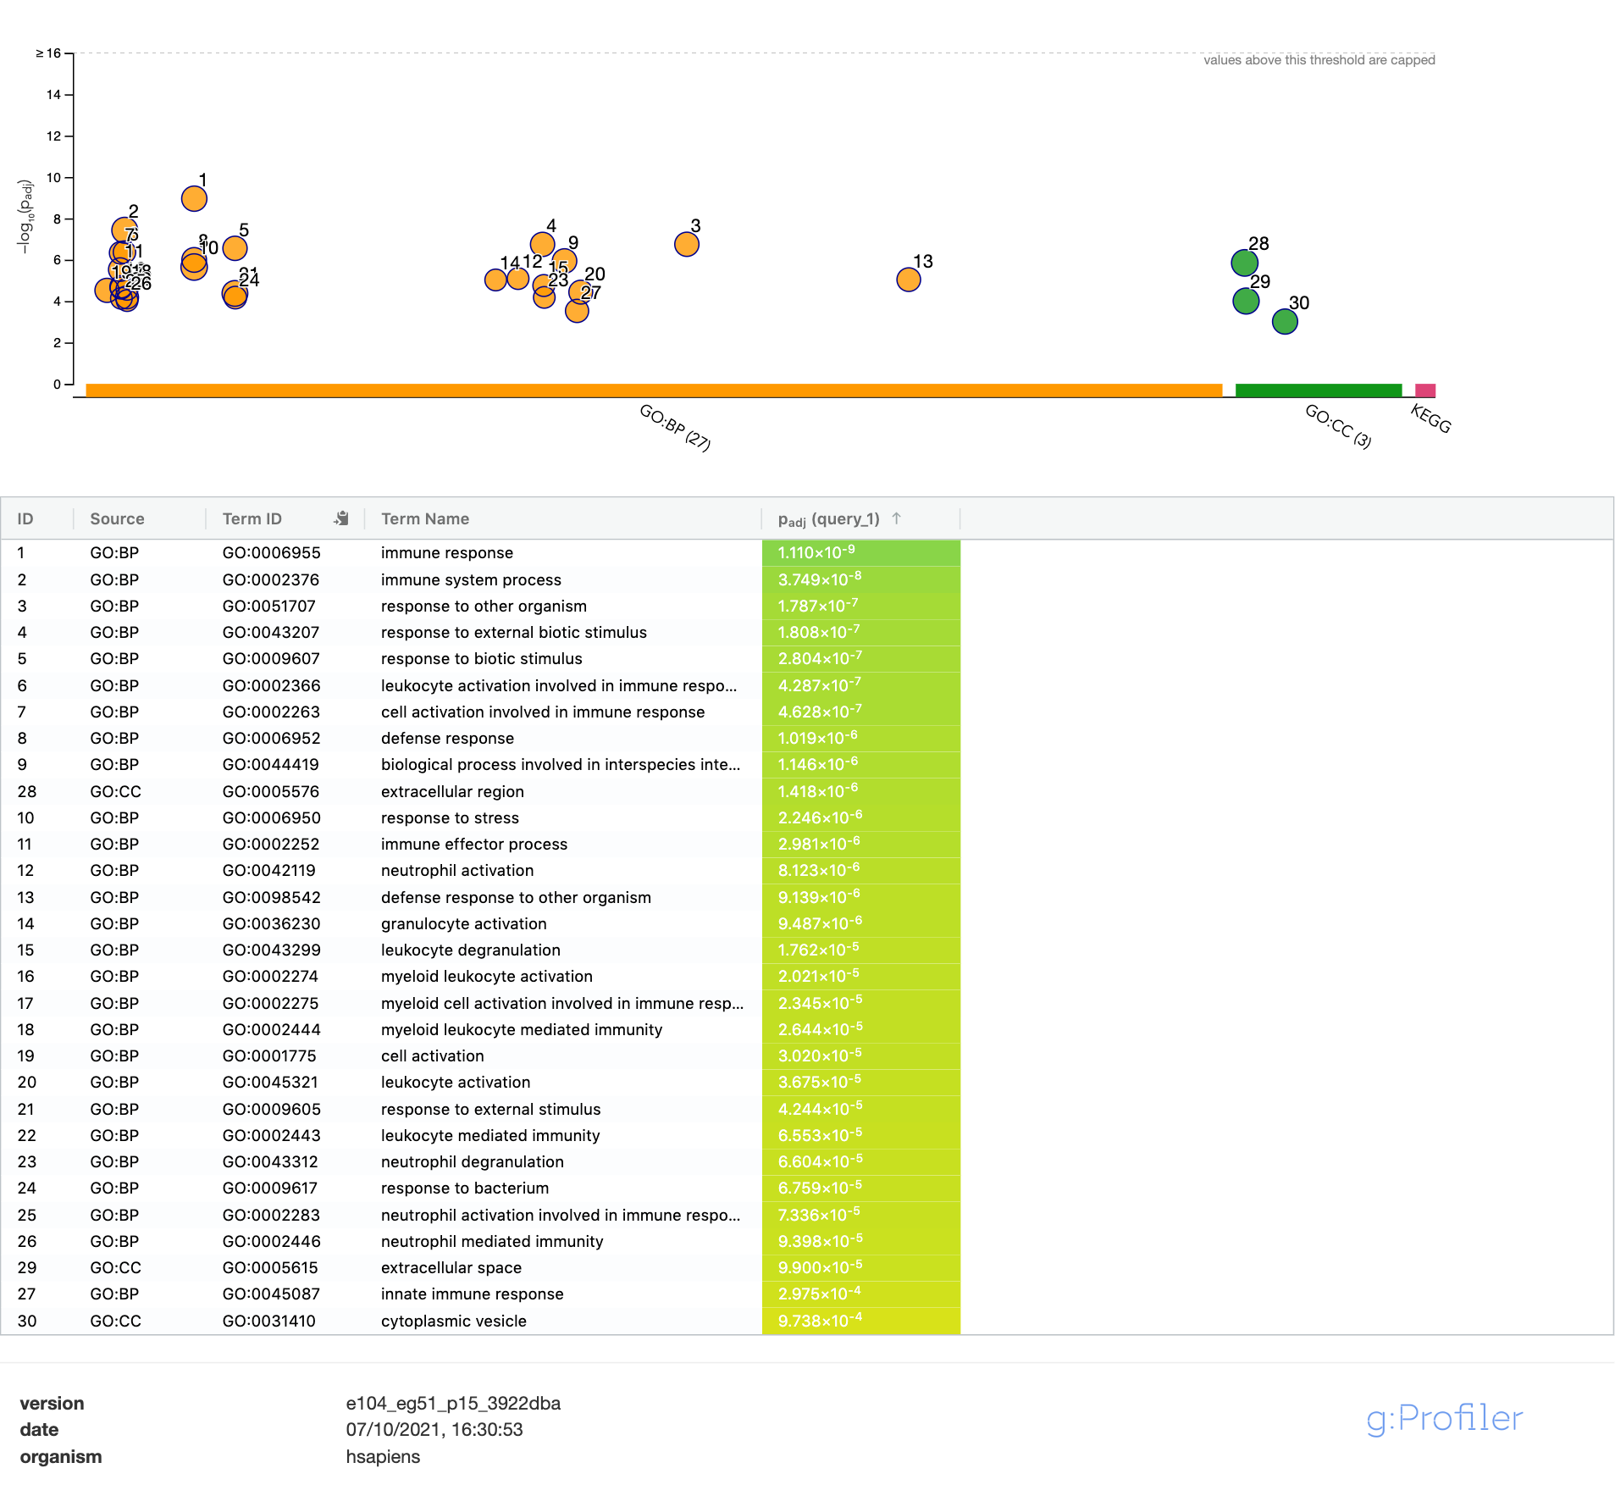
Cluster 3 – Myeloid 2

Slide 4
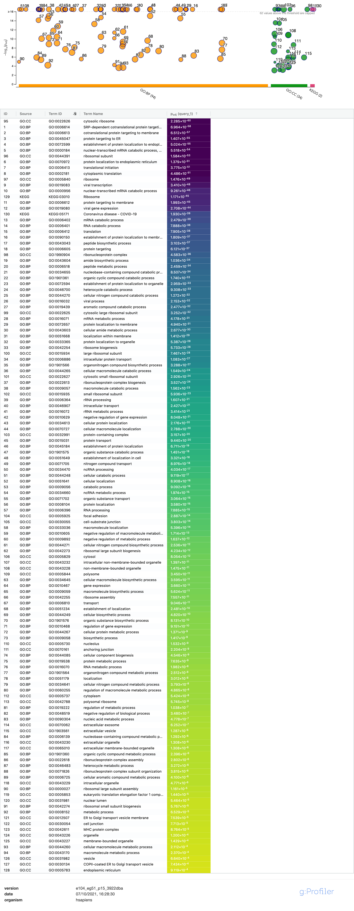
Cluster 4 –
Ribosome
Translation

Slide 5
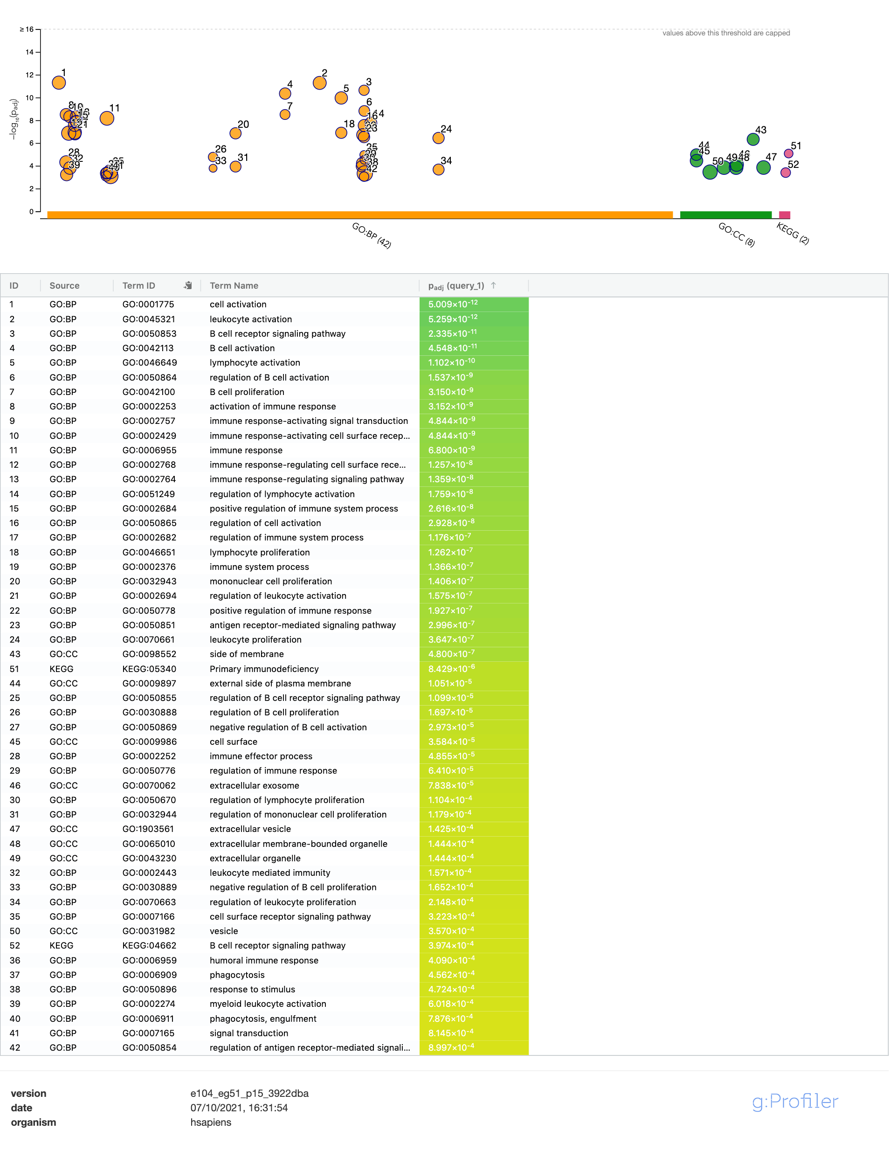
Cluster 5 – B cells

Slide 6
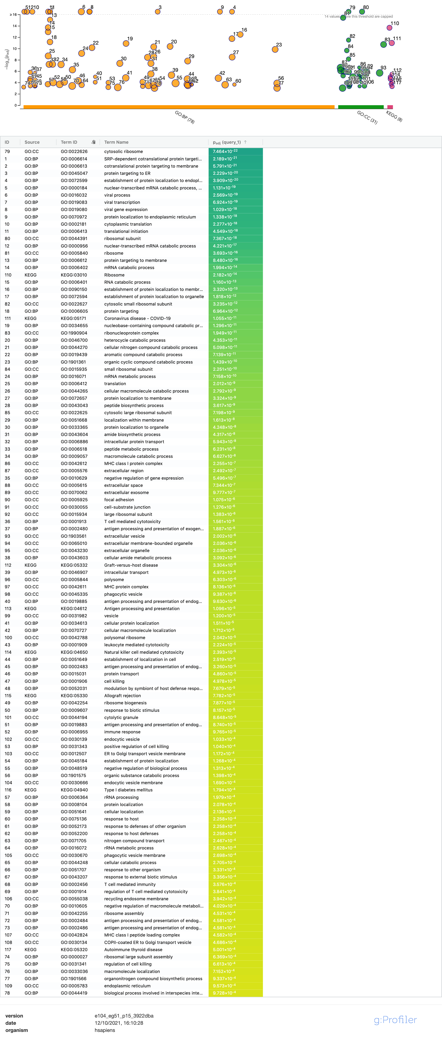
High differentially expressed genes associated with Perf+ CD56neg cell subset

Slide 7
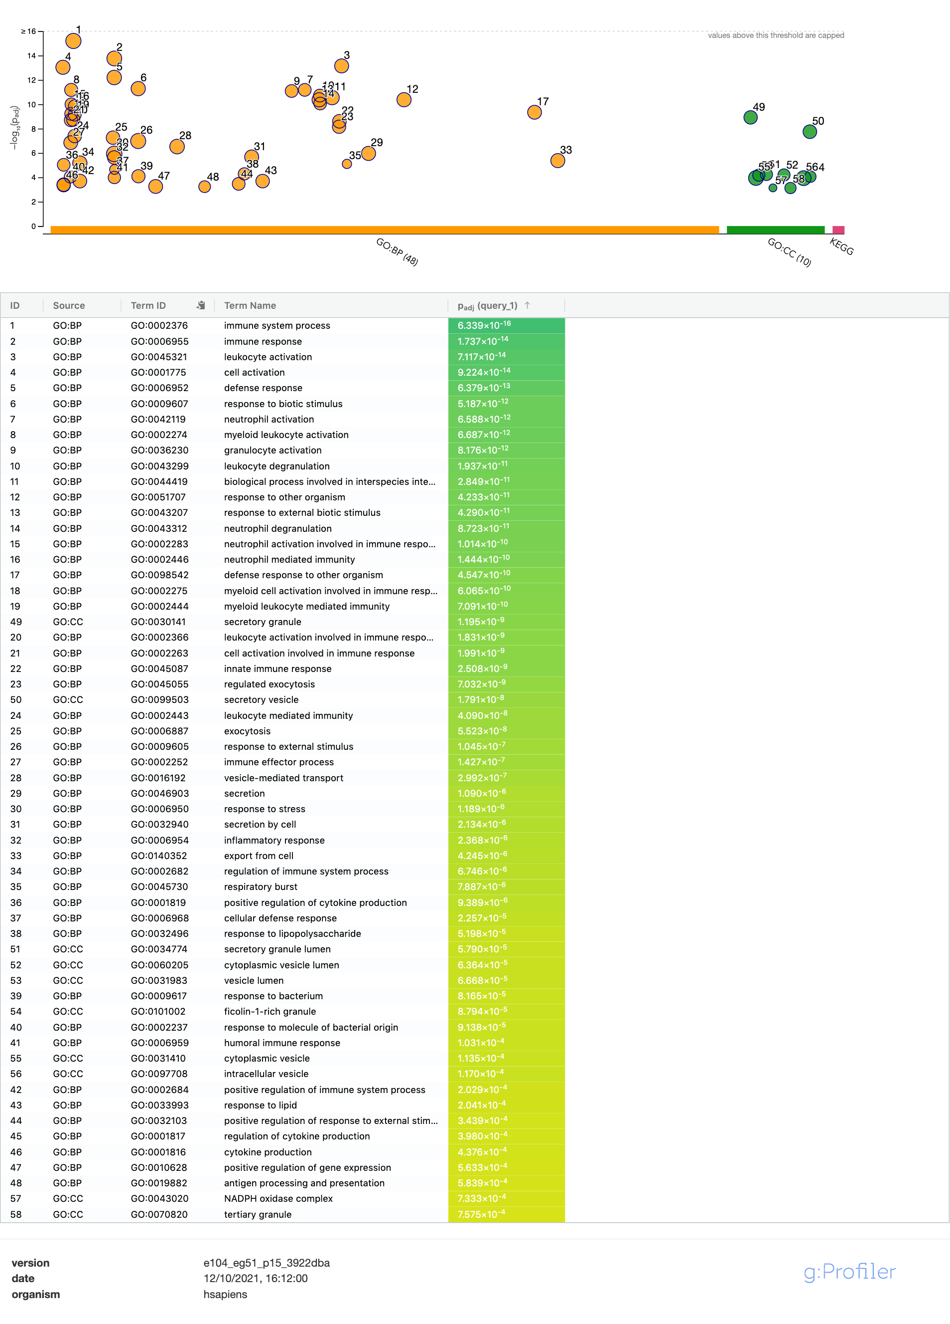
High differentially expressed genes associated with Perf- CD56neg cell subset

